Slide 1
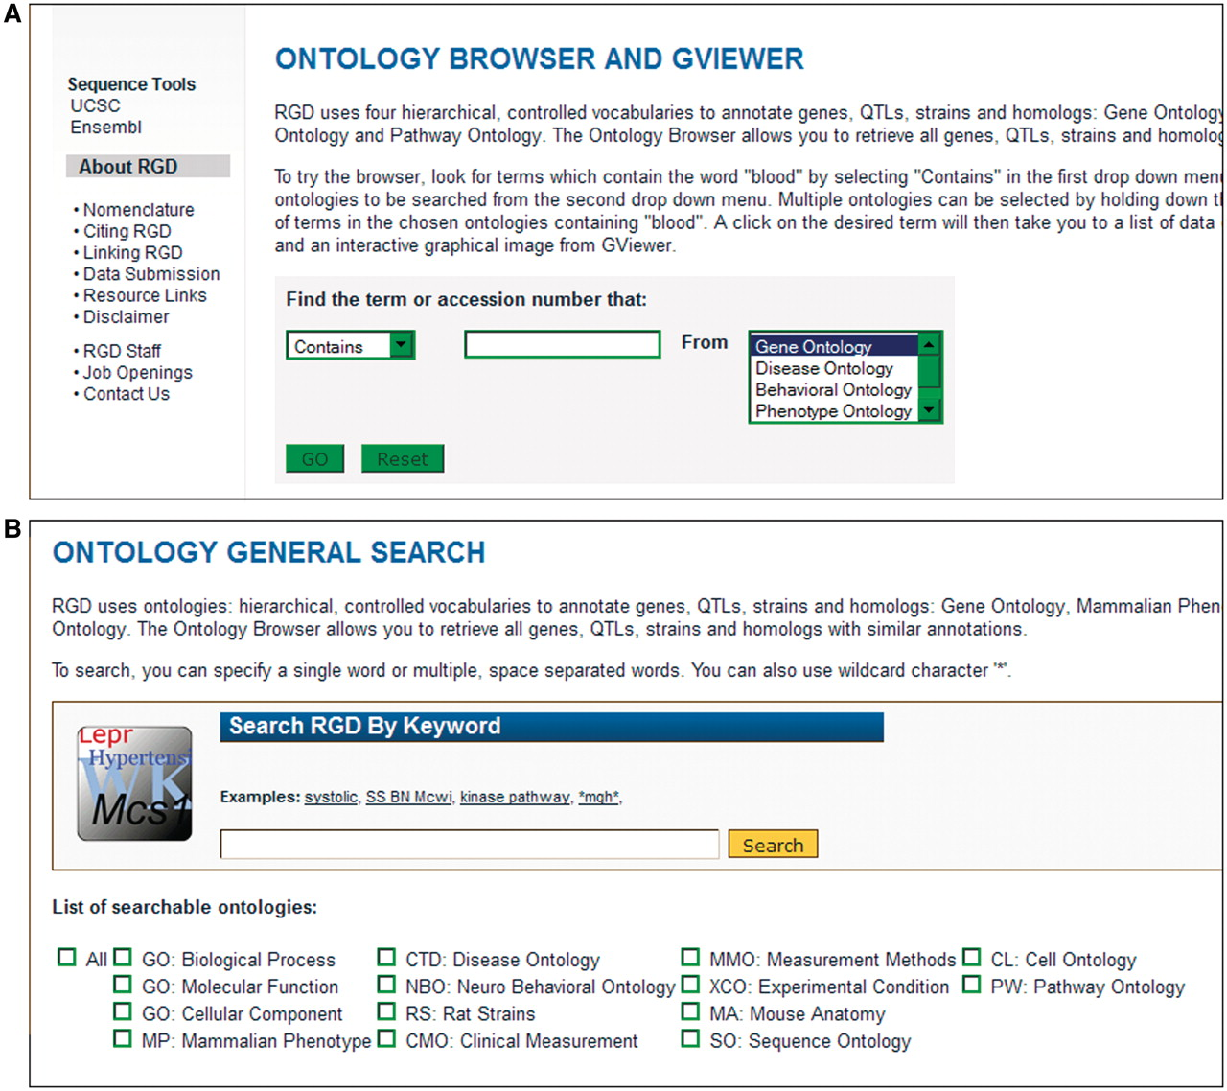
Figure 1. Old and new ontology search. (A) Old ontology search with choice of ‘Contains, Equals, Begins With, or Ends ...
Notes:
Figure 1. Old and new ontology search. (A) Old ontology search with choice of ‘Contains, Equals, Begins With, or Ends With’ for searching terms in one ontology at a time. (B) New ontology search interface with options of searching all or a combination of 14 different ontologies/vocabularies for terms, synonyms or accession numbers.
Unless provided in the caption above, the following copyright applies to the content of this slide: © The Author(s) 2012. Published by Oxford University Press.This is an Open Access article distributed under the terms of the Creative Commons Attribution Non-Commercial License (http://creativecommons.org/licenses/by-nc/3.0), which permits unrestricted non-commercial use, distribution, and reproduction in any medium, provided the original work is properly cited.

Slide 2
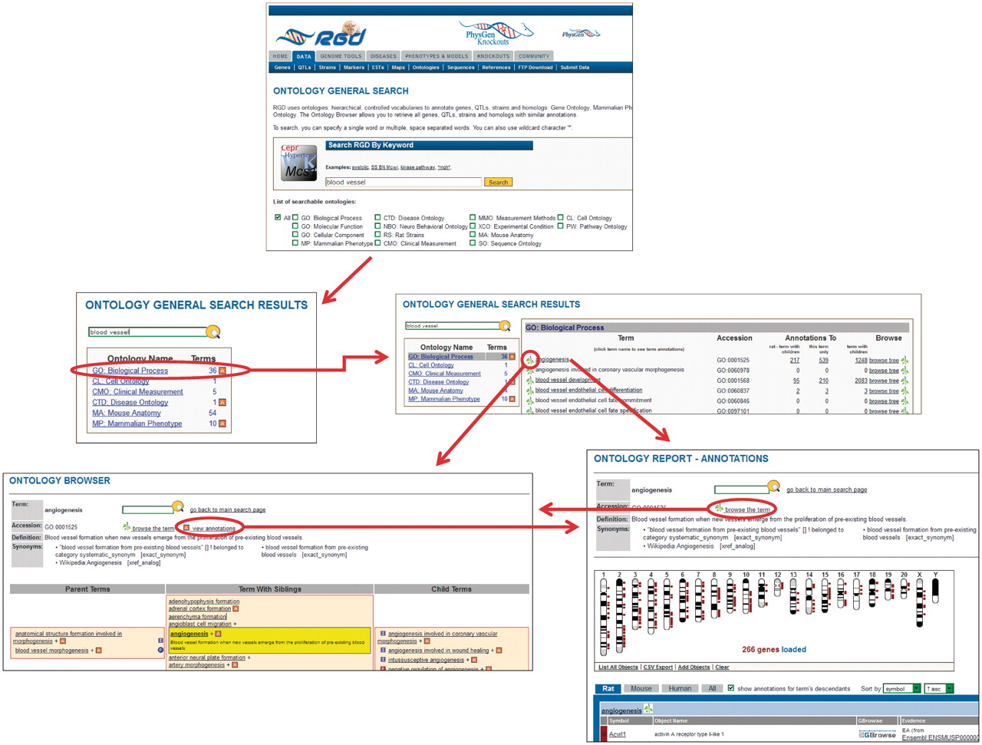
Figure 2. New ontology term search process at RGD. In this example, a search is done for ‘blood vessel’. From the ...
Notes:
Figure 2. New ontology term search process at RGD. In this example, a search is done for ‘blood vessel’. From the ontologies returned, the user selects ‘GO: Biological Process’. From the terms returned, the user selects ‘angiogenesis’. Via convenient links the user has the option of viewing the term in the ontology browser or viewing the annotations for the term on the ontology report page. The user also has the option of following a link from the browser to the annotations or the reverse.
Unless provided in the caption above, the following copyright applies to the content of this slide: © The Author(s) 2012. Published by Oxford University Press.This is an Open Access article distributed under the terms of the Creative Commons Attribution Non-Commercial License (http://creativecommons.org/licenses/by-nc/3.0), which permits unrestricted non-commercial use, distribution, and reproduction in any medium, provided the original work is properly cited.

Slide 3
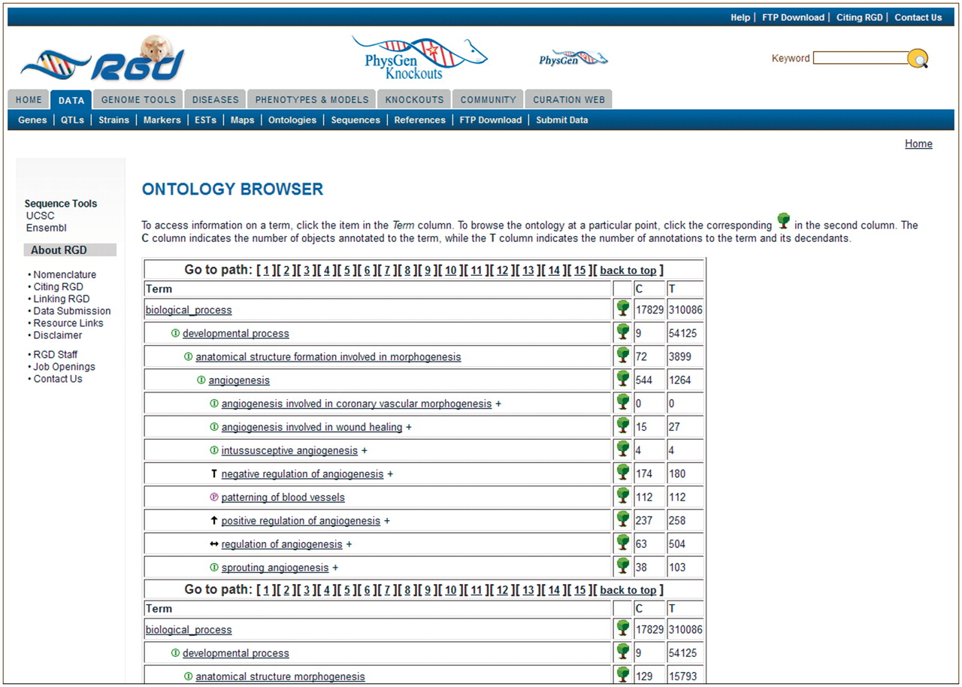
Figure 3. Old RGD ontology browser. Terms are displayed in an expandable tree format with each term being a link to an ...
Notes:
Figure 3. Old RGD ontology browser. Terms are displayed in an expandable tree format with each term being a link to an ontology report page listing all RGD annotations using that term. This example has 15 paths for the term ‘angiogenesis’, with most of the paths not visible without scrolling. The ‘C’ column contains the number of objects annotated to the term on each line, and the ‘T’ column contains the total number of annotations to the term and its children. Clicking the tree icon on each line resets the view to show that line’s term with all its children.
Unless provided in the caption above, the following copyright applies to the content of this slide: © The Author(s) 2012. Published by Oxford University Press.This is an Open Access article distributed under the terms of the Creative Commons Attribution Non-Commercial License (http://creativecommons.org/licenses/by-nc/3.0), which permits unrestricted non-commercial use, distribution, and reproduction in any medium, provided the original work is properly cited.

Slide 4
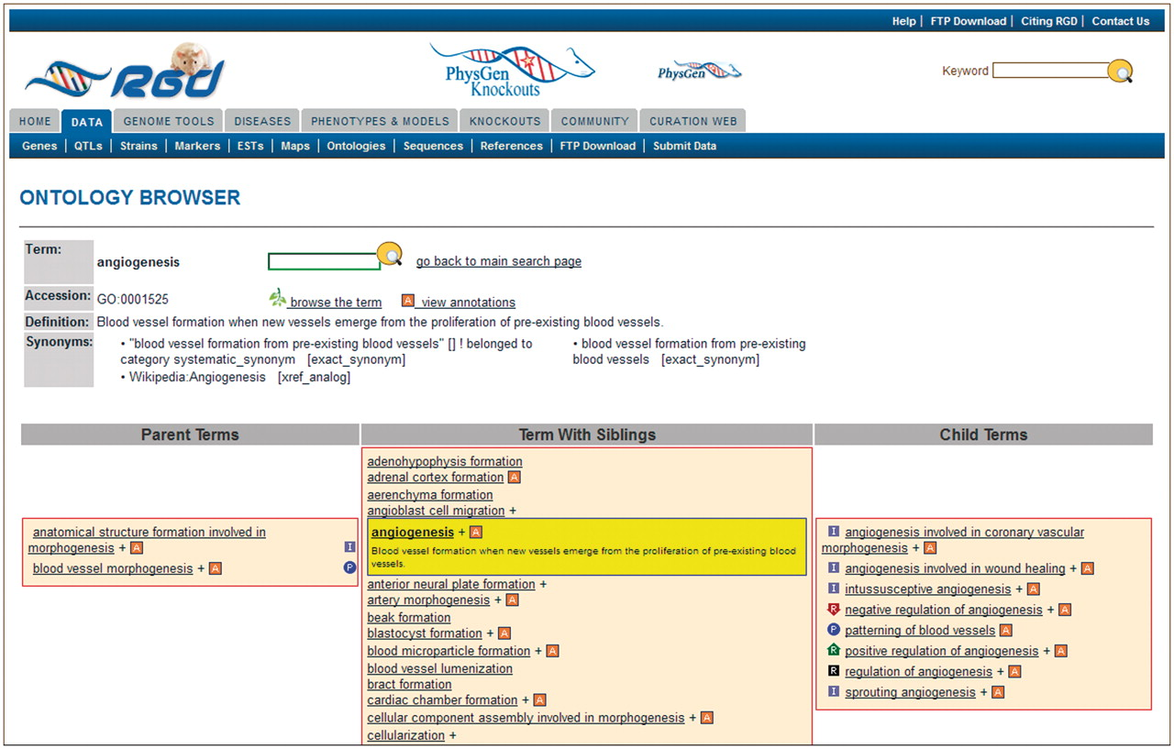
Figure 4. New RGD ontology browser. Terms are displayed in a driller format with each term being selectable such that ...
Notes:
Figure 4. New RGD ontology browser. Terms are displayed in a driller format with each term being selectable such that the selected term is highlighted and placed in the center column with all of its sibling terms. The selected term’s definition is shown both highlighted under the term in the center column and also at the top of the page. All parent terms of the selected term are listed in the left column and child terms of the selected term are listed in the right column. For any term that has annotations to it in RGD, the ‘A’ icon is a link to an ontology report page listing all RGD annotations to that term.
Unless provided in the caption above, the following copyright applies to the content of this slide: © The Author(s) 2012. Published by Oxford University Press.This is an Open Access article distributed under the terms of the Creative Commons Attribution Non-Commercial License (http://creativecommons.org/licenses/by-nc/3.0), which permits unrestricted non-commercial use, distribution, and reproduction in any medium, provided the original work is properly cited.

Slide 5
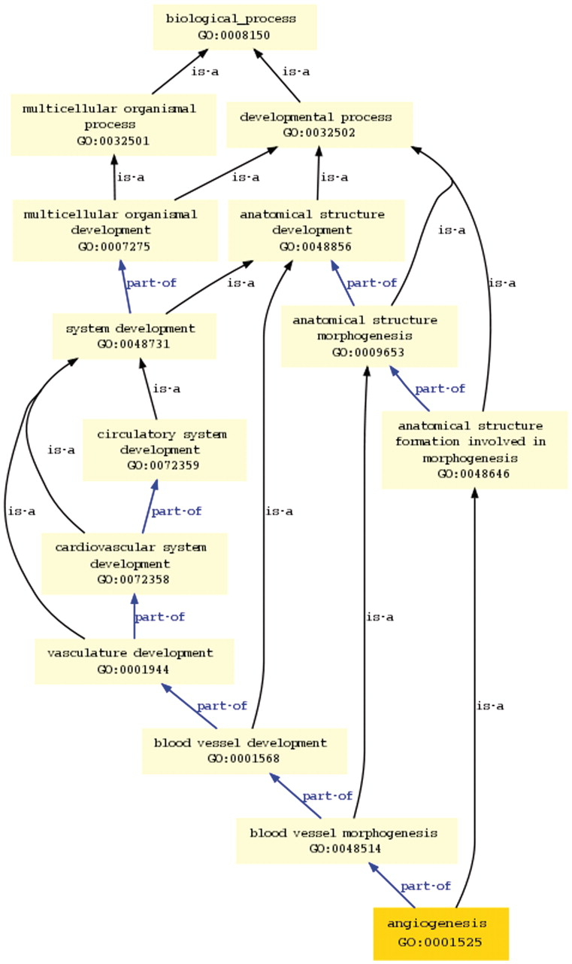
Figure 5. Graph view in new ontology browser. This view shows all the paths and parent terms between the selected term ...
Notes:
Figure 5. Graph view in new ontology browser. This view shows all the paths and parent terms between the selected term ‘angiogenesis’ and the top-level term ‘biological process’.
Unless provided in the caption above, the following copyright applies to the content of this slide: © The Author(s) 2012. Published by Oxford University Press.This is an Open Access article distributed under the terms of the Creative Commons Attribution Non-Commercial License (http://creativecommons.org/licenses/by-nc/3.0), which permits unrestricted non-commercial use, distribution, and reproduction in any medium, provided the original work is properly cited.

Slide 6
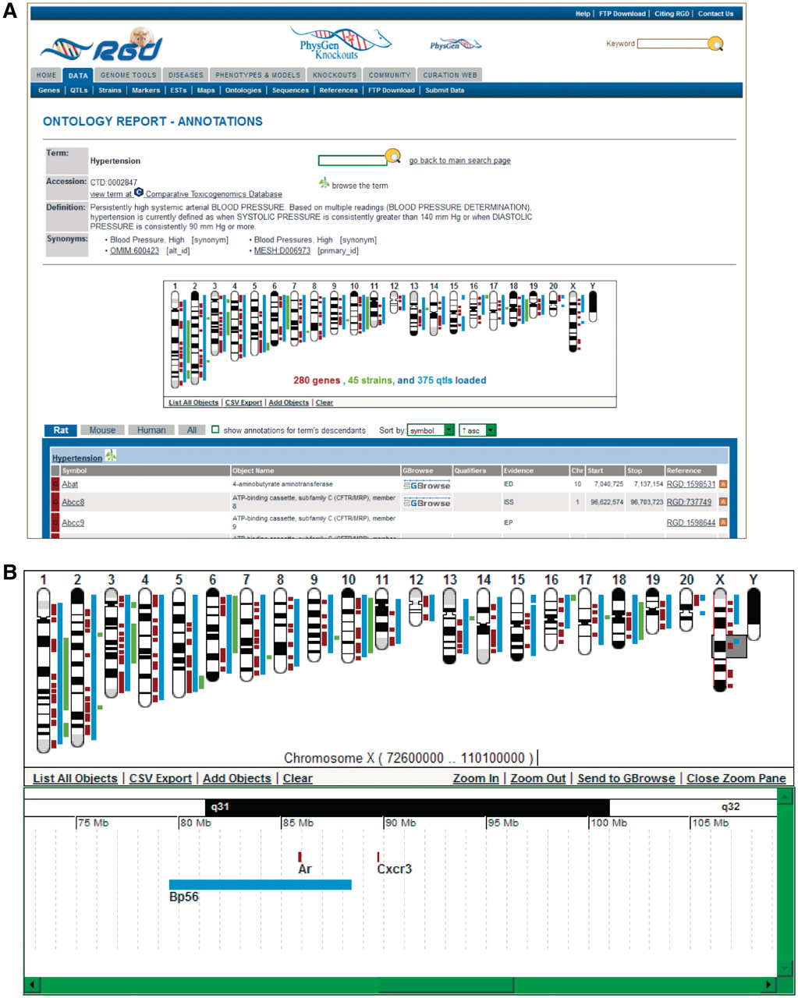
Figure 6. New ontology report page. (A) This example of an ontology report page is for the disease term ‘hypertension’. ...
Notes:
Figure 6. New ontology report page. (A) This example of an ontology report page is for the disease term ‘hypertension’. The GViewer shows that RGD annotations to ‘hypertension’ have been made to genes, QTLs and strains. Part of the list of annotations is shown below the GViewer. (B) This display of the GViewer shows a scrollable slider (gray box) on chromosome X. The zoom pane shows an enlarged view of the part of the chromosome that the slider covers. Two genes (Ar and Cxcr3) and a QTL (Bp56) are identified in the zoom pane.
Unless provided in the caption above, the following copyright applies to the content of this slide: © The Author(s) 2012. Published by Oxford University Press.This is an Open Access article distributed under the terms of the Creative Commons Attribution Non-Commercial License (http://creativecommons.org/licenses/by-nc/3.0), which permits unrestricted non-commercial use, distribution, and reproduction in any medium, provided the original work is properly cited.

Slide 7
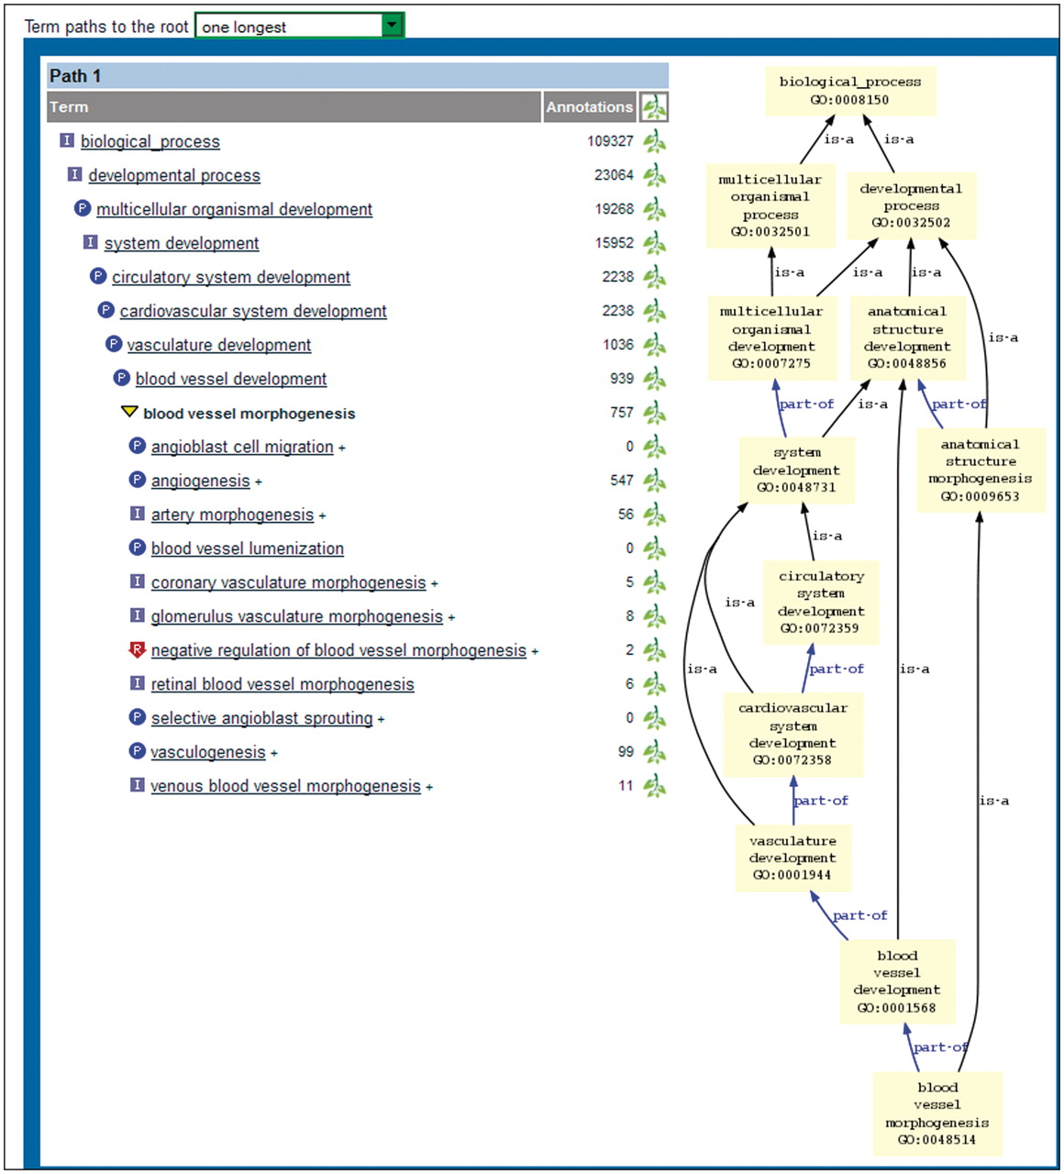
Figure 7. Bottom portion of new ontology report page. The tree view on the left shows the selected term in boldface. ...
Notes:
Figure 7. Bottom portion of new ontology report page. The tree view on the left shows the selected term in boldface. The parent and child terms are shown above and below the selected term, respectively. A single path (the longest one) is displayed because ‘one longest’ has been chosen in the dropdown menu above the display. The graph view on the right shows all paths from the selected term to the root node.
Unless provided in the caption above, the following copyright applies to the content of this slide: © The Author(s) 2012. Published by Oxford University Press.This is an Open Access article distributed under the terms of the Creative Commons Attribution Non-Commercial License (http://creativecommons.org/licenses/by-nc/3.0), which permits unrestricted non-commercial use, distribution, and reproduction in any medium, provided the original work is properly cited.

