Slide 1
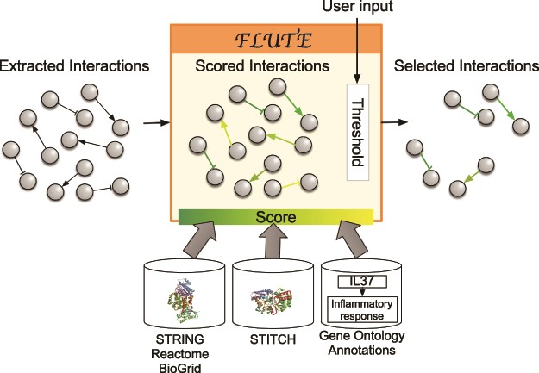
Figure 3 Filtration process with FLUTE: inputs to FLUTE include extracted interactions, scores of these interactions ...
Notes:
Figure 3 Filtration process with FLUTE: inputs to FLUTE include extracted interactions, scores of these interactions that are found in databases, and the user’s selection of thresholds for the scores. Outputs from FLUTE include selected interactions determined by their scores and thresholds.
Unless provided in the caption above, the following copyright applies to the content of this slide: © The Author(s) 2020. Published by Oxford University Press.This is an Open Access article distributed under the terms of the Creative Commons Attribution License (http://creativecommons.org/licenses/by/4.0/), which permits unrestricted reuse, distribution, and reproduction in any medium, provided the original work is properly cited.

