Slide 1
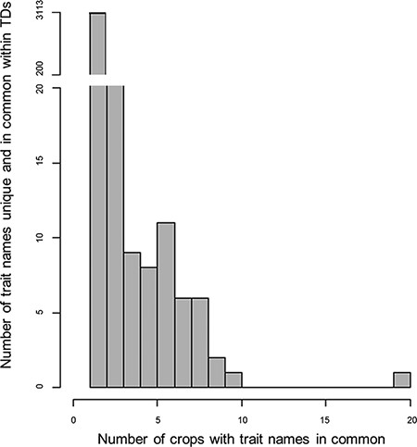
Figure 1. Histogram for the counts of trait names within the 28 Trait Dictionaries (TDs). The histogram represents 3627 ...
Notes:
Figure 1. Histogram for the counts of trait names within the 28 Trait Dictionaries (TDs). The histogram represents 3627 trait names within the TDs, along with the number of trait names across the TD for the 28 crop species. The gap in the data representing trait names that are repeated one or two times across the TDs was not plotted in the histogram; for more information, refer Supplementary Table S2 table.
Unless provided in the caption above, the following copyright applies to the content of this slide: © The Author(s) 2021. Published by Oxford University Press.This is an Open Access article distributed under the terms of the Creative Commons Attribution License (http://creativecommons.org/licenses/by/4.0/), which permits unrestricted reuse, distribution, and reproduction in any medium, provided the original work is properly cited.

