Slide 1
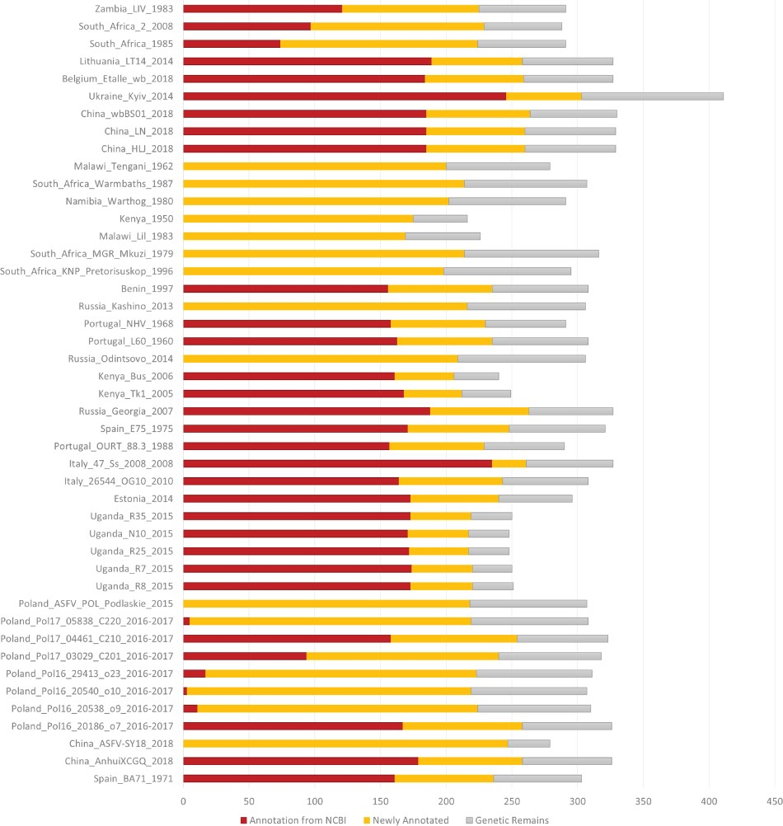
Figure 1 Number of annotated genes in all the ASFV strains. NCBI annotated genes, newly annotated genes and genetic ...
Notes:
Figure 1 Number of annotated genes in all the ASFV strains. NCBI annotated genes, newly annotated genes and genetic remains are marked in deep red, orange and grey, respectively.
Unless provided in the caption above, the following copyright applies to the content of this slide: © The Author(s) 2020. Published by Oxford University Press.This is an Open Access article distributed under the terms of the Creative Commons Attribution License (http://creativecommons.org/licenses/by/4.0/), which permits unrestricted reuse, distribution, and reproduction in any medium, provided the original work is properly cited.

