Slide 1
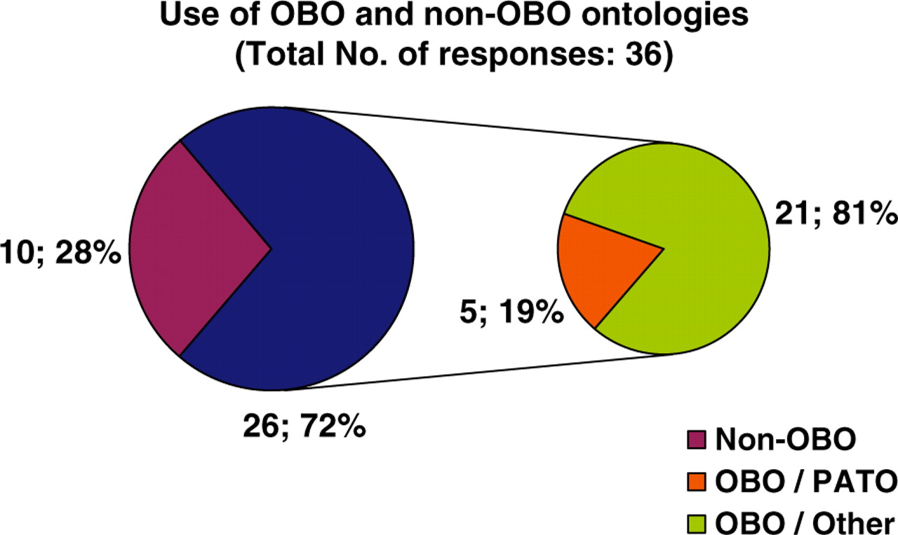
Figure 5. Pie chart illustrating the use of ontologies by biological databases. Twenty-eight percent of resources do ...
Notes:
Figure 5. Pie chart illustrating the use of ontologies by biological databases. Twenty-eight percent of resources do not use any ontology for their data description. Seventy-two percent of resources use an ontology developed by the OBO foundry, of which 19% use PATO and 81% another OBO ontology.
Unless provided in the caption above, the following copyright applies to the content of this slide: © The Author(s) 2010. Published by Oxford University Press.This is Open Access article distributed under the terms of the Creative Commons Attribution Non-Commercial License (http://creativecommons.org/licenses/by-nc/2.5), which permits unrestricted non-commercial use, distribution, and reproduction in any medium, provided the original work is properly cited.

