Slide 1
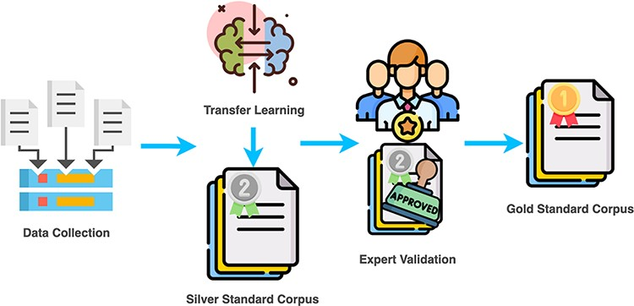
Figure 1. CAFETERIA annotation flowchart.
Notes:
Figure 1. CAFETERIA annotation flowchart.
Unless provided in the caption above, the following copyright applies to the content of this slide: © The Author(s) 2022. Published by Oxford University Press.This is an Open Access article distributed under the terms of the Creative Commons Attribution-NonCommercial License (https://creativecommons.org/licenses/by-nc/4.0/), which permits non-commercial re-use, distribution, and reproduction in any medium, provided the original work is properly cited. For commercial re-use, please contact journals.permissions@oup.com

Slide 2
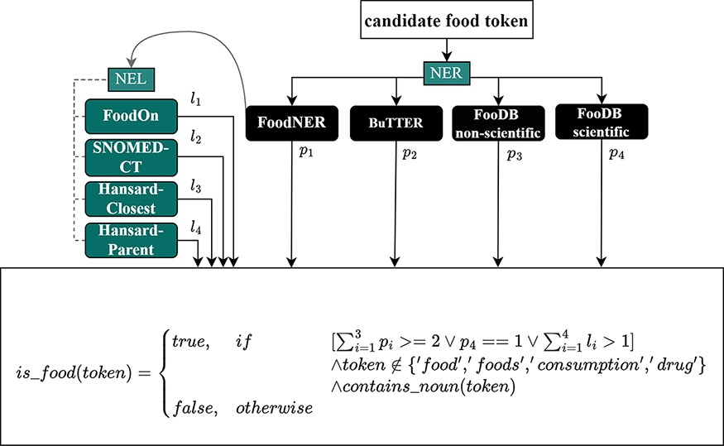
Figure 2. The food voting scheme for FoodNER.
Notes:
Figure 2. The food voting scheme for FoodNER.
Unless provided in the caption above, the following copyright applies to the content of this slide: © The Author(s) 2022. Published by Oxford University Press.This is an Open Access article distributed under the terms of the Creative Commons Attribution-NonCommercial License (https://creativecommons.org/licenses/by-nc/4.0/), which permits non-commercial re-use, distribution, and reproduction in any medium, provided the original work is properly cited. For commercial re-use, please contact journals.permissions@oup.com

Slide 3
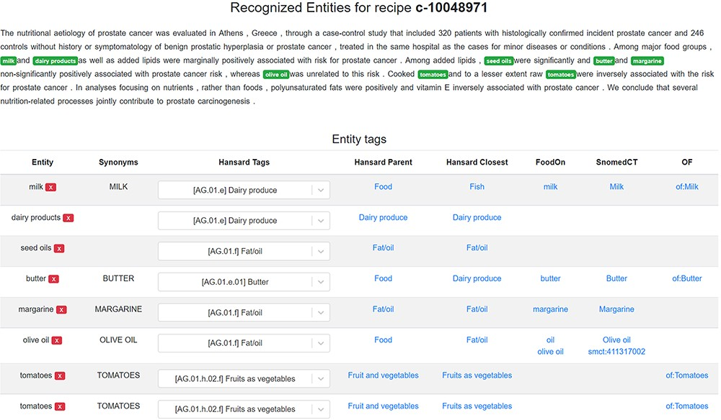
Figure 3. A scientific abstract annotated with food entities in the FoodViz tool.
Notes:
Figure 3. A scientific abstract annotated with food entities in the FoodViz tool.
Unless provided in the caption above, the following copyright applies to the content of this slide: © The Author(s) 2022. Published by Oxford University Press.This is an Open Access article distributed under the terms of the Creative Commons Attribution-NonCommercial License (https://creativecommons.org/licenses/by-nc/4.0/), which permits non-commercial re-use, distribution, and reproduction in any medium, provided the original work is properly cited. For commercial re-use, please contact journals.permissions@oup.com

Slide 4
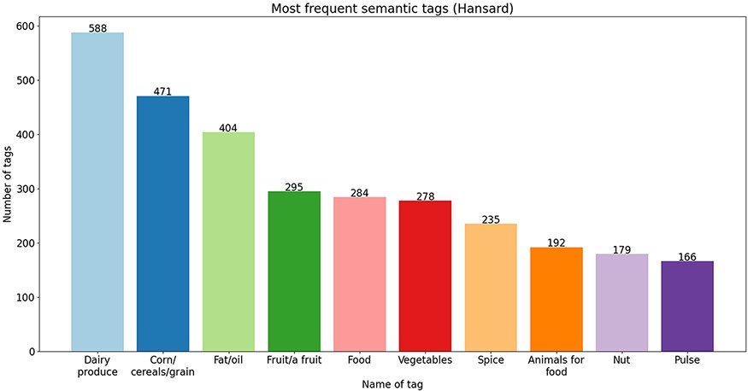
Figure 4. Ten most frequent semantic tags from the Hansard corpus.
Notes:
Figure 4. Ten most frequent semantic tags from the Hansard corpus.
Unless provided in the caption above, the following copyright applies to the content of this slide: © The Author(s) 2022. Published by Oxford University Press.This is an Open Access article distributed under the terms of the Creative Commons Attribution-NonCommercial License (https://creativecommons.org/licenses/by-nc/4.0/), which permits non-commercial re-use, distribution, and reproduction in any medium, provided the original work is properly cited. For commercial re-use, please contact journals.permissions@oup.com

Slide 5
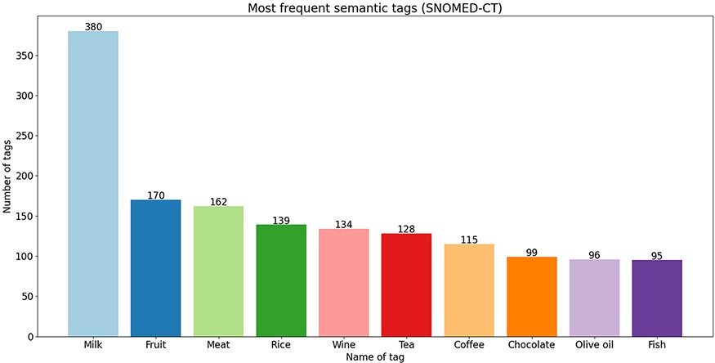
Figure 5. Ten most frequent semantic tags from the SNOMED-CT ontology.
Notes:
Figure 5. Ten most frequent semantic tags from the SNOMED-CT ontology.
Unless provided in the caption above, the following copyright applies to the content of this slide: © The Author(s) 2022. Published by Oxford University Press.This is an Open Access article distributed under the terms of the Creative Commons Attribution-NonCommercial License (https://creativecommons.org/licenses/by-nc/4.0/), which permits non-commercial re-use, distribution, and reproduction in any medium, provided the original work is properly cited. For commercial re-use, please contact journals.permissions@oup.com

Slide 6
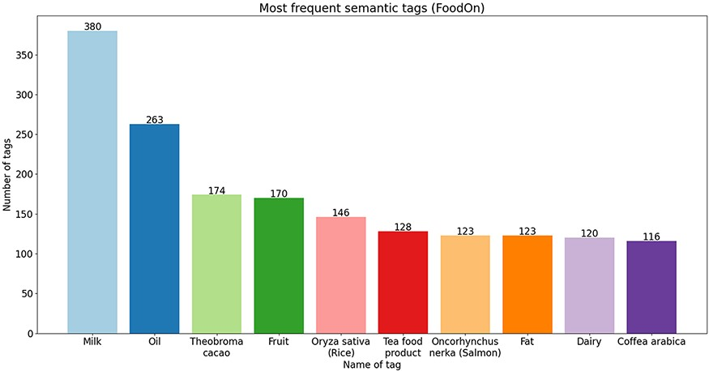
Figure 6. Ten most frequent semantic tags from the FoodOn ontology.
Notes:
Figure 6. Ten most frequent semantic tags from the FoodOn ontology.
Unless provided in the caption above, the following copyright applies to the content of this slide: © The Author(s) 2022. Published by Oxford University Press.This is an Open Access article distributed under the terms of the Creative Commons Attribution-NonCommercial License (https://creativecommons.org/licenses/by-nc/4.0/), which permits non-commercial re-use, distribution, and reproduction in any medium, provided the original work is properly cited. For commercial re-use, please contact journals.permissions@oup.com

Slide 7
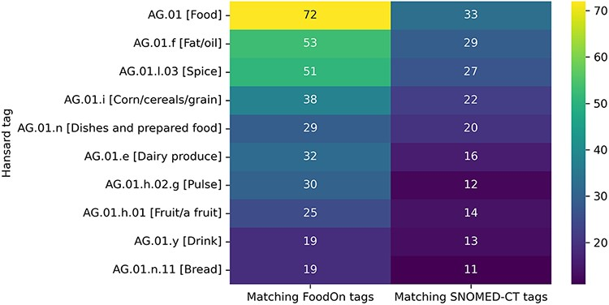
Figure 7. Top 10 semantic tags from the Hansard taxonomy that correspond to the highest number of unique tags from the ...
Notes:
Figure 7. Top 10 semantic tags from the Hansard taxonomy that correspond to the highest number of unique tags from the FoodOn and SNOMED-CT ontologies.
Unless provided in the caption above, the following copyright applies to the content of this slide: © The Author(s) 2022. Published by Oxford University Press.This is an Open Access article distributed under the terms of the Creative Commons Attribution-NonCommercial License (https://creativecommons.org/licenses/by-nc/4.0/), which permits non-commercial re-use, distribution, and reproduction in any medium, provided the original work is properly cited. For commercial re-use, please contact journals.permissions@oup.com

Slide 8
Figure 8. Median number of unique FoodOn and SNOMED-CT semantic tags that are matched to the Hansard tags of each level ...
Notes:
Figure 8. Median number of unique FoodOn and SNOMED-CT semantic tags that are matched to the Hansard tags of each level of the taxonomy.
Unless provided in the caption above, the following copyright applies to the content of this slide: © The Author(s) 2022. Published by Oxford University Press.This is an Open Access article distributed under the terms of the Creative Commons Attribution-NonCommercial License (https://creativecommons.org/licenses/by-nc/4.0/), which permits non-commercial re-use, distribution, and reproduction in any medium, provided the original work is properly cited. For commercial re-use, please contact journals.permissions@oup.com

Slide 9
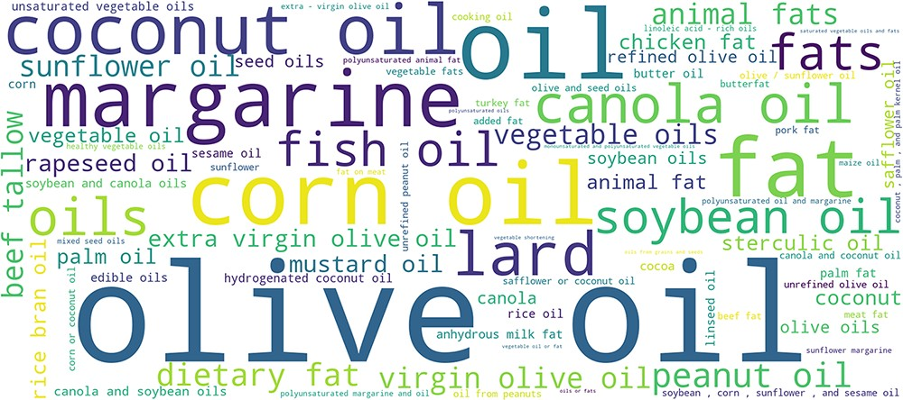
Figure 9. Text phrases linked to the AG.01.f [Fat/oil] Hansard semantic tag.
Notes:
Figure 9. Text phrases linked to the AG.01.f [Fat/oil] Hansard semantic tag.
Unless provided in the caption above, the following copyright applies to the content of this slide: © The Author(s) 2022. Published by Oxford University Press.This is an Open Access article distributed under the terms of the Creative Commons Attribution-NonCommercial License (https://creativecommons.org/licenses/by-nc/4.0/), which permits non-commercial re-use, distribution, and reproduction in any medium, provided the original work is properly cited. For commercial re-use, please contact journals.permissions@oup.com

Slide 10
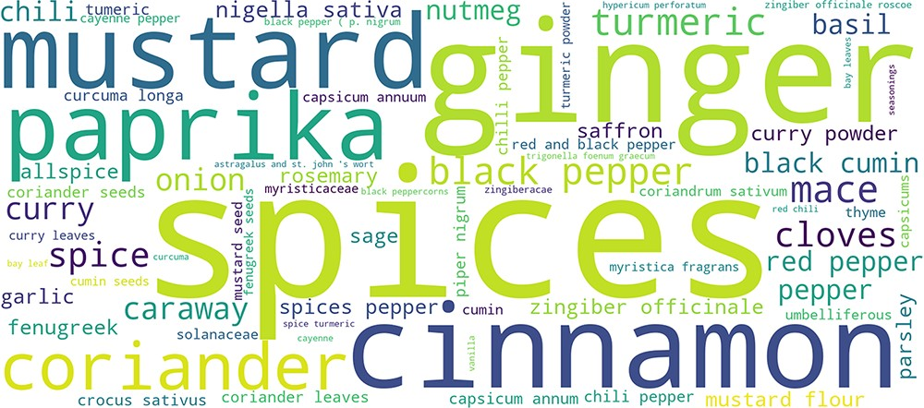
Figure 10. Food phrases linked to the AG.01.l.03 [Spice] Hansard semantic tag.
Notes:
Figure 10. Food phrases linked to the AG.01.l.03 [Spice] Hansard semantic tag.
Unless provided in the caption above, the following copyright applies to the content of this slide: © The Author(s) 2022. Published by Oxford University Press.This is an Open Access article distributed under the terms of the Creative Commons Attribution-NonCommercial License (https://creativecommons.org/licenses/by-nc/4.0/), which permits non-commercial re-use, distribution, and reproduction in any medium, provided the original work is properly cited. For commercial re-use, please contact journals.permissions@oup.com

