Slide 1
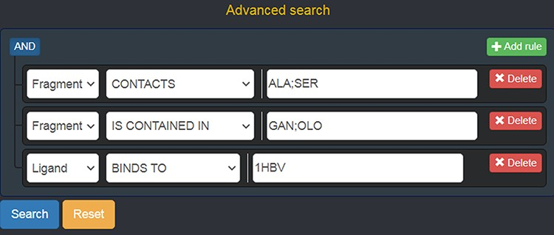
Figure 5. Advanced search panel, with some text fields populated as an example. The semantics of the query shown here ...
Notes:
Figure 5. Advanced search panel, with some text fields populated as an example. The semantics of the query shown here is the following: “retrieve all of the Fragments which contact the amino acids ALA or SER, AND which are contained in the ligands with code GAN or OLO, AND whose containing Ligands bind to the protein identified by the PDB ID 1 HBV.
Unless provided in the caption above, the following copyright applies to the content of this slide: © The Author(s) 2022. Published by Oxford University Press.This is an Open Access article distributed under the terms of the Creative Commons Attribution-NonCommercial License (https://creativecommons.org/licenses/by-nc/4.0/), which permits non-commercial re-use, distribution, and reproduction in any medium, provided the original work is properly cited. For commercial re-use, please contact journals.permissions@oup.com

