Slide 1
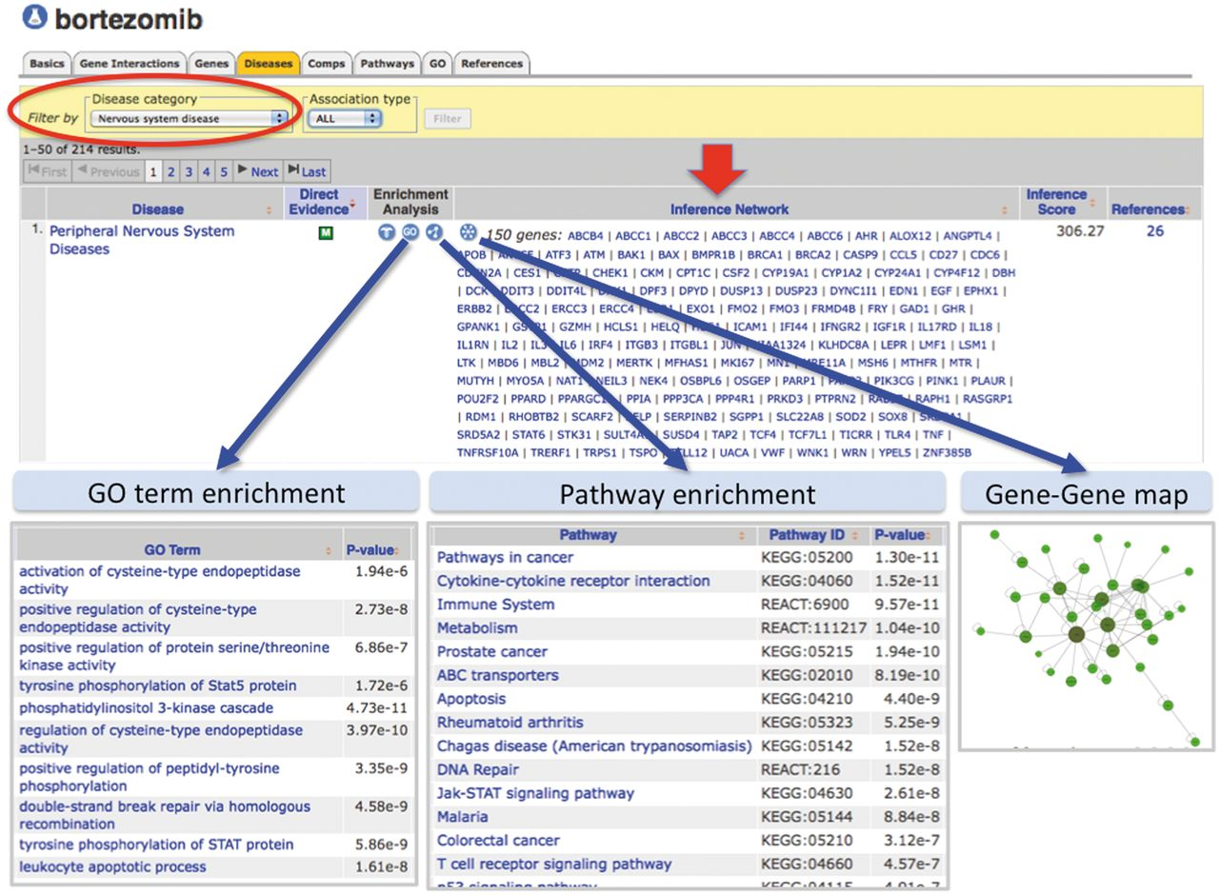
Figure 7. Enhanced content helps develop testable hypotheses for known drug–disease events. CTD’s page for the drug ...
Notes:
Figure 7. Enhanced content helps develop testable hypotheses for known drug–disease events. CTD’s page for the drug bortezomib is selected for ‘Diseases’ data (orange tab), and the results have been filtered for the category ‘Nervous system disease’ (red circle) to focus on NeuroTox events. Bortezomib is inferred to peripheral neuropathy by 150 genes (red arrow, ‘Inference Network’). Embedded web tools automatically generate lists of enriched GO terms, pathway annotations and gene–gene interaction maps (blue arrows).
Unless provided in the caption above, the following copyright applies to the content of this slide: © The Author(s) 2013. Published by Oxford University Press.This is an Open Access article distributed under the terms of the Creative Commons Attribution License (http://creativecommons.org/licenses/by/3.0/), which permits unrestricted reuse, distribution, and reproduction in any medium, provided the original work is properly cited.

