Slide 1
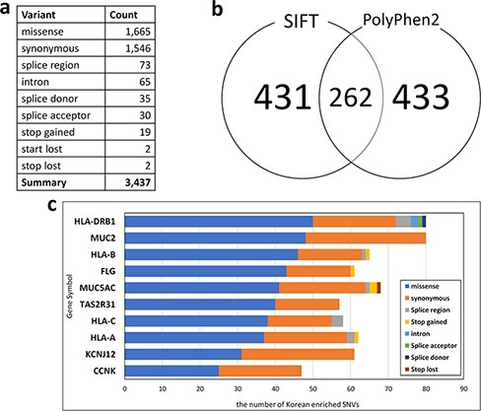
Figure 3. Statistics of Korean-enriched SNVs. (a) Annotation of Korean-enriched SNVs, (b) Venn diagram of the ...
Notes:
Figure 3. Statistics of Korean-enriched SNVs. (a) Annotation of Korean-enriched SNVs, (b) Venn diagram of the Korean-enriched pathogenic variants predicted by SIFT and PolyPhen-2 algorithms and (c) top 10 genes with Korean-enriched variants. The x-axis represents the number of Korean-enriched SNVs, and the y-axis represents the gene symbol.
Unless provided in the caption above, the following copyright applies to the content of this slide: © The Author(s) 2022. Published by Oxford University Press.This is an Open Access article distributed under the terms of the Creative Commons Attribution License (https://creativecommons.org/licenses/by/4.0/), which permits unrestricted reuse, distribution, and reproduction in any medium, provided the original work is properly cited.

