Slide 1
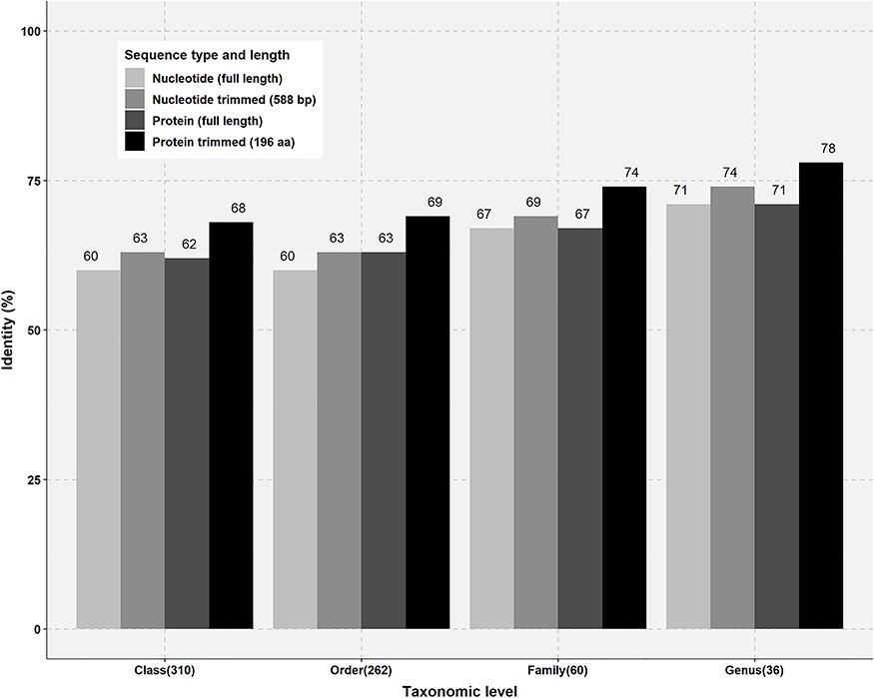
Figure 3 Percentage identity thresholds of FTHFS sequences at different taxonomic levels. Full-length and trimmed ...
Notes:
Figure 3 Percentage identity thresholds of FTHFS sequences at different taxonomic levels. Full-length and trimmed sequences of known taxonomy for class (310), order (262), family (60) and genus (36) level were compared with clone sequences of 588 bp and translated sequences of 196 aa.
Unless provided in the caption above, the following copyright applies to the content of this slide: © The Author(s) 2019. Published by Oxford University Press.This is an Open Access article distributed under the terms of the Creative Commons Attribution Non-Commercial License (http://creativecommons.org/licenses/by-nc/4.0/), which permits non-commercial re-use, distribution, and reproduction in any medium, provided the original work is properly cited. For commercial re-use, please contact journals.permissions@oup.com

Slide 2
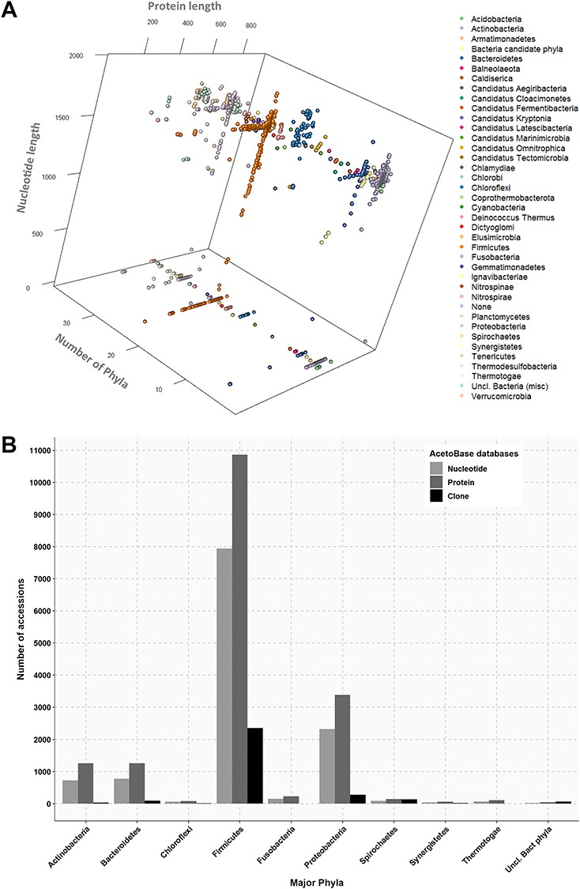
Figure 2 (A) Three-dimensional projection of nucleotide and protein sequence length according to phylum. Length of ...
Notes:
Figure 2 (A) Three-dimensional projection of nucleotide and protein sequence length according to phylum. Length of protein sequences, length of nucleotide sequences and number of phyla are shown on the x-axis, y-axis and z-axis, respectively. Protein sequences without a corresponding nucleotide sequence in the database are indicated on the z-plane. (B) Phylum affiliations of nucleotide, protein and clone accessions in AcetoBase. Phyla containing less than 20 accessions are not shown.
Unless provided in the caption above, the following copyright applies to the content of this slide: © The Author(s) 2019. Published by Oxford University Press.This is an Open Access article distributed under the terms of the Creative Commons Attribution Non-Commercial License (http://creativecommons.org/licenses/by-nc/4.0/), which permits non-commercial re-use, distribution, and reproduction in any medium, provided the original work is properly cited. For commercial re-use, please contact journals.permissions@oup.com

Slide 3
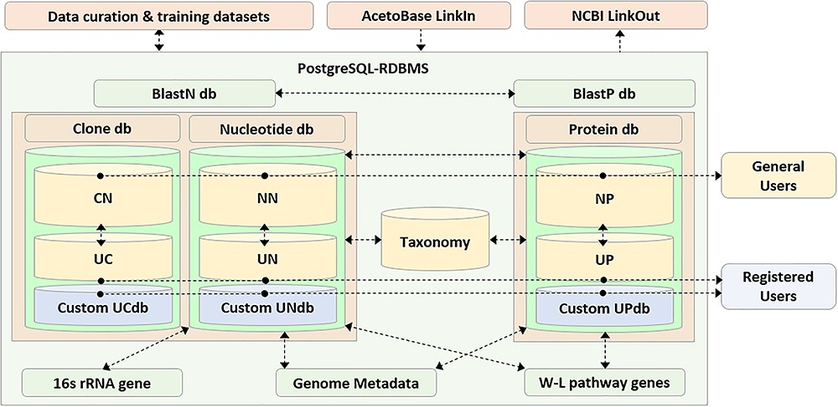
Figure 1 Schematic representation of the AcetoBase repository and database. The nucleotide database (db) table ...
Notes:
Figure 1 Schematic representation of the AcetoBase repository and database. The nucleotide database (db) table consists of reference nucleotide (NN) table and user nucleotide (UN) table, the clone database table consists of reference clone (CN) table and user clone (UC) table and the protein database table consists of reference protein (NP) table and user protein (UP) table. General users have access to all sequences in the databases except for those that are not yet public, while registered users also have access to the custom database generated with their own clone (UCdb), nucleotide (UNdb) and protein (UPdb) sequences. W-L, Wood–Ljungdahl.
Unless provided in the caption above, the following copyright applies to the content of this slide: © The Author(s) 2019. Published by Oxford University Press.This is an Open Access article distributed under the terms of the Creative Commons Attribution Non-Commercial License (http://creativecommons.org/licenses/by-nc/4.0/), which permits non-commercial re-use, distribution, and reproduction in any medium, provided the original work is properly cited. For commercial re-use, please contact journals.permissions@oup.com

Slide 4
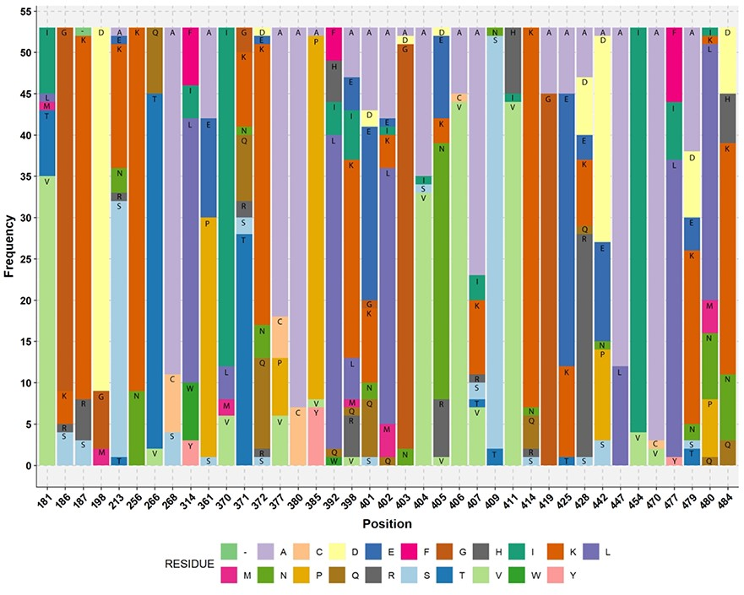
Figure 4 Stacked bar plot showing the amino acid residue of acetogens corresponding to the reference M. thermoacetica ...
Notes:
Figure 4 Stacked bar plot showing the amino acid residue of acetogens corresponding to the reference M. thermoacetica FTHFS aa sequence. The aa residue position of M. thermoacetica is shown on the x-axis and the frequency of the aa residue in the multiple alignment of 53 sequences of known acetogens (M. thermoacetica included) is shown on the y-axis. Minus sign (−) denotes absence of any amino acid residue.
Unless provided in the caption above, the following copyright applies to the content of this slide: © The Author(s) 2019. Published by Oxford University Press.This is an Open Access article distributed under the terms of the Creative Commons Attribution Non-Commercial License (http://creativecommons.org/licenses/by-nc/4.0/), which permits non-commercial re-use, distribution, and reproduction in any medium, provided the original work is properly cited. For commercial re-use, please contact journals.permissions@oup.com

Slide 5
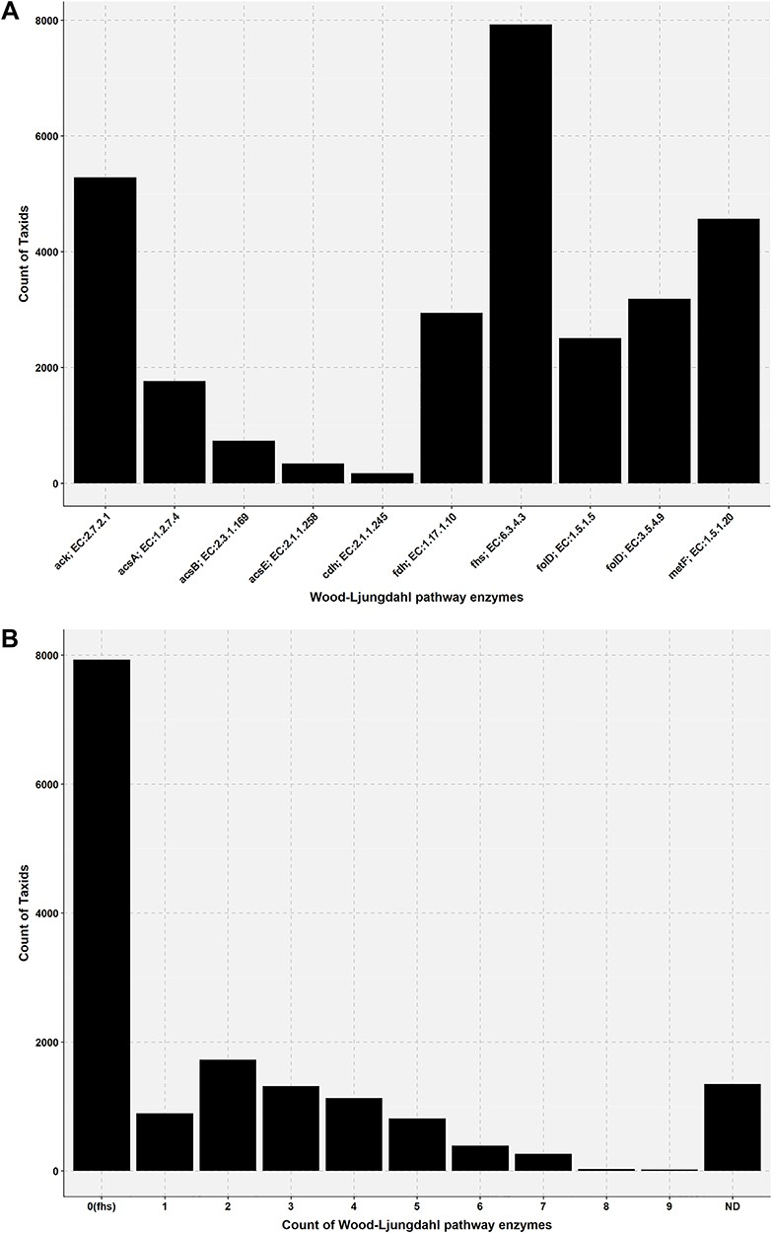
Figure 5 Bar plot showing the presence of Wood–Ljungdahl pathway enzymes in the genome of AcetoBas accessions. (A) ...
Notes:
Figure 5 Bar plot showing the presence of Wood–Ljungdahl pathway enzymes in the genome of AcetoBas accessions. (A) Count of taxids for the Wood–Ljungdahl pathway enzymes in the genome of AcetoBase accessions (ND, not determined). (B) Count of taxids for the presence of particular enzymes in the Wood–Ljungdahl pathway.
Unless provided in the caption above, the following copyright applies to the content of this slide: © The Author(s) 2019. Published by Oxford University Press.This is an Open Access article distributed under the terms of the Creative Commons Attribution Non-Commercial License (http://creativecommons.org/licenses/by-nc/4.0/), which permits non-commercial re-use, distribution, and reproduction in any medium, provided the original work is properly cited. For commercial re-use, please contact journals.permissions@oup.com

Slide 6
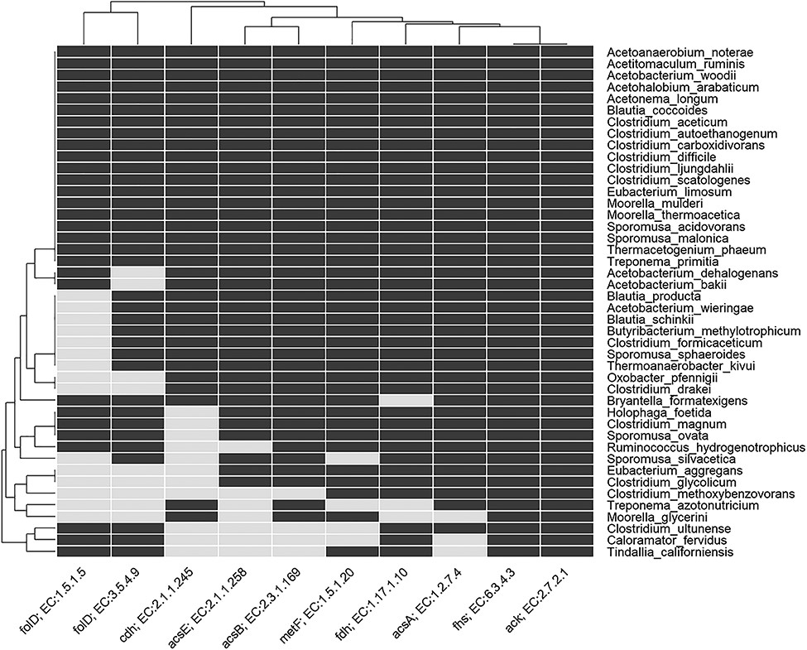
Figure 6 Heatmap indicating the presence and absence of enzymes involved in the Wood–Ljungdahl pathway in genome of ...
Notes:
Figure 6 Heatmap indicating the presence and absence of enzymes involved in the Wood–Ljungdahl pathway in genome of known acetogens. The rows show the named acetogens, and the columns show the EC number and gene name for the enzymes. For details of enzyme EC number, etc., see Table S2 in Supplementary Information.
Unless provided in the caption above, the following copyright applies to the content of this slide: © The Author(s) 2019. Published by Oxford University Press.This is an Open Access article distributed under the terms of the Creative Commons Attribution Non-Commercial License (http://creativecommons.org/licenses/by-nc/4.0/), which permits non-commercial re-use, distribution, and reproduction in any medium, provided the original work is properly cited. For commercial re-use, please contact journals.permissions@oup.com

