Slide 1
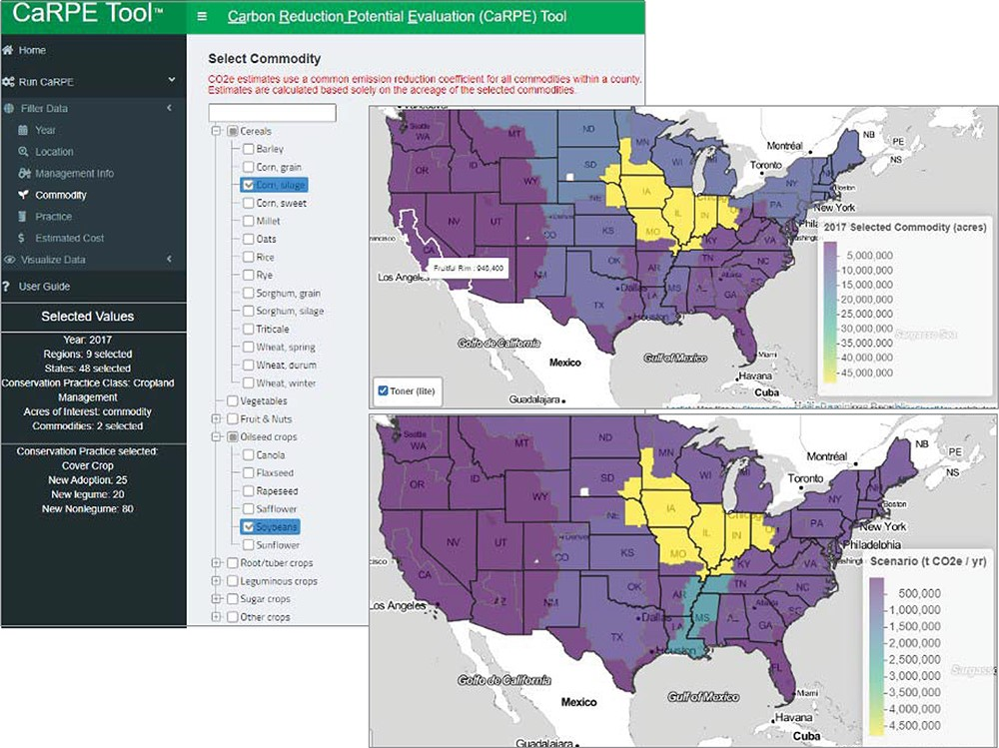
Figure 4. CaRPE screenshot showing an example of limiting acres to grain corn and soybeans, a map pooled by region ...
Notes:
Figure 4. CaRPE screenshot showing an example of limiting acres to grain corn and soybeans, a map pooled by region showing the distribution of those acres across the nine FSRs and the distribution of the tonnes of CO2e reduction potentials resulting from a cover crop scenario using the default settings.
Unless provided in the caption above, the following copyright applies to the content of this slide: Published by Oxford University Press 2022. This work is written by (a) US Government employee(s) and is in the public domain in the US.This work is written by (a) US Government employee(s) and is in the public domain in the US.

