Slide 1
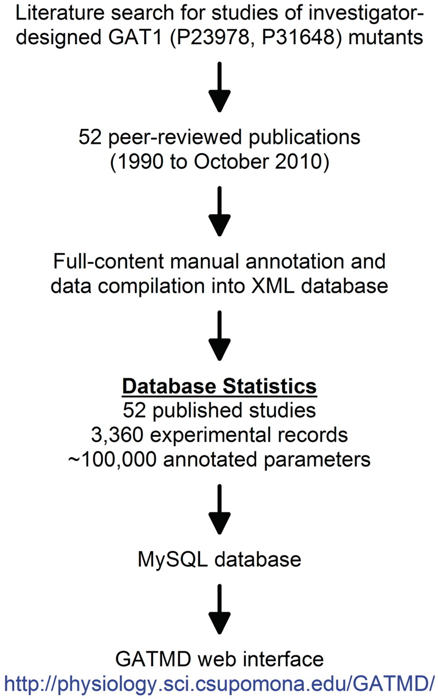
Figure 1. General approach for the development of GATMD. A thorough search of the PubMed database revealed 52 published ...
Notes:
Figure 1. General approach for the development of GATMD. A thorough search of the PubMed database revealed 52 published studies in which investigator-designed mutants of GAT1 have been studied. A complete list of the papers annotated in GATMD is available online. Using the data model shown in Table 1 and described in greater detail in the online tutorial, full annotation of these published studies yielded 3360 experimental records containing a total of ∼100 000 annotated parameters. The web interface of GATMD utilizes Perl/CGI scripts to access the GATMD MySQL database.
Unless provided in the caption above, the following copyright applies to the content of this slide: © The Author(s) 2010. Published by Oxford University Press.This is Open Access article distributed under the terms of the Creative Commons Attribution Non-Commercial License (http://creativecommons.org/licenses/by-nc/2.5), which permits unrestricted non-commercial use, distribution, and reproduction in any medium, provided the original work is properly cited.

Slide 2
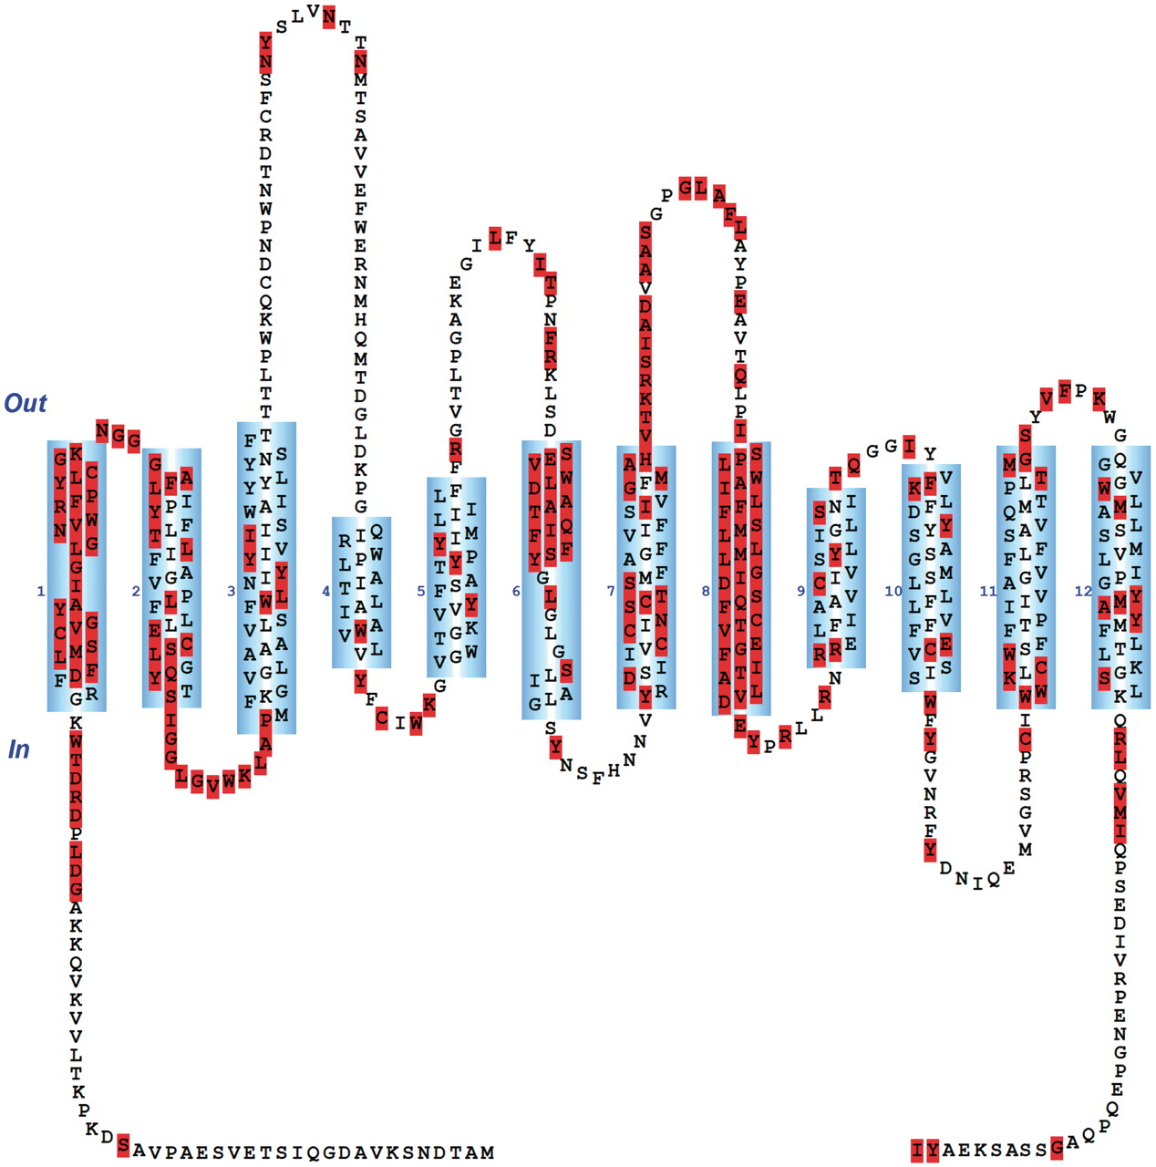
Figure 6. Using a predefined query under the Basic Search Functions menu of the ‘Search’ page, a partial screenshot of ...
Notes:
Figure 6. Using a predefined query under the Basic Search Functions menu of the ‘Search’ page, a partial screenshot of the resulting page is shown in which all rat GAT1 residues subjected to substitution mutagenesis are highlighted. As of the last update of GATMD, 218 of 599 rat GAT1 residues have been subjected to substitution mutagenesis. Each residue of the topology diagram (highlighted or not) has a hyperlink which may be used to retrieve the associated experimental evidence for that residue.
Unless provided in the caption above, the following copyright applies to the content of this slide: © The Author(s) 2010. Published by Oxford University Press.This is Open Access article distributed under the terms of the Creative Commons Attribution Non-Commercial License (http://creativecommons.org/licenses/by-nc/2.5), which permits unrestricted non-commercial use, distribution, and reproduction in any medium, provided the original work is properly cited.

Slide 3
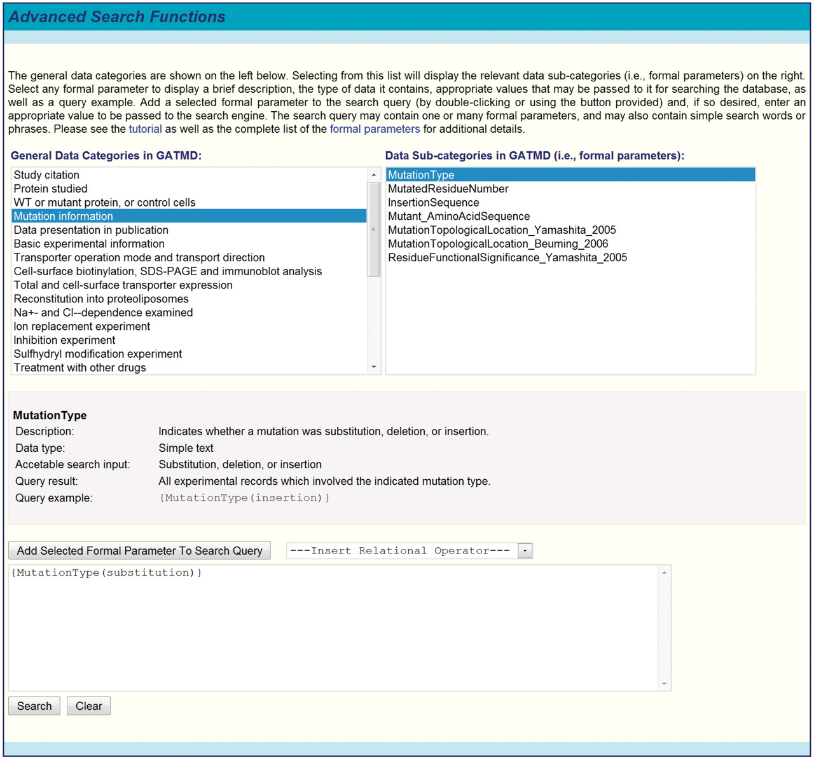
Figure 5. Screenshot of GATMD advanced search functions. The general data categories of GATMD are shown on the left ...
Notes:
Figure 5. Screenshot of GATMD advanced search functions. The general data categories of GATMD are shown on the left (see also Table 1). Selecting from this list will display the relevant data sub-categories (i.e. formal parameters) on the right. Selecting any formal parameter displays a brief description, the type of data it contains, appropriate values that may be passed to it for searching the database, as well as a query example. Advanced queries must conform to the guidelines outlined in text and described in greater detail in the online tutorial.
Unless provided in the caption above, the following copyright applies to the content of this slide: © The Author(s) 2010. Published by Oxford University Press.This is Open Access article distributed under the terms of the Creative Commons Attribution Non-Commercial License (http://creativecommons.org/licenses/by-nc/2.5), which permits unrestricted non-commercial use, distribution, and reproduction in any medium, provided the original work is properly cited.

Slide 4
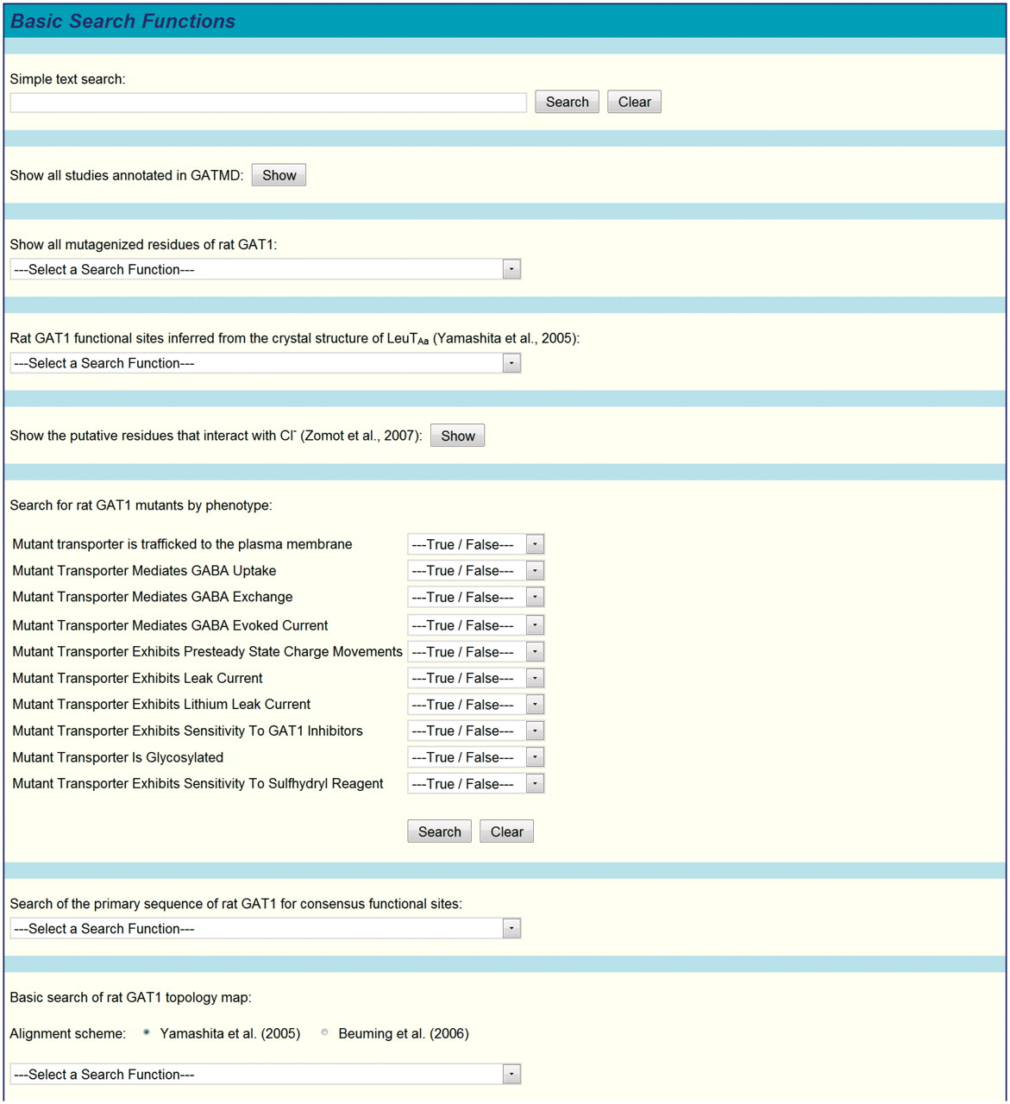
Figure 4. Partial screenshot of GATMD basic search functions. A number of predefined search functions are available ...
Notes:
Figure 4. Partial screenshot of GATMD basic search functions. A number of predefined search functions are available under the ‘Basic Search Functions’ menu. A text search box is also provided, where terms/phrases may be entered for searching all data in the database. Text searches must conform to the guidelines outlined in text and described in greater detail in the online tutorial. Advanced queries (see text and Figure 5) may also be entered in this search box.
Unless provided in the caption above, the following copyright applies to the content of this slide: © The Author(s) 2010. Published by Oxford University Press.This is Open Access article distributed under the terms of the Creative Commons Attribution Non-Commercial License (http://creativecommons.org/licenses/by-nc/2.5), which permits unrestricted non-commercial use, distribution, and reproduction in any medium, provided the original work is properly cited.

Slide 5
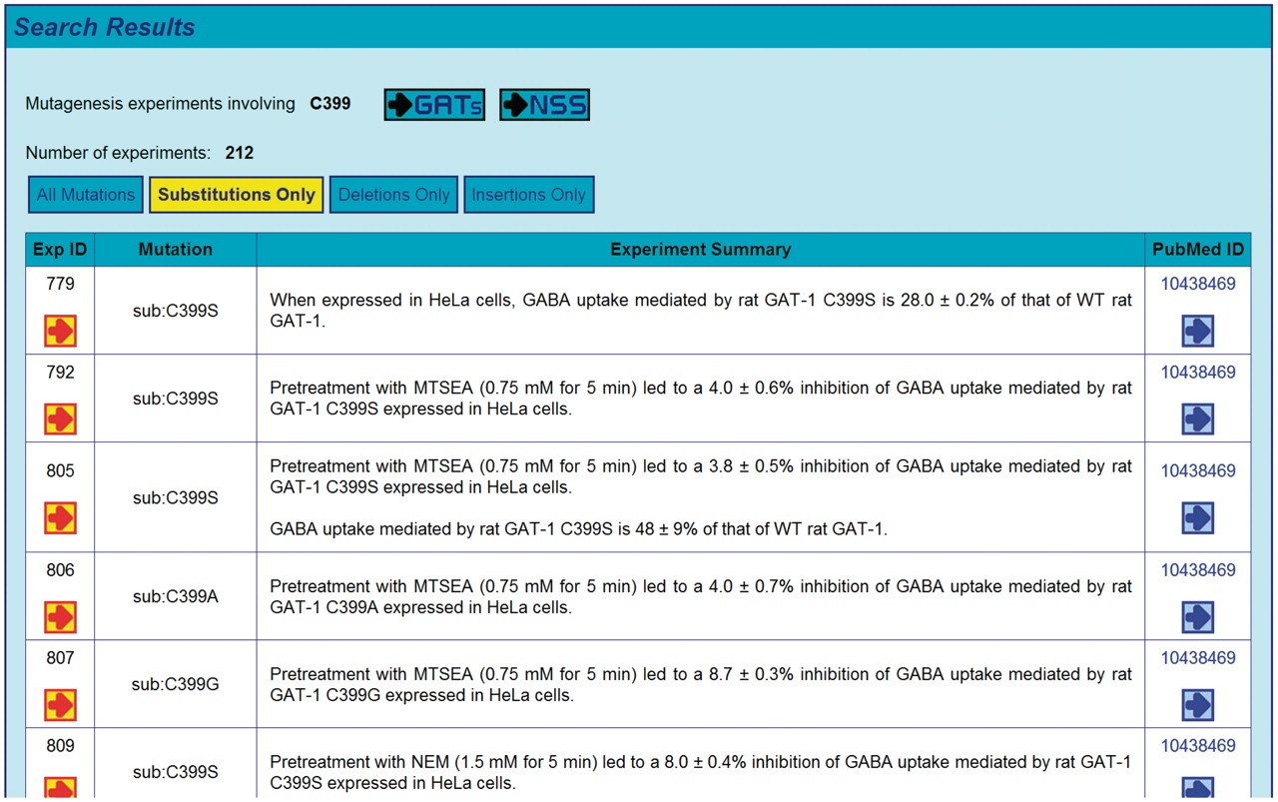
Figure 3. A representative screenshot is shown, where search results are initially presented as the summary statements ...
Notes:
Figure 3. A representative screenshot is shown, where search results are initially presented as the summary statements of individual experimental records returned by the query. Any residues implicated in the search results are also highlighted in the GAT1 topology diagram (see Figure 6). Additional links are provided to refine the search and/or to reveal further details about any given experimental record.
Unless provided in the caption above, the following copyright applies to the content of this slide: © The Author(s) 2010. Published by Oxford University Press.This is Open Access article distributed under the terms of the Creative Commons Attribution Non-Commercial License (http://creativecommons.org/licenses/by-nc/2.5), which permits unrestricted non-commercial use, distribution, and reproduction in any medium, provided the original work is properly cited.

Slide 6
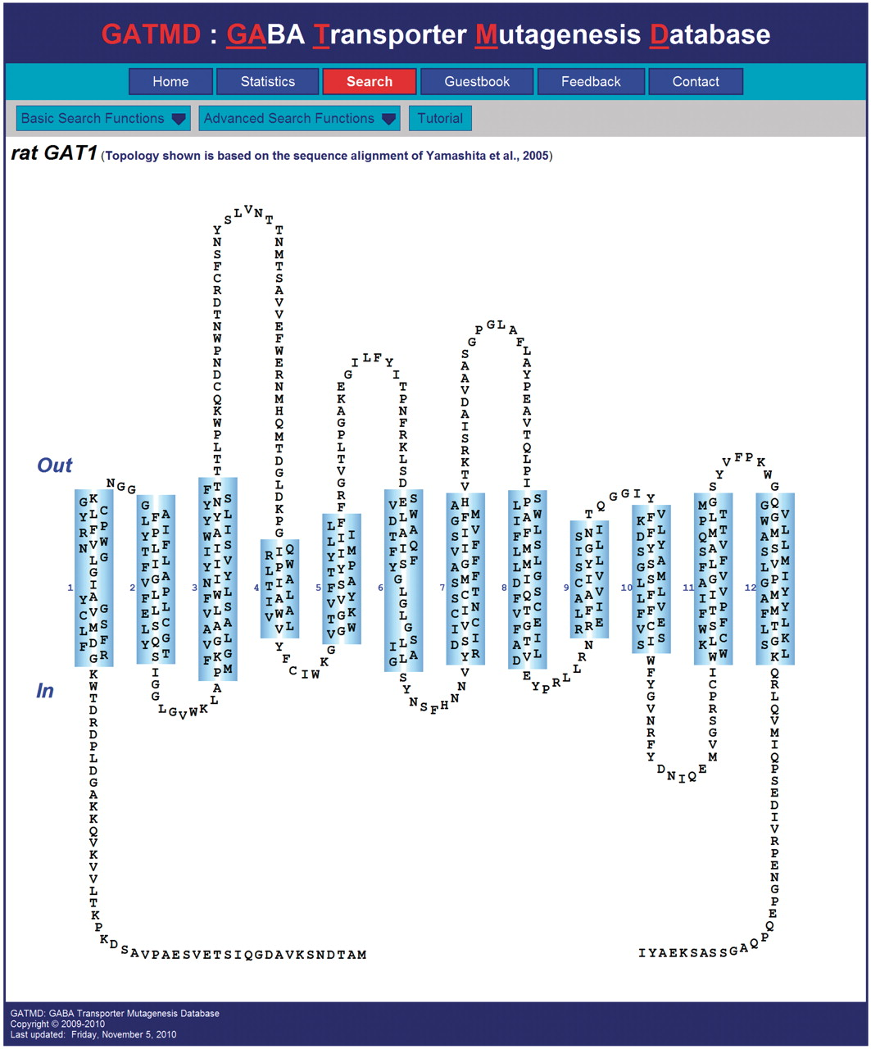
Figure 2. Screenshot of GATMD ‘Search’ page. The topology diagram of GAT1 shown corresponds to the sequence alignment ...
Notes:
Figure 2. Screenshot of GATMD ‘Search’ page. The topology diagram of GAT1 shown corresponds to the sequence alignment of Yamashita et al. (41). Out and In refer to the extracellular and intracellular space, respectively. Cylinders (numbered 1–12) correspond to alpha helical, membrane-spanning regions. Transmembrane domains 1 and 6 contain unwound regions as suggested by the crystal structure of the related bacterial leucine transporter, LeuTAa (41). Each residue is depicted by its one-letter amino acid symbol. For each of the 599 residues, a hyperlink is provided, which will retrieve all database experimental records associated with that residue. Additional search features of the database may be accessed under the ‘Basic Search Functions’ and ‘Advanced Search Functions’ menus. A tutorial is also available.
Unless provided in the caption above, the following copyright applies to the content of this slide: © The Author(s) 2010. Published by Oxford University Press.This is Open Access article distributed under the terms of the Creative Commons Attribution Non-Commercial License (http://creativecommons.org/licenses/by-nc/2.5), which permits unrestricted non-commercial use, distribution, and reproduction in any medium, provided the original work is properly cited.

Slide 7
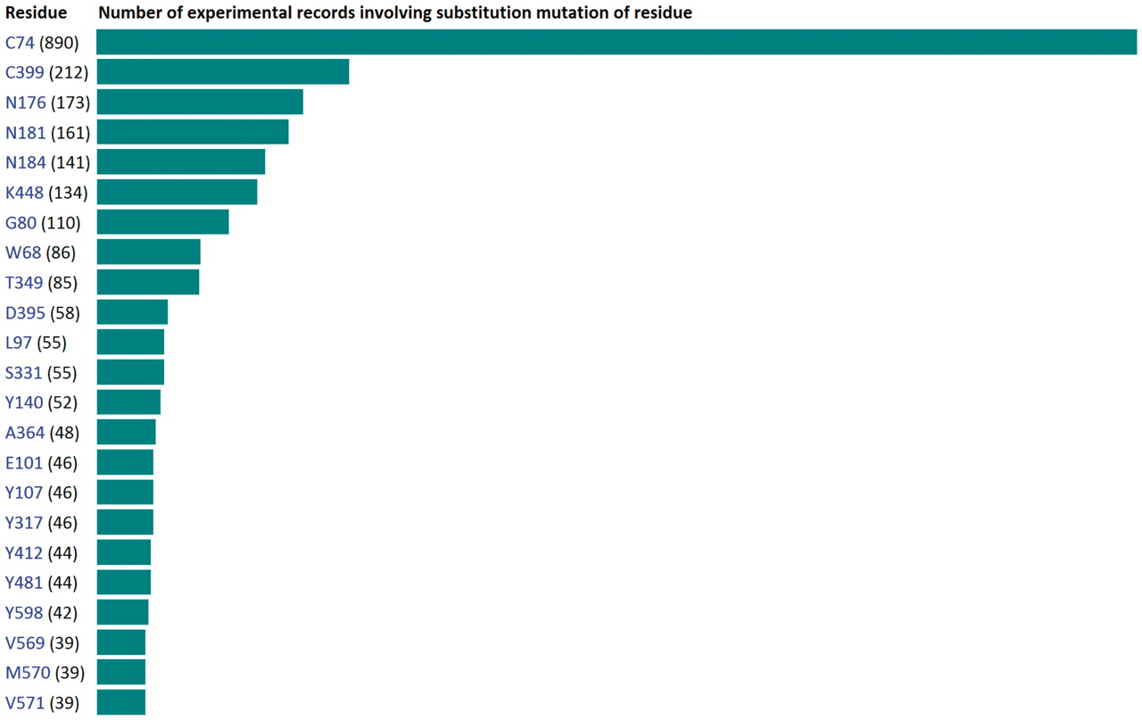
Figure 7. A partial screenshot of the ‘Statistics’ page shows the frequency with which each of the 599 residues of GAT1 ...
Notes:
Figure 7. A partial screenshot of the ‘Statistics’ page shows the frequency with which each of the 599 residues of GAT1 has been subjected to substitution mutagenesis. In addition, general database statistics are shown on this page and reveal a quick glance of mutagenesis experiments, as well as the expression systems and experimental approaches used to study the GABA transporters. Links provided on this page utilize advanced search queries to retrieve the corresponding experimental records.
Unless provided in the caption above, the following copyright applies to the content of this slide: © The Author(s) 2010. Published by Oxford University Press.This is Open Access article distributed under the terms of the Creative Commons Attribution Non-Commercial License (http://creativecommons.org/licenses/by-nc/2.5), which permits unrestricted non-commercial use, distribution, and reproduction in any medium, provided the original work is properly cited.

