Slide 1
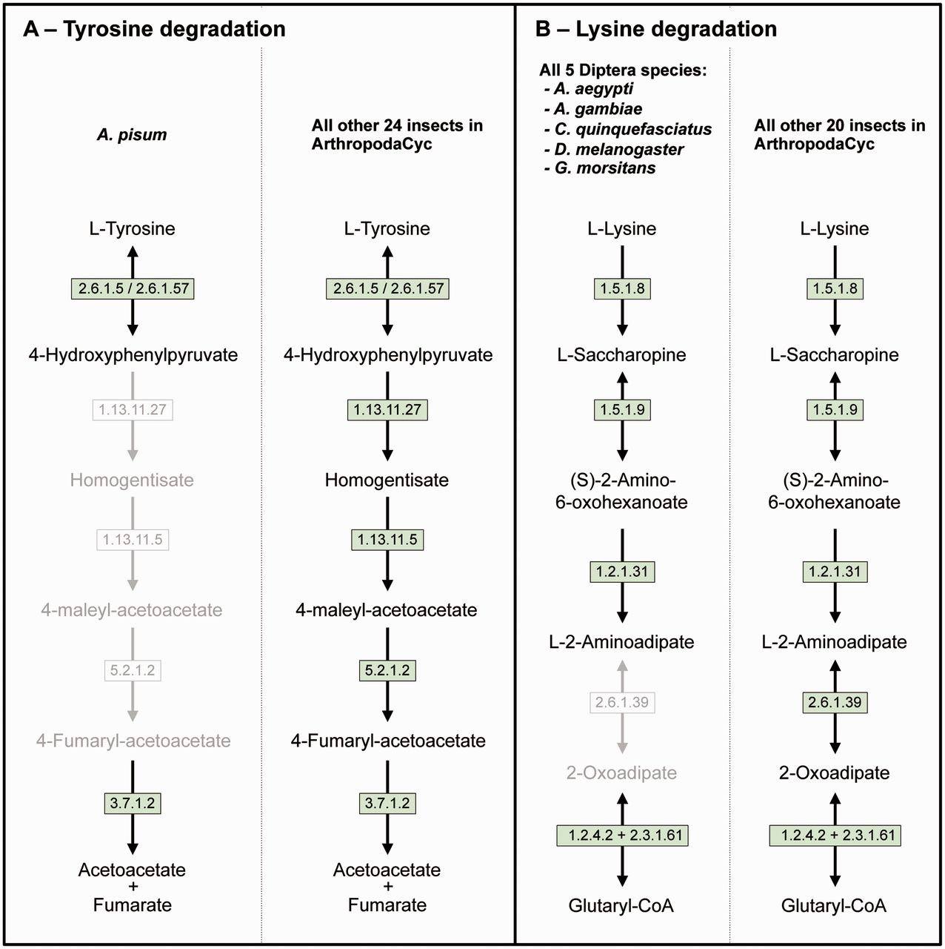
Figure 3. Two examples of insect pathway differences identified using ArthropodaCyc. (A) Pathway of tyrosine ...
Notes:
Figure 3. Two examples of insect pathway differences identified using ArthropodaCyc. (A) Pathway of tyrosine degradation, comparison between A. pisum and the other insects of ArthropodaCyc; (B) Pathway of lysine degradation, comparison between the five species of Diptera and the other insects of ArthropodaCyc. In each pathway, green coloured enzymes are present, while grey enzymes and reactions are absent. Enzymes: 1.13.11.5 = homogentisate 1,2-dioxygenase; 1.13.11.27 = 4-hydroxyphenylpyruvate dioxygenase; 1.2.1.31 = L-aminoadipate-semialdehyde dehydrogenase; 1.2.4.2 = oxoglutarate dehydrogenase (succinyl-transferring); 1.5.1.8 = saccharopine dehydrogenase (NADP+, L-lysine-forming); 1.5.1.9 = saccharopine dehydrogenase (NAD+, L-glutamate-forming); 2.3.1.61 = dihydrolipoyllysine-residue succinyltransferase; 2.6.1.5 = tyrosine transaminase; 2.6.1.39 = 2-aminoadipate transaminase; 2.6.1.57 = aromatic-amino-acid transaminase; 3.7.1.2 = fumarylacetoacetase; 5.2.1.2 = maleylacetoacetate isomerase.
Unless provided in the caption above, the following copyright applies to the content of this slide: © The Author(s) 2016. Published by Oxford University Press.This is an Open Access article distributed under the terms of the Creative Commons Attribution License (http://creativecommons.org/licenses/by/4.0/), which permits unrestricted reuse, distribution, and reproduction in any medium, provided the original work is properly cited.

