Slide 1
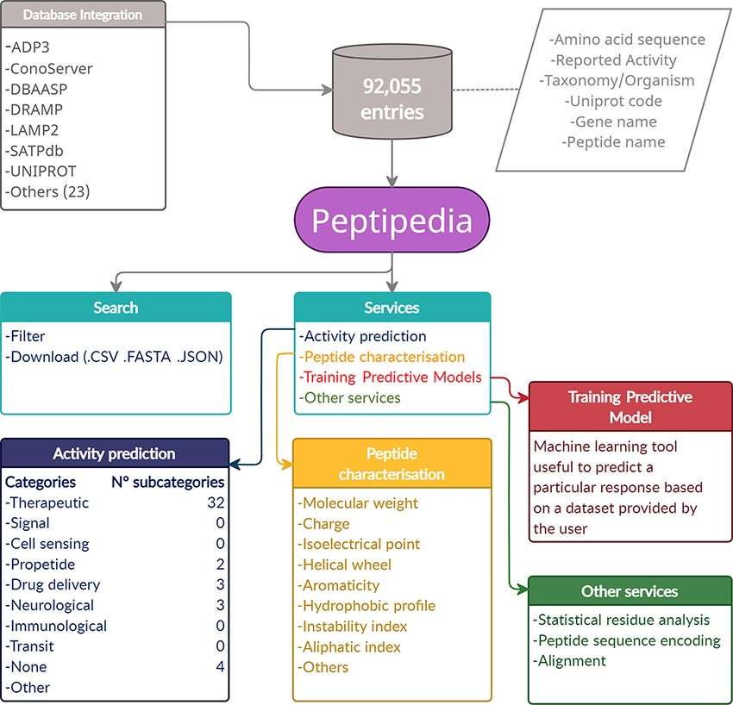
Figure 1. Representative scheme of building and characteristics of Peptipedia. Peptipedia is a computational tool for ...
Notes:
Figure 1. Representative scheme of building and characteristics of Peptipedia. Peptipedia is a computational tool for peptide sequence analysis. The information presented by our tool was consolidated from 30 databases, considering information on the sequence, taxonomy and different properties of stored peptides. Searching for sequences and relevant information in our web application is easy, personalized and intuitive, allowing download of the information in multiple formats. Peptipedia has enabled different tools that will help characterize and analyse sequences, as well as functionalities supported by machine learning methods that facilitate the development of predictive models and a biological activity predictor system.
Unless provided in the caption above, the following copyright applies to the content of this slide: © The Author(s) 2021. Published by Oxford University Press.This is an Open Access article distributed under the terms of the Creative Commons Attribution License (https://creativecommons.org/licenses/by/4.0/), which permits unrestricted reuse, distribution, and reproduction in any medium, provided the original work is properly cited.

