Slide 1
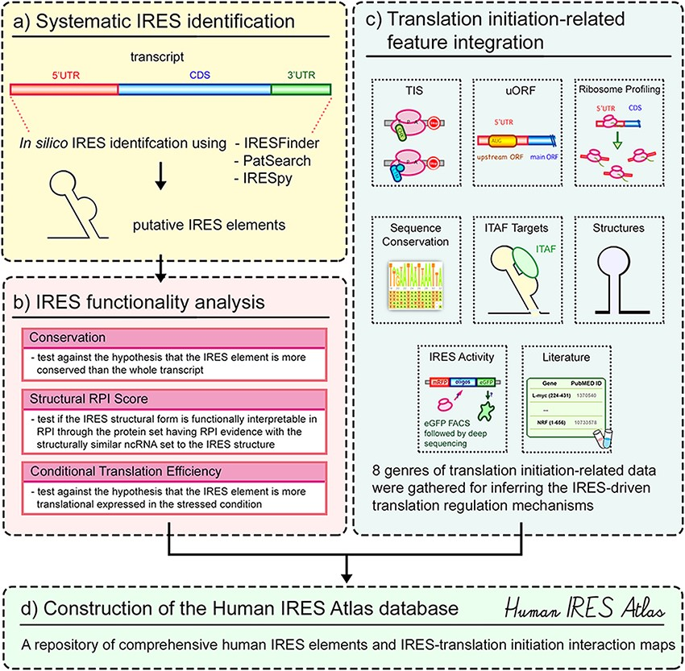
Figure 1. Overview of the Human IRES Atlas database.
Notes:
Figure 1. Overview of the Human IRES Atlas database. The construction of Human IRES Atlas can be divided into four different parts. First, the systematic transcriptome-wide IRES identification on all human transcripts was performed based on the evaluated screening tools (part a). The IRES functionality from sequence conservation, structural RPI score and conditional translation efficiency was then estimated for each identified putative IRES (part b). To further provide potential translational regulation information, eight types of datasets were collected and integrated into the repository to assist the deduction of IRES-mediated translational regulation mechanism hypotheses (part c). Finally, an easy-to-use query interface and a transcript detail page with translation initiation interaction maps were implemented to help biologists infer testable hypotheses for subsequent IRES-driven translation initiation research experiments (part d).
Unless provided in the caption above, the following copyright applies to the content of this slide: © The Author(s) 2021. Published by Oxford University Press.This is an Open Access article distributed under the terms of the Creative Commons Attribution License (http://creativecommons.org/licenses/by/4.0/), which permits unrestricted reuse, distribution, and reproduction in any medium, provided the original work is properly cited.

