Slide 1
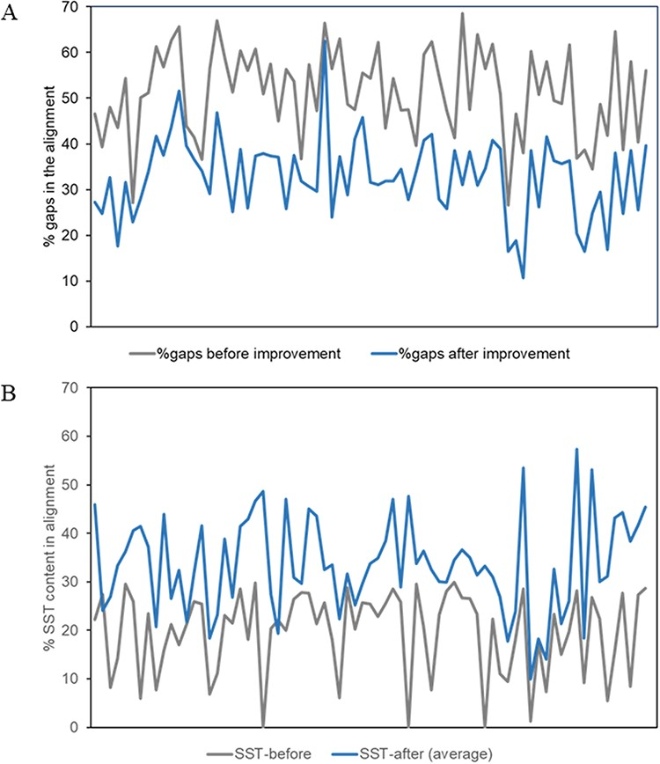
Figure 4. Plots of alignment statistics showing a decrease in the number of gaps in the alignment and an increase in ...
Notes:
Figure 4. Plots of alignment statistics showing a decrease in the number of gaps in the alignment and an increase in conserved secondary structural positions. (A) Percentage of gaps, averaged over members of a superfamily, in the alignment before and after the improvement of alignment. (B) Equivalent secondary structural positions (SST) in the alignment of about 80 superfamilies, before and after the improvement of alignment.
Unless provided in the caption above, the following copyright applies to the content of this slide: © The Author(s) 2022. Published by Oxford University Press.This is an Open Access article distributed under the terms of the Creative Commons Attribution License (https://creativecommons.org/licenses/by/4.0/), which permits unrestricted reuse, distribution, and reproduction in any medium, provided the original work is properly cited.

