Slide 1
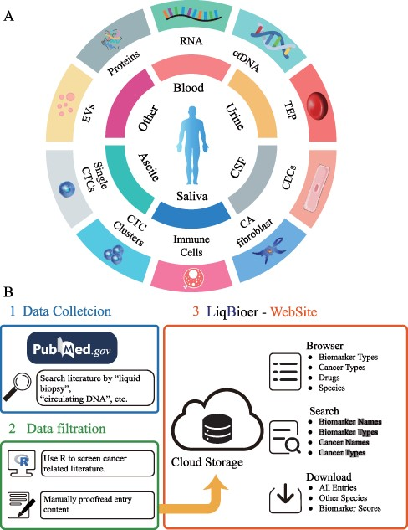
Figure 1. Construction of LiqBioer. (A) Biomarkers in body fluids, such as blood, urine, CSF, saliva and ascites. EVs, ...
Notes:
Figure 1. Construction of LiqBioer. (A) Biomarkers in body fluids, such as blood, urine, CSF, saliva and ascites. EVs, proteins, circulating cell-free RNA (non-coding and messenger RNA), ctDNA, TEPs, the tumor cell fraction with CTCs and the non-tumor cell fraction (immune cells, CECs or CA fibroblasts) can be detected in the different body fluids. CSF, cerebrospinal fluid; EV, extracellular vesicle; CA fibroblast, cancer-associated fibroblast; CEC, circulating endothelial cell; TEP, tumor-educated platelet. (B) Process of data collection, filtering and website structure. 1: Data collection. 2: Data filtration. 3: Structure of website.
Unless provided in the caption above, the following copyright applies to the content of this slide: © The Author(s) 2022. Published by Oxford University Press.This is an Open Access article distributed under the terms of the Creative Commons Attribution-NonCommercial License (https://creativecommons.org/licenses/by-nc/4.0/), which permits non-commercial re-use, distribution, and reproduction in any medium, provided the original work is properly cited. For commercial re-use, please contact journals.permissions@oup.com

