Slide 1
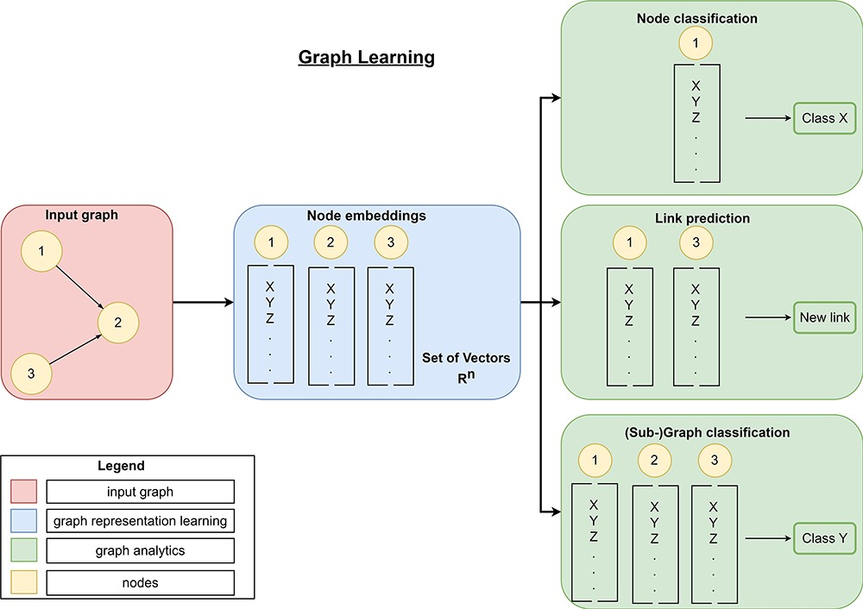
Figure 8. Overview of graph learning (machine learning on graphs). Graph learning can process a high-dimensional input ...
Notes:
Figure 8. Overview of graph learning (machine learning on graphs). Graph learning can process a high-dimensional input graph (red rectangle) using graph representation learning (blue rectangles) and graph analytics (green rectangles). Graph representation learning allows the generation of low-dimensional node embeddings using graph representation approaches (manual feature extraction, matrix-factorization-based, random-walk-based, or graph neural networks). These embeddings represent feature information and topological information about a node efficiently. Then, graph analytics use these low-dimensional embeddings for graph mining tasks like link prediction to predict new links, node classification to classify nodes or (sub-)graph classification to classify entire (sub-)graphs.
Unless provided in the caption above, the following copyright applies to the content of this slide: © The Author(s) 2024. Published by Oxford University Press.This is an Open Access article distributed under the terms of the Creative Commons Attribution License (https://creativecommons.org/licenses/by/4.0/), which permits unrestricted reuse, distribution, and reproduction in any medium, provided the original work is properly cited.

