Slide 1
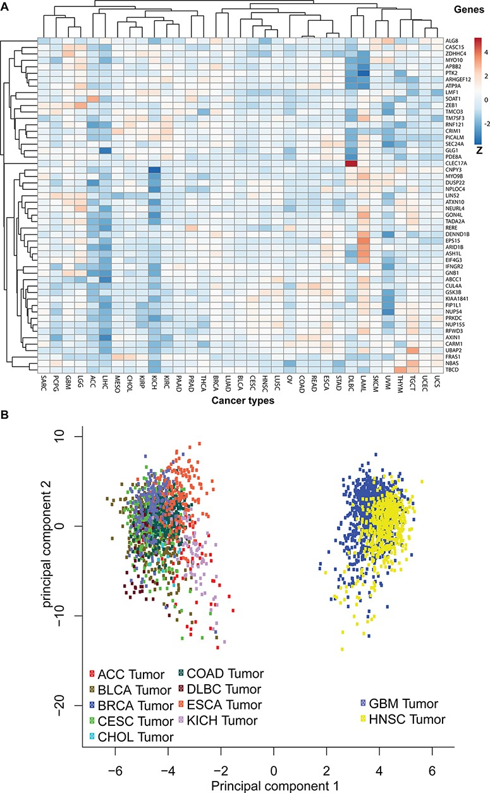
Figure 6. Pan-cancer expression pattern analyses. (A) The pan-cancer expression patterns for the 52 circRNA parental ...
Notes:
Figure 6. Pan-cancer expression pattern analyses. (A) The pan-cancer expression patterns for the 52 circRNA parental genes. Genes with similar expression patterns are clustered together. The Z-scores indicate higher or lower than average expressions in each category. (B) A principal component analysis based on pan-cancer expression profiles. The TCGA data sets are plotted in different colours: adrenocortical carcinoma (ACC), bladder urothelial carcinoma (BLCA), breast invasive carcinoma (BRCA), cervical squamous cell carcinoma and endocervical adenocarcinoma (CESC), cholangiocarcinoma (CHOL), colon adenocarcinoma (COAD), oesophageal carcinoma (ESCA), glioblastoma multiforme (GBM), head and neck squamous cell carcinoma (HNSC) and KICH.
Unless provided in the caption above, the following copyright applies to the content of this slide: © The Author(s) 2021. Published by Oxford University Press.This is an Open Access article distributed under the terms of the Creative Commons Attribution License (http://creativecommons.org/licenses/by/4.0/), which permits unrestricted reuse, distribution, and reproduction in any medium, provided the original work is properly cited.

