Slide 1
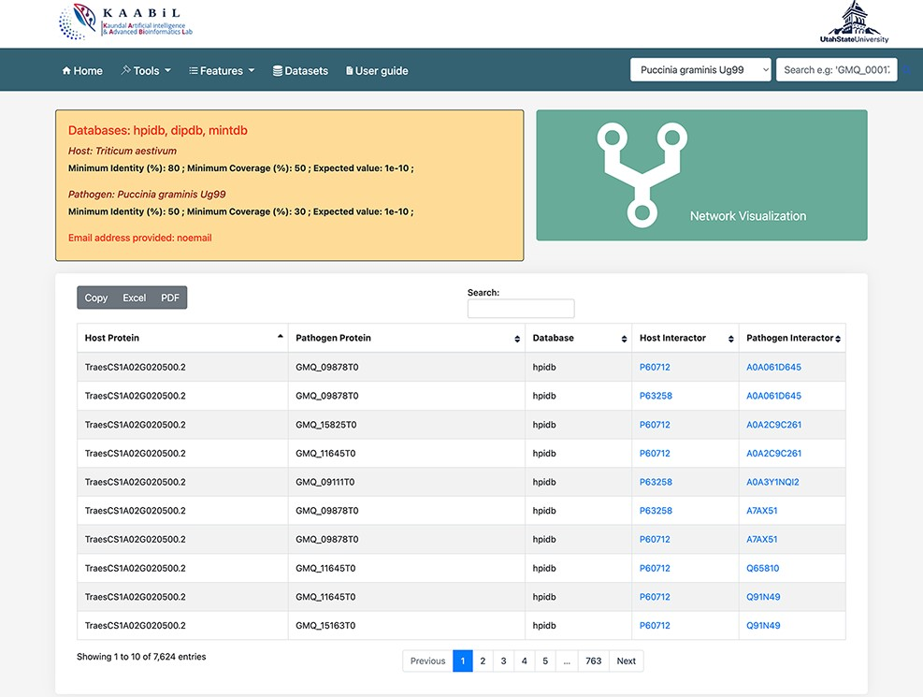
Figure 2. The ‘Table’ view of resulting host–pathogen interactions. The interologs of the corresponding host and ...
Notes:
Figure 2. The ‘Table’ view of resulting host–pathogen interactions. The interologs of the corresponding host and pathogen query proteins are also provided. Results can be downloaded in an Excel or PDF format or can be copied to the clipboard.
Unless provided in the caption above, the following copyright applies to the content of this slide: © The Author(s) 2022. Published by Oxford University Press.This is an Open Access article distributed under the terms of the Creative Commons Attribution License (https://creativecommons.org/licenses/by/4.0/), which permits unrestricted reuse, distribution, and reproduction in any medium, provided the original work is properly cited.

