Slide 1
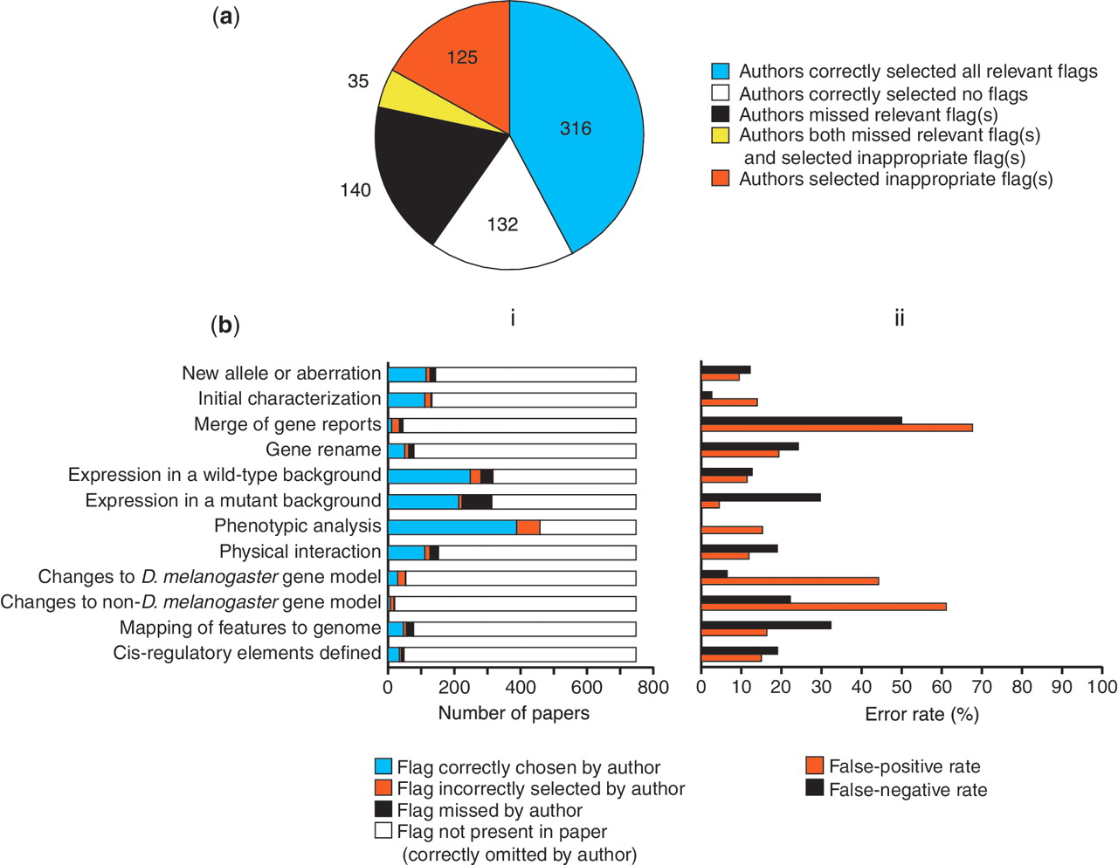
Figure 5. Accuracy of author-submitted data type flags. (a) Accuracy at the level of the whole paper. The number of ...
Notes:
Figure 5. Accuracy of author-submitted data type flags. (a) Accuracy at the level of the whole paper. The number of papers in each category is shown. (b) Accuracy on a flag-by-flag basis. (i) Frequency of occurrence and accuracy of selection of each data type flag. (ii) Error rates for selection of each data type flag.
Unless provided in the caption above, the following copyright applies to the content of this slide: © The Author(s) 2012. Published by Oxford University Press.This is an Open Access article distributed under the terms of the Creative Commons Attribution Non-Commercial License (http://creativecommons.org/licenses/by-nc/3.0), which permits unrestricted non-commercial use, distribution, and reproduction in any medium, provided the original work is properly cited.

