Slide 1
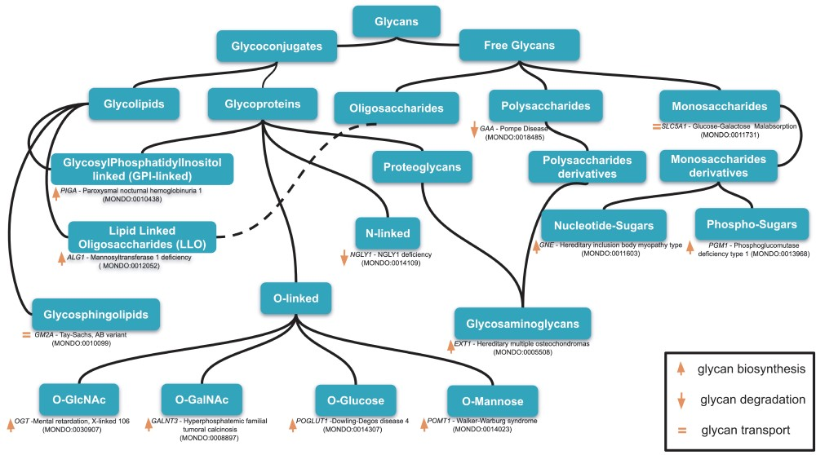
Figure 1 An example of classification of relevant glycans involved in human diseases based on the essential of ...
Notes:
Figure 1 An example of classification of relevant glycans involved in human diseases based on the essential of glycobiology and CHEBI ontology. Glycans can be free or conjugated to macromolecules (protein, lipids). Free glycans can be monosaccharides (n = 1), oligosaccharides (2 < n 10), and their derivatives (e.g. acetylated, sulfated) 13 exemplary diseases names along with the mutated genes and MONDO ID (in parentheses) are indicated for 13 classes of glycans. Up, down orange arrows and orange equal signs indicate, respectively, the involvement of the gene products in glycan biosynthesis, degradation or transport. Based on our disease curation, there are 176 glycan-related diseases (CDG and diseases in which glycophenotypes are detectable, see online supplementary material for Table S1).
Unless provided in the caption above, the following copyright applies to the content of this slide: © The Author(s) 2019. Published by Oxford University Press.This is an Open Access article distributed under the terms of the Creative Commons Attribution License (http://creativecommons.org/licenses/by/4.0/), which permits unrestricted reuse, distribution, and reproduction in any medium, provided the original work is properly cited.

