Slide 1
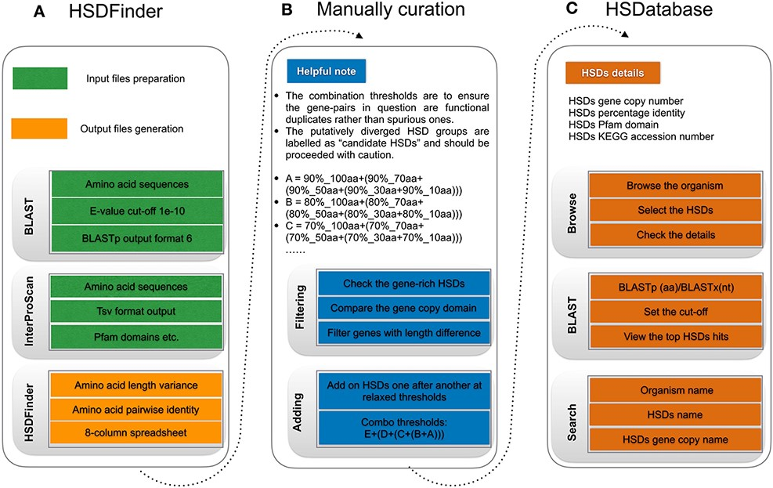
Figure 2. The workflow of HSDatabase. (A) Steps for using HSDFinder to collect candidate HSDs. (B) Manual curation of ...
Notes:
Figure 2. The workflow of HSDatabase. (A) Steps for using HSDFinder to collect candidate HSDs. (B) Manual curation of HSDs via filtering and adding new HSD candidates prior to being deposited into HSDatabase. (C) Steps of accessing HSD data in HSDatabase, including browsing via organism name, blasting query sequences against the database and searching through the HSD and gene copy IDs.
Unless provided in the caption above, the following copyright applies to the content of this slide: © The Author(s) 2022. Published by Oxford University Press.This is an Open Access article distributed under the terms of the Creative Commons Attribution-NonCommercial License (https://creativecommons.org/licenses/by-nc/4.0/), which permits non-commercial re-use, distribution, and reproduction in any medium, provided the original work is properly cited. For commercial re-use, please contact journals.permissions@oup.com

