Slide 1
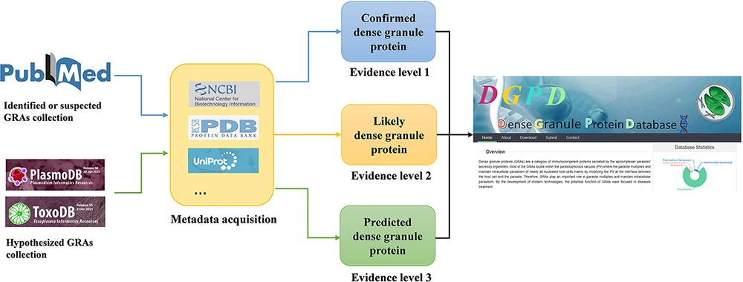
Figure 1. Workflow for data curation in DGPD database. Experimentally validated GRAs are classified as the group of ...
Notes:
Figure 1. Workflow for data curation in DGPD database. Experimentally validated GRAs are classified as the group of ‘confirmed GRAs’ (with blue arrows). Highly suspected GRAs existing in the main text or attachment of literature are included in the group of ‘likely GRAs’ (with orange arrows). Homologous proteins of known dense granule proteins in PlasmoDB and ToxoDB database are included in the group of ‘predicted GRAs’ (with green arrows).
Unless provided in the caption above, the following copyright applies to the content of this slide: © The Author(s) 2022. Published by Oxford University Press.This is an Open Access article distributed under the terms of the Creative Commons Attribution-NonCommercial License (https://creativecommons.org/licenses/by-nc/4.0/), which permits non-commercial re-use, distribution, and reproduction in any medium, provided the original work is properly cited. For commercial re-use, please contact journals.permissions@oup.com

Slide 2
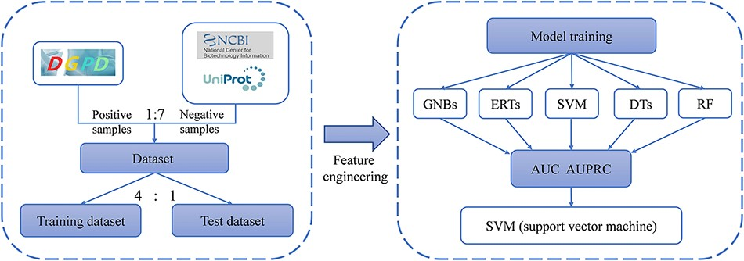
Figure 2. The workflow of prediction models for identifying GRAs.
Notes:
Figure 2. The workflow of prediction models for identifying GRAs.
Unless provided in the caption above, the following copyright applies to the content of this slide: © The Author(s) 2022. Published by Oxford University Press.This is an Open Access article distributed under the terms of the Creative Commons Attribution-NonCommercial License (https://creativecommons.org/licenses/by-nc/4.0/), which permits non-commercial re-use, distribution, and reproduction in any medium, provided the original work is properly cited. For commercial re-use, please contact journals.permissions@oup.com

Slide 3
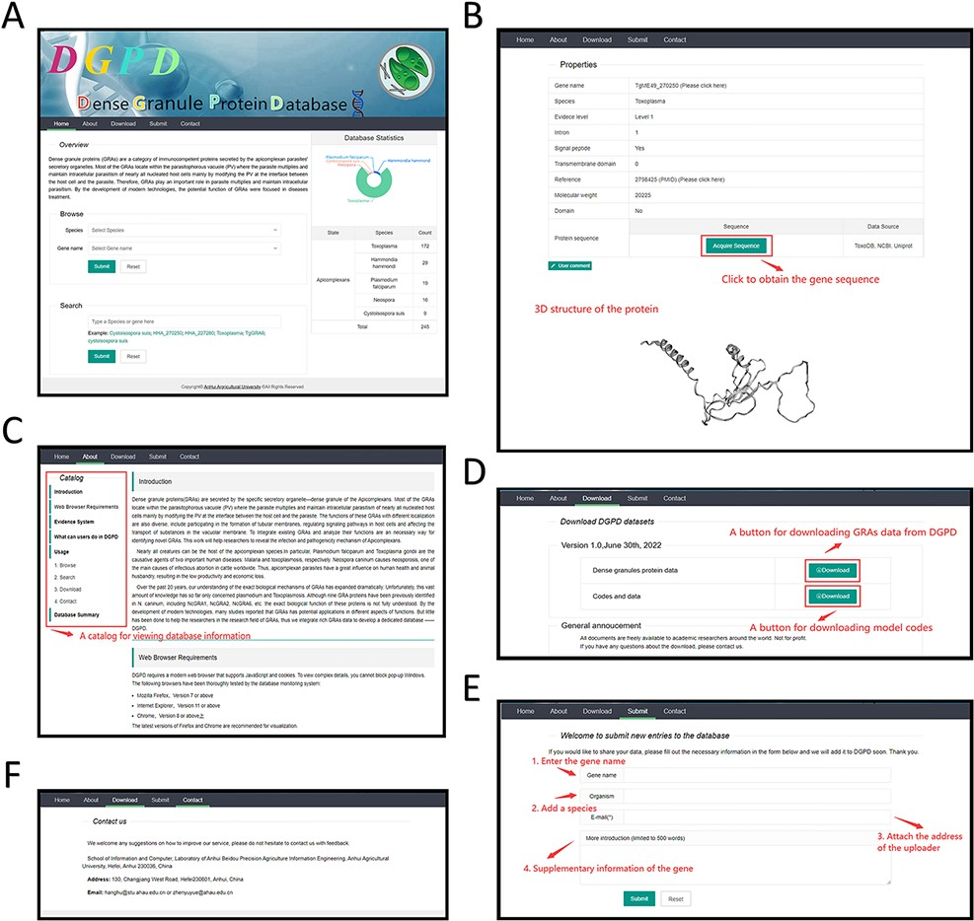
Figure 3. A web-interface of DGPD database. (A) Panel of GRA repository. A statistics visualization is displayed on the ...
Notes:
Figure 3. A web-interface of DGPD database. (A) Panel of GRA repository. A statistics visualization is displayed on the right. The gene information can be viewed by submitting keywords in search bar. (B) Panel of gene information. Detailed information of gene that users search is visualized on this panel. (C) Panel of database introduction and help. Users will receive help and brief introduction for database functions. The catalog is displayed on the top left. (D) Download panel. All data are available through this panel. (E) Data submission panel. The novel GRAs information is allowed to submit in this panel. (F) Contact panel. The different contact ways is provided for user to communicate with us.
Unless provided in the caption above, the following copyright applies to the content of this slide: © The Author(s) 2022. Published by Oxford University Press.This is an Open Access article distributed under the terms of the Creative Commons Attribution-NonCommercial License (https://creativecommons.org/licenses/by-nc/4.0/), which permits non-commercial re-use, distribution, and reproduction in any medium, provided the original work is properly cited. For commercial re-use, please contact journals.permissions@oup.com

Slide 4
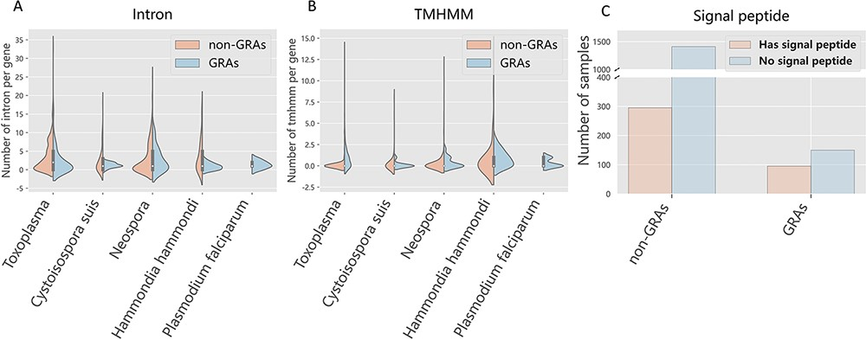
Figure 4. Feature analysis between positive and negative samples across species. Orange and blue represent GRAs and ...
Notes:
Figure 4. Feature analysis between positive and negative samples across species. Orange and blue represent GRAs and non-GRAs, respectively.
Unless provided in the caption above, the following copyright applies to the content of this slide: © The Author(s) 2022. Published by Oxford University Press.This is an Open Access article distributed under the terms of the Creative Commons Attribution-NonCommercial License (https://creativecommons.org/licenses/by-nc/4.0/), which permits non-commercial re-use, distribution, and reproduction in any medium, provided the original work is properly cited. For commercial re-use, please contact journals.permissions@oup.com

Slide 5
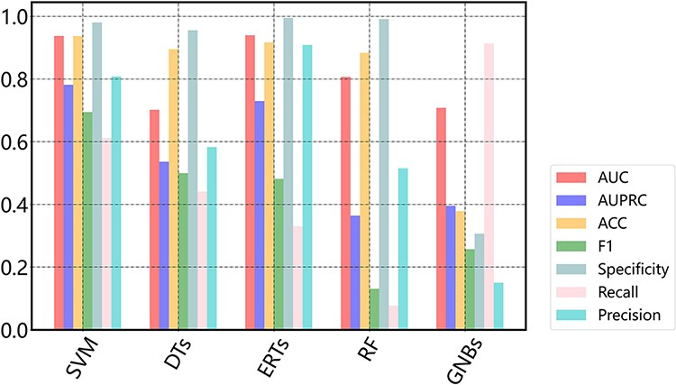
Figure 5. Performance of different machine learning-based models.
Notes:
Figure 5. Performance of different machine learning-based models.
Unless provided in the caption above, the following copyright applies to the content of this slide: © The Author(s) 2022. Published by Oxford University Press.This is an Open Access article distributed under the terms of the Creative Commons Attribution-NonCommercial License (https://creativecommons.org/licenses/by-nc/4.0/), which permits non-commercial re-use, distribution, and reproduction in any medium, provided the original work is properly cited. For commercial re-use, please contact journals.permissions@oup.com

