Slide 1
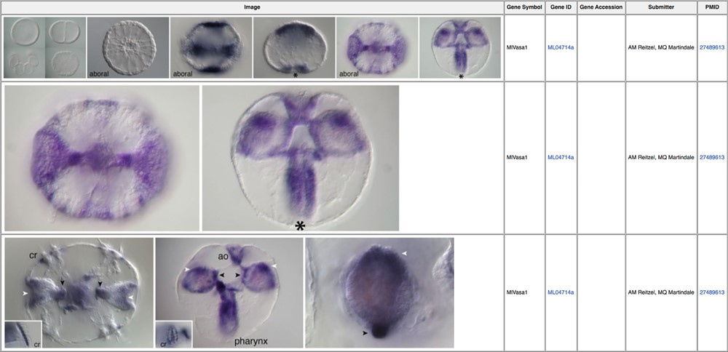
Figure 2 In situ images illustrating expression patterns for the germ cell marker vasa (MGP gene identifier ML04714a) ...
Notes:
Figure 2 In situ images illustrating expression patterns for the germ cell marker vasa (MGP gene identifier ML04714a) during early Mnemiopsis development (39). Linked PubMed identifiers in the right-most column bring the user to the PubMed manuscript entry in which these results were originally reported.
Unless provided in the caption above, the following copyright applies to the content of this slide: Published by Oxford University Press 2020.This work is written by US Government employees and is in the public domain in the US.

