Slide 1
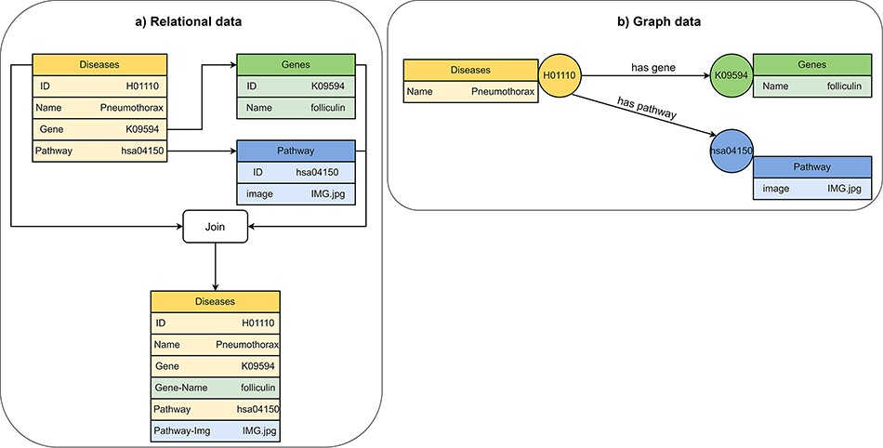
Figure 5. Visualization of (A) relational data and (B) graph data of disease, gene and pathway entities in KEGG (201). ...
Notes:
Figure 5. Visualization of (A) relational data and (B) graph data of disease, gene and pathway entities in KEGG (201). A disease references to a pathway entity and to a gene entity. For receiving information from multiple tables in a relational database, we must perform join operations on the tables. In a graph database, we traverse edges to receive information from multiple nodes.
Unless provided in the caption above, the following copyright applies to the content of this slide: © The Author(s) 2024. Published by Oxford University Press.This is an Open Access article distributed under the terms of the Creative Commons Attribution License (https://creativecommons.org/licenses/by/4.0/), which permits unrestricted reuse, distribution, and reproduction in any medium, provided the original work is properly cited.

