Slide 1
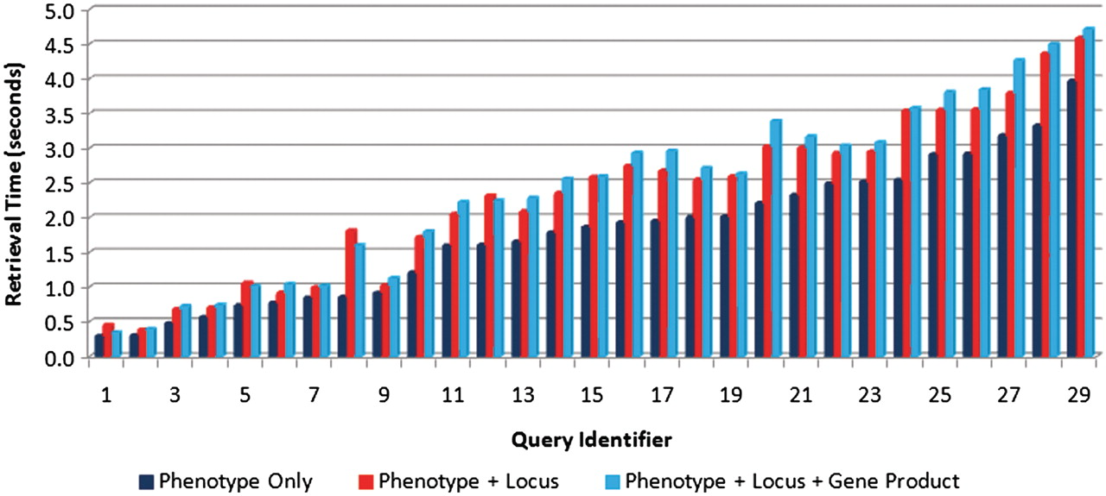
Figure 9. Comparison of retrieval speeds for each of the test queries (see Table 4 for the link between query ...
Notes:
Figure 9. Comparison of retrieval speeds for each of the test queries (see Table 4 for the link between query identifier and query text) executed on one text source (phenotype captions only) (right bars), two sources (phenotype caption + locus descriptions) (middle bars) and three sources (left bars). There is a slight increase in execution as the number of sources increases.
Unless provided in the caption above, the following copyright applies to the content of this slide: © The Author(s) 2011. Published by Oxford University Press.This is Open Access article distributed under the terms of the Creative Commons Attribution Non-Commercial License (http://creativecommons.org/licenses/by-nc/2.5), which permits unrestricted non-commercial use, distribution, and reproduction in any medium, provided the original work is properly cited.

