Slide 1
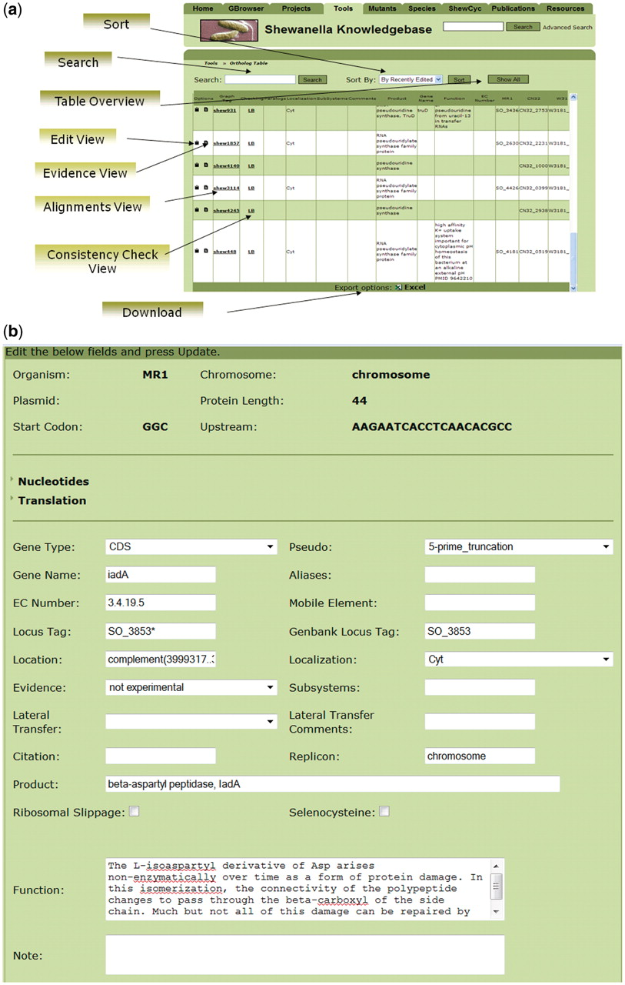
Figure 1. Interplay between the ortholog and genomes editors in SKB (a) and the interface for curation of the ...
Notes:
Figure 1. Interplay between the ortholog and genomes editors in SKB (a) and the interface for curation of the Shewanella orthologous table (b). The interface provides access to different types of product annotations, to sequence alignments and to results of the automatic checking of the consistency on protein length and protein families across products of the orthologous group.
Unless provided in the caption above, the following copyright applies to the content of this slide: © The Author(s) 2010. Published by Oxford University Press.This is Open Access article distributed under the terms of the Creative Commons Attribution Non-Commercial License (http://creativecommons.org/licenses/by-nc/2.5), which permits unrestricted non-commercial use, distribution, and reproduction in any medium, provided the original work is properly cited.

Slide 2
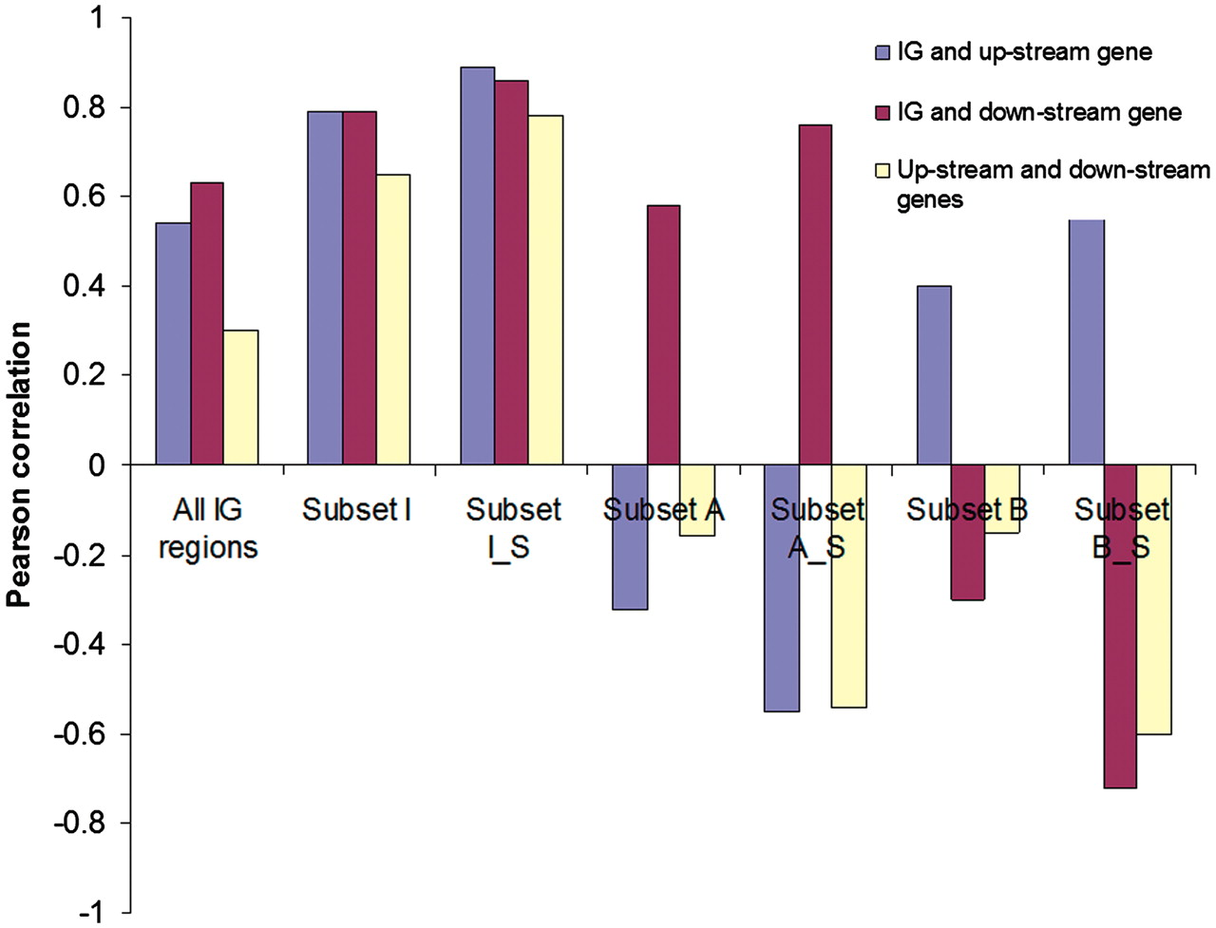
Figure 2. Pearson correlations of changes in the expression [log (2) ratio of the average expression level in Crp(−) ...
Notes:
Figure 2. Pearson correlations of changes in the expression [log (2) ratio of the average expression level in Crp(−) mutant versus wild-type strain] of IG regions with changes in the expression of upstream and downstream genes. The analyzed data sets are provided in the Supplementary Data 3. Subset I (1466): IG regions with the same direction of change in gene expression as their neighboring genes. Subset I_S (449): A selection of IG regions from Subset I with significant changes in gene expression in the IG regions and in the neighboring genes. Subset A (805): IG regions with directions of changes in gene expression that are opposite to upstream genes. Subset A_S (54): A selection of IG regions from Subset A with significant changes in gene expression in the IG regions and in the neighboring genes. Subset B (820): IG regions with directions of changes in gene expression that are opposite to downstream genes. Subset B_S (48): A selection of IG regions from Subset B with significant changes in gene expression in the IG regions and in the neighboring genes.
Unless provided in the caption above, the following copyright applies to the content of this slide: © The Author(s) 2010. Published by Oxford University Press.This is Open Access article distributed under the terms of the Creative Commons Attribution Non-Commercial License (http://creativecommons.org/licenses/by-nc/2.5), which permits unrestricted non-commercial use, distribution, and reproduction in any medium, provided the original work is properly cited.

Slide 3
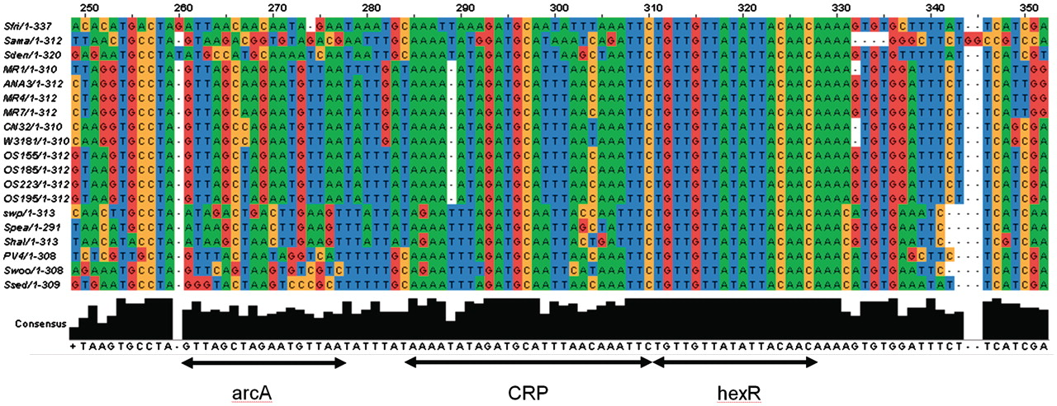
Figure 5. The alignment of a conserved regulatory locus in the Shewanella genomes in the intergenic region between hexR ...
Notes:
Figure 5. The alignment of a conserved regulatory locus in the Shewanella genomes in the intergenic region between hexR and zwf genes. The locus is located from −56 to −103 nc upstream of zwf and has three adjacent binding sites for ArcA, HexR and Crp, respectively. The Crp binding site (TAAAAATAGATGCATTTAACAAATTC) was extracted from ShewRegDB. It was predicted by TractorDB (24). The HexR binding site is identified by similarity to HexR binding site consensus in Pseudomonas species (60, 61). The HexR binding site in Shewanella perfectly matches the Pseudomonas aeruginosa binding site (TGTTGTttaattACtACA) with the same location (−71 nt 5′ of the transcriptional start site of zwf (59). Binding of HexR to this binding site in P. aeruginosa was experimentally confirmed by gel shift assays. The HexR binding site in Shewanella has a perfect consensus TGTTGTTATATTACAACA across the species. The alignment also indicates that in Shewanella spp. the HexR binding site overlaps the Crp binding site. Thus, in some growth conditions, the ED pathway may be activated by Crp, but HexR binding to the site can prevent the pathway activation. In the Crp(−) mutant, hexR is downregulated and releases the ED operon for activation by other transcription factors, like ArcA, for example. One of the binding sites for the two-component response regulator ArcA is demonstrated with the consensus (5′-GTTAgctagAATGTTA-3′).
Unless provided in the caption above, the following copyright applies to the content of this slide: © The Author(s) 2010. Published by Oxford University Press.This is Open Access article distributed under the terms of the Creative Commons Attribution Non-Commercial License (http://creativecommons.org/licenses/by-nc/2.5), which permits unrestricted non-commercial use, distribution, and reproduction in any medium, provided the original work is properly cited.

Slide 4
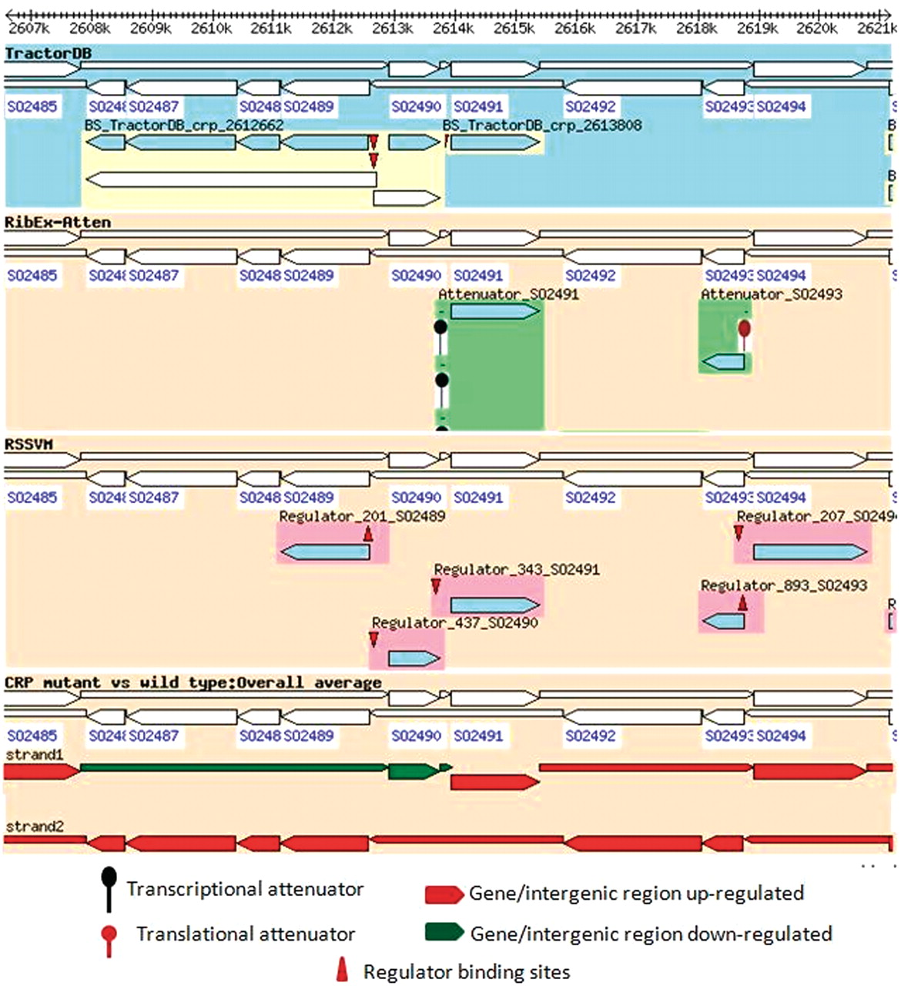
Figure 4. Regulation of pykA, hexR and enzymes of the ED pathway in MR1 and overlay of the regulatory information with ...
Notes:
Figure 4. Regulation of pykA, hexR and enzymes of the ED pathway in MR1 and overlay of the regulatory information with the experimental data. The figure indicates that enzymes of the ED pathway (SO2486_ SO2489) as well as pykA are significantly upregulated in the Crp(−) mutant, but hexR and the intergenic region between hexR and pykA are downregulated. The regulatory information provided in the first track of the browser (TractorDB) gives an explanation for the observed changes in the gene expressions. It indicates that the genes, hexR and pykA and the operon with the enzymes of the ED pathway have binding sites in their promoters predicted by TractorDB. Thus, both genes and the operon are likely regulated by Crp. In the wild-type strain of MR1, the ED pathway is not active because of upregulation of hexR by Crp during the transition from aerobic to anaerobic conditions. The Crp(−) mutant strain does not produce Crp; therefore, the transcriptional repressor HexR is absent in the mutant, and enzymes of the ED pathway, which were suppressed by HexR in the wild-type strain, are upregulated in the Crp(−) strain.
Unless provided in the caption above, the following copyright applies to the content of this slide: © The Author(s) 2010. Published by Oxford University Press.This is Open Access article distributed under the terms of the Creative Commons Attribution Non-Commercial License (http://creativecommons.org/licenses/by-nc/2.5), which permits unrestricted non-commercial use, distribution, and reproduction in any medium, provided the original work is properly cited.

Slide 5
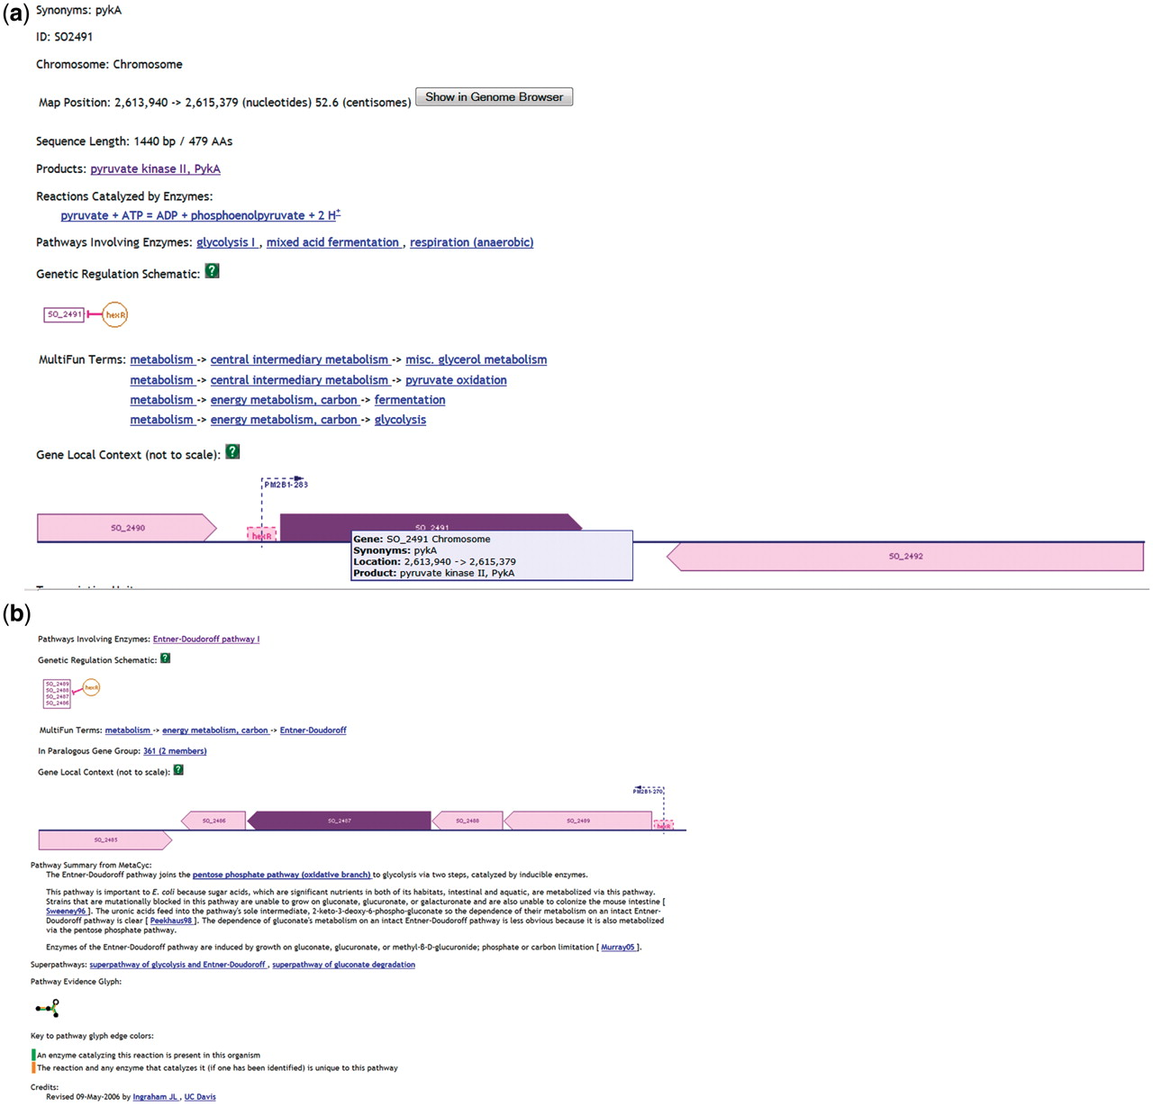
Figure 3. Information from ShewCyc on PykA (a) and HexR (b) in the MR1 pathway genome database.
Notes:
Figure 3. Information from ShewCyc on PykA (a) and HexR (b) in the MR1 pathway genome database.
Unless provided in the caption above, the following copyright applies to the content of this slide: © The Author(s) 2010. Published by Oxford University Press.This is Open Access article distributed under the terms of the Creative Commons Attribution Non-Commercial License (http://creativecommons.org/licenses/by-nc/2.5), which permits unrestricted non-commercial use, distribution, and reproduction in any medium, provided the original work is properly cited.

