Slide 1
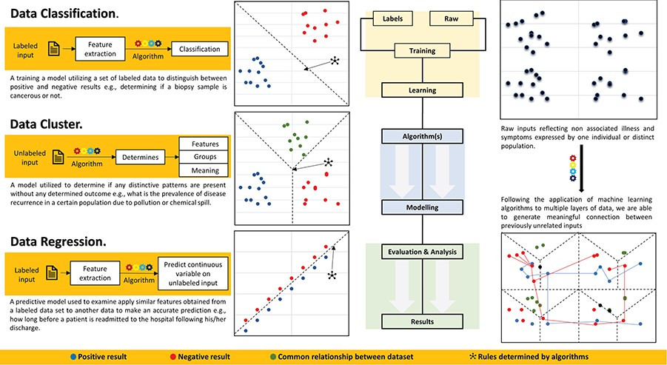
Figure 2 Data classification, clustering and regression for healthcare data analytics. ML application process includes ...
Notes:
Figure 2 Data classification, clustering and regression for healthcare data analytics. ML application process includes creating and labeling of raw data, training classifier for data modeling using appropriate algorithm and analyzing and reporting results.
Unless provided in the caption above, the following copyright applies to the content of this slide: © The Author(s) 2020. Published by Oxford University Press.This is an Open Access article distributed under the terms of the Creative Commons Attribution License (http://creativecommons.org/licenses/by/4.0/), which permits unrestricted reuse, distribution, and reproduction in any medium, provided the original work is properly cited.

