Slide 1
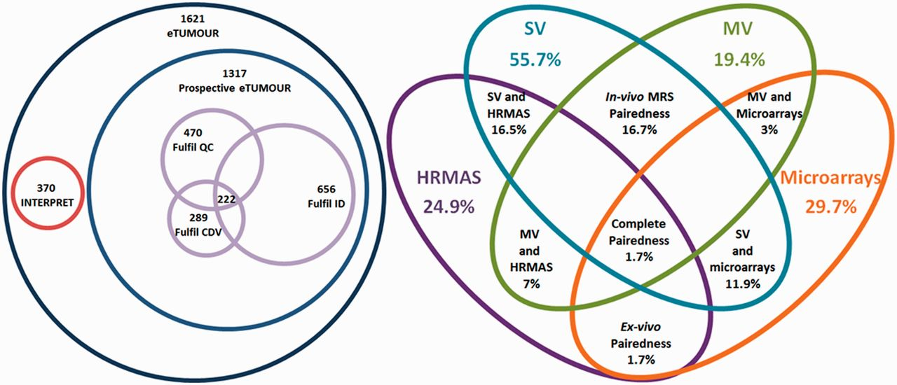
Figure 9 Venn diagrams of the main metrics defined. Left: number of cases by origin (INTERPRET or prospective eT), ...
Notes:
Figure 9 Venn diagrams of the main metrics defined. Left: number of cases by origin (INTERPRET or prospective eT), with numbers fulfilling the QC, the CDV and the ID and the intersection of all three. Size of Venn diagrams is proportional to the number of cases. Right: different pairedness values (intersections), with completeness for each data type. Values are expressed in percentage of cases from the total 1621. Size of Venn diagrams is not proportional to percentages.
Unless provided in the caption above, the following copyright applies to the content of this slide: © The Author(s) 2012. Published by Oxford University Press.This is an Open Access article distributed under the terms of the Creative Commons Attribution License (http://creativecommons.org/licenses/by-nc/3.0/), which permits non-commercial reuse, distribution, and reproduction in any medium, provided the original work is properly cited. For commercial re-use, please contact journals.permissions@oup.com.

