Slide 1
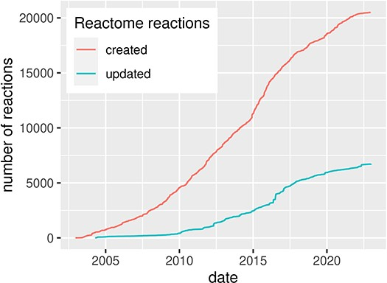
Figure 1. Evolution of the Reactome pathway database, illustrated by the number of created and updated reactions over ...
Notes:
Figure 1. Evolution of the Reactome pathway database, illustrated by the number of created and updated reactions over time, for human pathways. Source: reactome.org (4).
Unless provided in the caption above, the following copyright applies to the content of this slide: © The Author(s) 2024. Published by Oxford University Press.This is an Open Access article distributed under the terms of the Creative Commons Attribution License (https://creativecommons.org/licenses/by/4.0/), which permits unrestricted reuse, distribution, and reproduction in any medium, provided the original work is properly cited.

