Slide 1
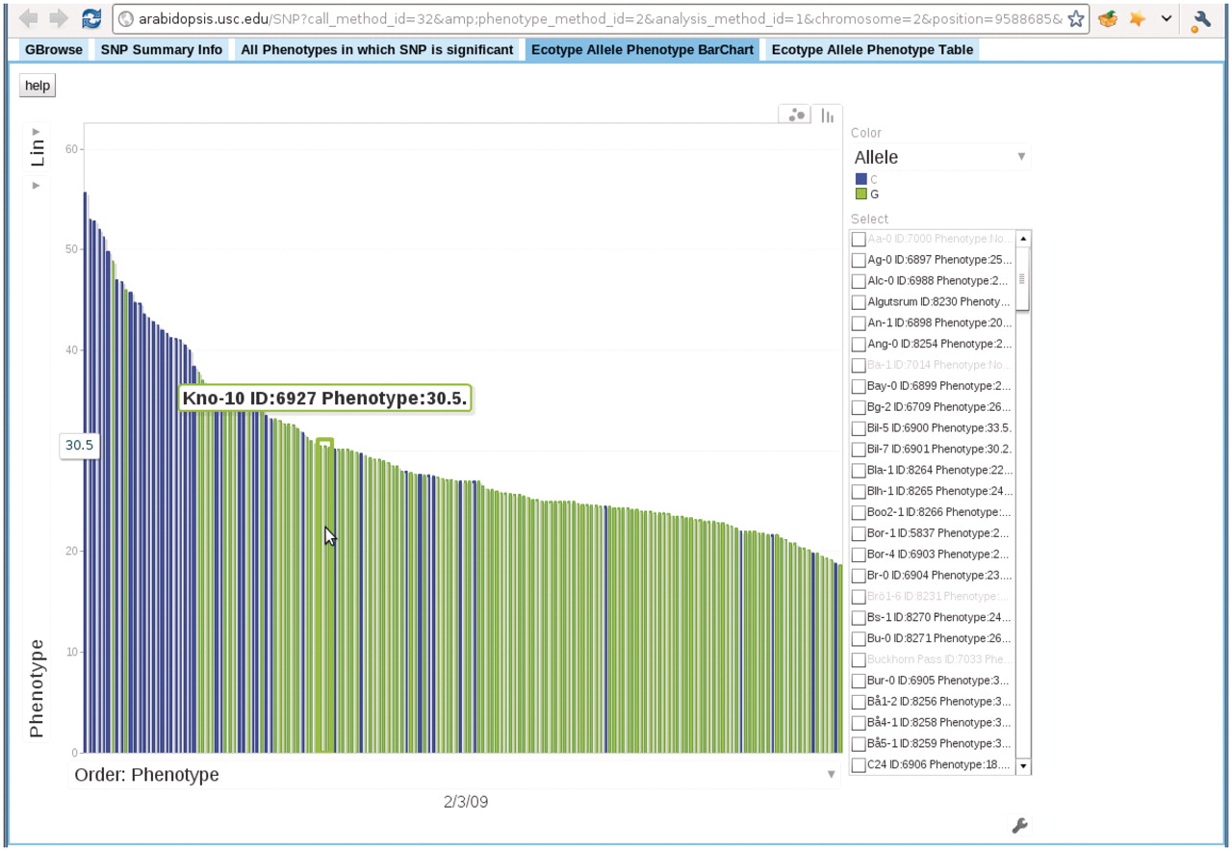
Figure 12. Bar chart depicting the correspondence between accession allele and phenotype. In this bar chart, each bar ...
Notes:
Figure 12. Bar chart depicting the correspondence between accession allele and phenotype. In this bar chart, each bar represents an accession and is colored according to the allele the accession carries. The height of each bar corresponds to the phenotype of the accession. All accessions are sorted horizontally according to their phenotype. Mouse-over each bar displays the information of that accession. This example is from the ‘Ecotype Allele Phenotype Barchart’ tab of http://arabidopsis.gmi.oeaw.ac.at:5000/SNP/?call_method_id=32&amp;phenotype_method_id=2&analysis_method_id=1&chromosome=2&position=9588685&score=10.1255444864.
Unless provided in the caption above, the following copyright applies to the content of this slide: © The Author(s) 2011. Published by Oxford University Press.This is Open Access article distributed under the terms of the Creative Commons Attribution Non-Commercial License (http://creativecommons.org/licenses/by-nc/2.5), which permits unrestricted non-commercial use, distribution, and reproduction in any medium, provided the original work is properly cited.

