Slide 1
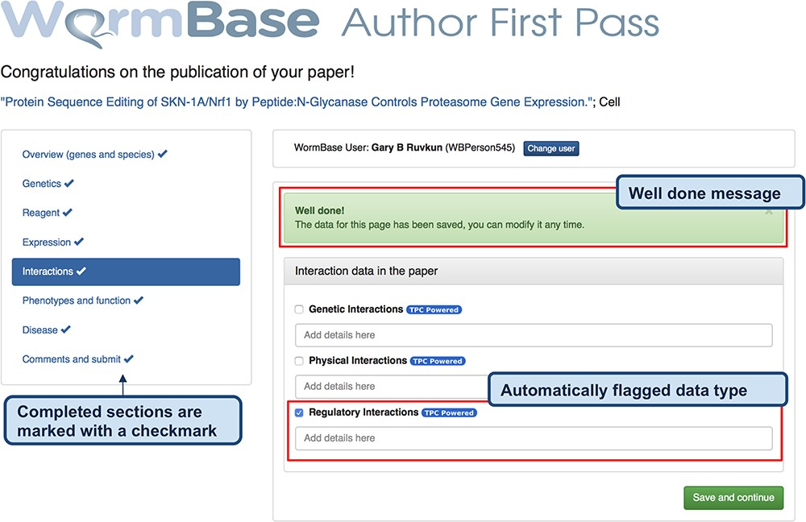
Figure 3 Feedback form for authors - completed form. When the author clicks ‘Save and continue’ (or ‘Finish and ...
Notes:
Figure 3 Feedback form for authors - completed form. When the author clicks ‘Save and continue’ (or ‘Finish and submit’ on the last widget), a pop-up message notifies that the data have been received by WB and the instruction alert turns green. The form returns a ‘Well done!’ message upon the completion of each section and the data are immediately stored in the WB database. In addition, to track the progress throughout the author curation process, completed sections are marked on the left menu with a special icon. The authors can modify the submitted data any time by returning to the form. The figure also shows an example of automatically classified data types, in this case regulatory interactions.
Unless provided in the caption above, the following copyright applies to the content of this slide: © The Author(s) 2020. Published by Oxford University Press.This is an Open Access article distributed under the terms of the Creative Commons Attribution License (http://creativecommons.org/licenses/by/4.0/), which permits unrestricted reuse, distribution, and reproduction in any medium, provided the original work is properly cited.

