Slide 1
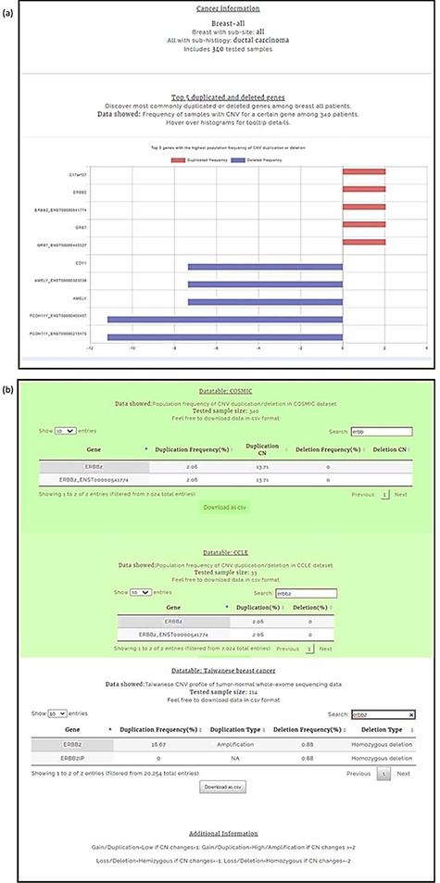
Figure 5. Breast carcinoma profile from the four-level hierarchy query system (a) Top five genes with the highest ...
Notes:
Figure 5. Breast carcinoma profile from the four-level hierarchy query system (a) Top five genes with the highest population frequency of CNV duplication or deletion. (b) Population frequency of CNV duplication/deletion in the CCLE, COSMIC and TWBC datasets.
Unless provided in the caption above, the following copyright applies to the content of this slide: © The Author(s) 2021. Published by Oxford University Press.This is an Open Access article distributed under the terms of the Creative Commons Attribution License (http://creativecommons.org/licenses/by/4.0/), which permits unrestricted reuse, distribution, and reproduction in any medium, provided the original work is properly cited.

