Slide 1
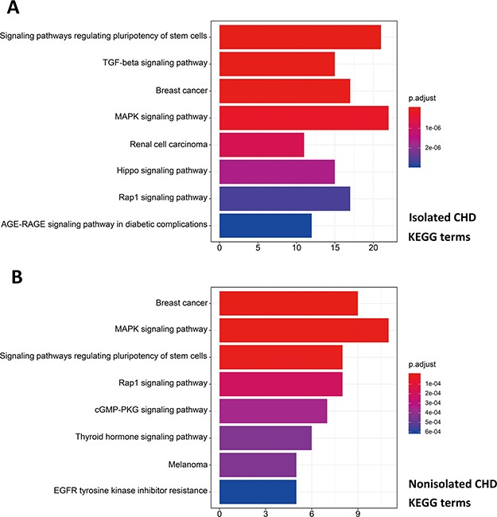
Figure 8 Pathway enrichment analysis for genetic variations of NS-CHD. The statistical significance level (p.adjust, ...
Notes:
Figure 8 Pathway enrichment analysis for genetic variations of NS-CHD. The statistical significance level (p.adjust, adjusted P-value) was depicted as different color. (Figure 8A, the top eight significant KEGG terms for isolated CHD; Figure 8B, the top eight significant KEGG terms for non-isolated CHD. X-axis indicated number of enriched genes; Y-axis indicated enriched pathways.)
Unless provided in the caption above, the following copyright applies to the content of this slide: © The Author(s) 2020. Published by Oxford University Press.This is an Open Access article distributed under the terms of the Creative Commons Attribution License (http://creativecommons.org/licenses/by/4.0/), which permits unrestricted reuse, distribution, and reproduction in any medium, provided the original work is properly cited.

