Slide 1
Figure 1. Schematic workflow of LBD construction.
Notes:
Figure 1. Schematic workflow of LBD construction.
Unless provided in the caption above, the following copyright applies to the content of this slide: © The Author(s) 2022. Published by Oxford University Press.This is an Open Access article distributed under the terms of the Creative Commons Attribution-NonCommercial License (https://creativecommons.org/licenses/by-nc/4.0/), which permits non-commercial re-use, distribution, and reproduction in any medium, provided the original work is properly cited. For commercial re-use, please contact journals.permissions@oup.com

Slide 2
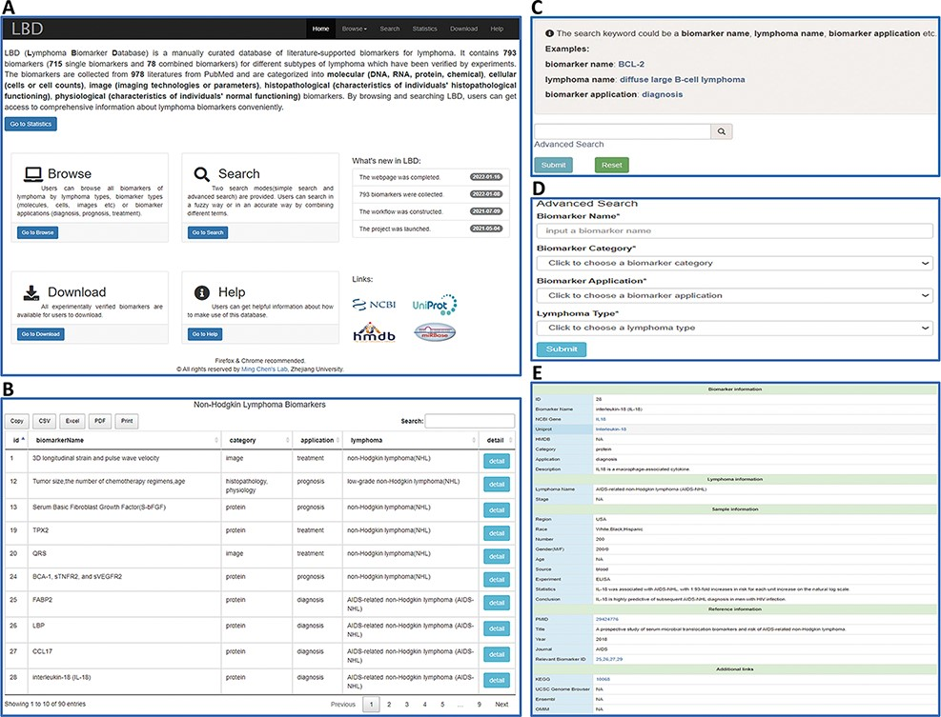
Figure 2. An overview of the web interface of LBD. (A) LBD homepage. (B) Browse the page of non-Hodgkin lymphoma ...
Notes:
Figure 2. An overview of the web interface of LBD. (A) LBD homepage. (B) Browse the page of non-Hodgkin lymphoma biomarkers. (C) Keyword search page. (D) Advanced search page. (E) Detailed page of IL-18.
Unless provided in the caption above, the following copyright applies to the content of this slide: © The Author(s) 2022. Published by Oxford University Press.This is an Open Access article distributed under the terms of the Creative Commons Attribution-NonCommercial License (https://creativecommons.org/licenses/by-nc/4.0/), which permits non-commercial re-use, distribution, and reproduction in any medium, provided the original work is properly cited. For commercial re-use, please contact journals.permissions@oup.com

Slide 3
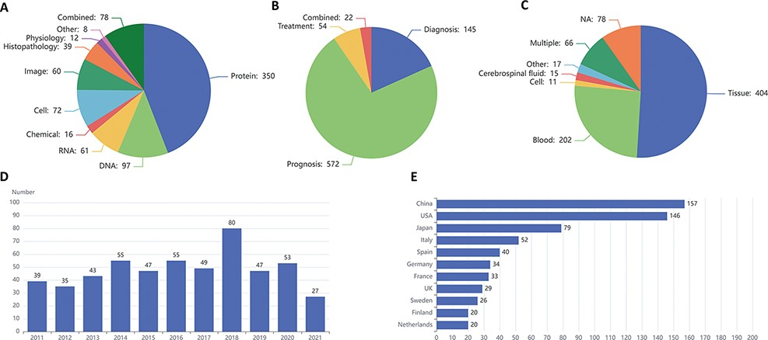
Figure 3. Statistics of lymphoma biomarkers. (A) Biomarker distribution by biomarker types. (B) Biomarker distribution ...
Notes:
Figure 3. Statistics of lymphoma biomarkers. (A) Biomarker distribution by biomarker types. (B) Biomarker distribution by biomarker applications. (C) Biomarker distribution by sample types. (D) Tendency for the number of articles published in the last 10 years. (E) Top 11 countries with the largest number of articles of lymphoma biomarkers.
Unless provided in the caption above, the following copyright applies to the content of this slide: © The Author(s) 2022. Published by Oxford University Press.This is an Open Access article distributed under the terms of the Creative Commons Attribution-NonCommercial License (https://creativecommons.org/licenses/by-nc/4.0/), which permits non-commercial re-use, distribution, and reproduction in any medium, provided the original work is properly cited. For commercial re-use, please contact journals.permissions@oup.com

Slide 4
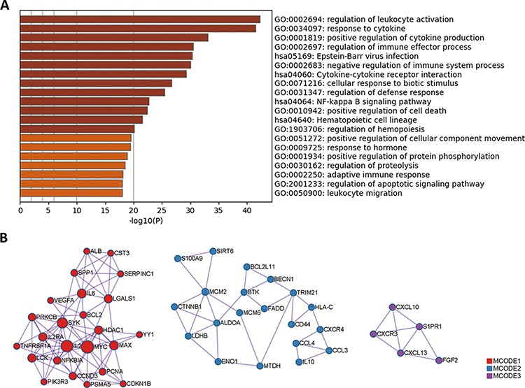
Figure 4. GO and KEGG enrichment analysis of protein biomarkers in LBD. (A) Enriched GO and KEGG pathways. (B) ...
Notes:
Figure 4. GO and KEGG enrichment analysis of protein biomarkers in LBD. (A) Enriched GO and KEGG pathways. (B) Protein–protein interaction network components identified by the MCODE algorithm. Nodes represent protein biomarkers in LBD. Edges represent the relationships between different proteins. The size of the node represents the node degree.
Unless provided in the caption above, the following copyright applies to the content of this slide: © The Author(s) 2022. Published by Oxford University Press.This is an Open Access article distributed under the terms of the Creative Commons Attribution-NonCommercial License (https://creativecommons.org/licenses/by-nc/4.0/), which permits non-commercial re-use, distribution, and reproduction in any medium, provided the original work is properly cited. For commercial re-use, please contact journals.permissions@oup.com

