Slide 1
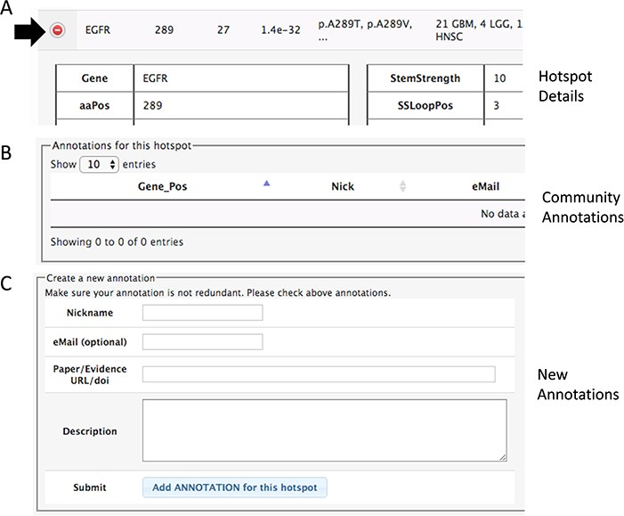
Figure 3 Section of the details to add community annotations. (A) Option to show details. (B) Current community ...
Notes:
Figure 3 Section of the details to add community annotations. (A) Option to show details. (B) Current community annotations for that hotspot. (C) Form to add new user annotations.
Unless provided in the caption above, the following copyright applies to the content of this slide: © The Author(s) 2020. Published by Oxford University Press.This is an Open Access article distributed under the terms of the Creative Commons Attribution License (http://creativecommons.org/licenses/by/4.0/), which permits unrestricted reuse, distribution, and reproduction in any medium, provided the original work is properly cited.

