Slide 1
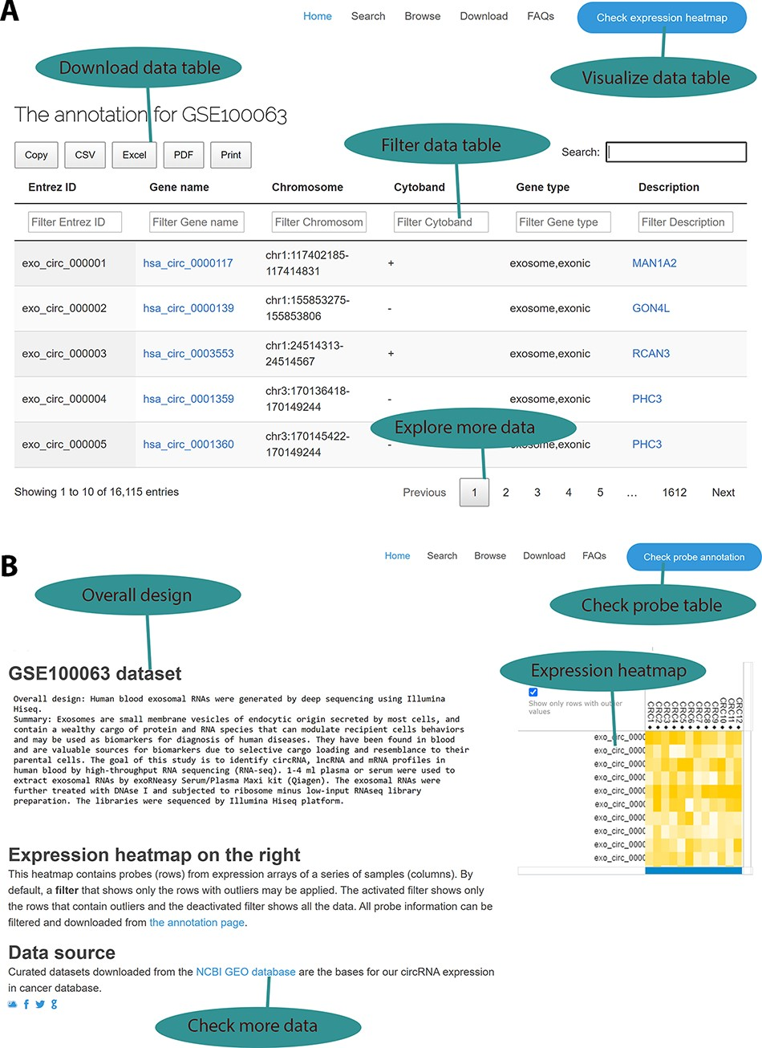
Figure 2. Web interface for the circExp database. (A) On the probe annotation page, users can follow four highlighted ...
Notes:
Figure 2. Web interface for the circExp database. (A) On the probe annotation page, users can follow four highlighted functions for data filtering, downloading and pagination. Each column in the data table can also be sorted by clicking the column number. The column filtering function works by entering a keyword for a column. The filtered results can be downloaded in Excel, CSV and PDF formats. Users can switch to the expression heatmap by clicking the button on the top right of the screen. (B) On the expression heatmap page, users find a data set’s overall design and they can link back to the original records in the public database. The data set’s heatmap explores expression patterns.
Unless provided in the caption above, the following copyright applies to the content of this slide: © The Author(s) 2021. Published by Oxford University Press.This is an Open Access article distributed under the terms of the Creative Commons Attribution License (http://creativecommons.org/licenses/by/4.0/), which permits unrestricted reuse, distribution, and reproduction in any medium, provided the original work is properly cited.

