Slide 1
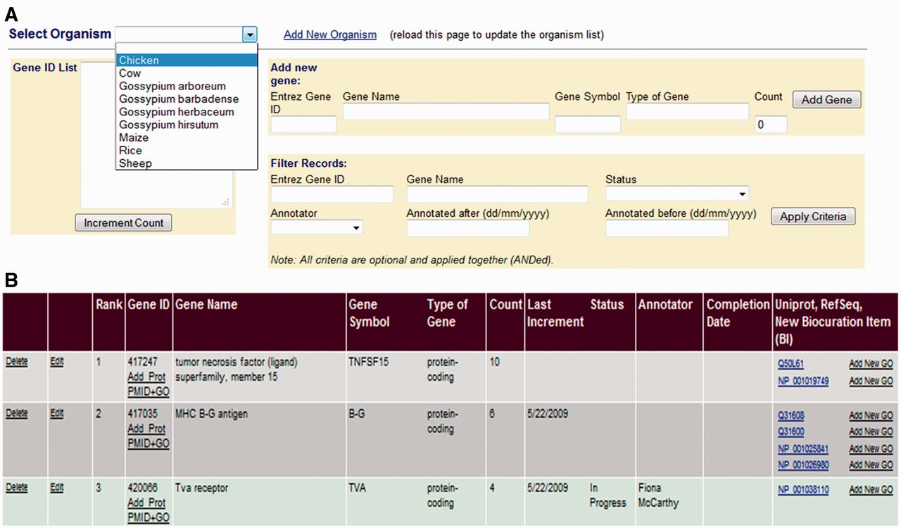
Figure 2 The GP Interface. The GP Interface is used to direct biocurator’s annotation to genes that the community see ...
Notes:
Figure 2 The GP Interface. The GP Interface is used to direct biocurator’s annotation to genes that the community see as requiring annotation. Genes are prioritized separately for each species (A), and each species has a searchable, ranked list where genes are ranked based on requests for annotation and presence on commonly used array. Each gene is linked its gene products in the biocuration interface (B) so that the biocurator can move seamlessly to annotation.
Unless provided in the caption above, the following copyright applies to the content of this slide: © The Author(s) 2012. Published by Oxford University Press.This is an Open Access article distributed under the terms of the Creative Commons Attribution License (http://creativecommons.org/licenses/by-nc/3.0/), which permits non-commercial reuse, distribution, and reproduction in any medium, provided the original work is properly cited. For commercial re-use, please contact journals.permissions@oup.com.

