Slide 1
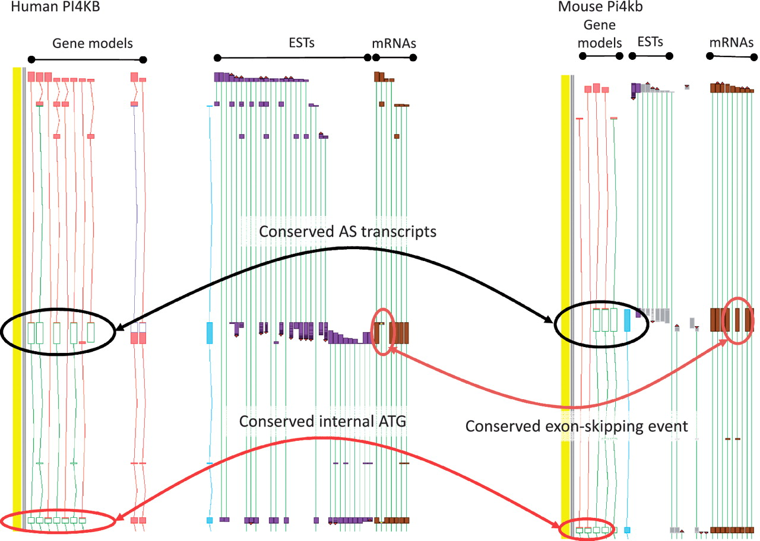
Figure 4 Zmap screenshot of the PI4KB/Pi4kb genes encoding phosphatidylinositol 4-kinase, catalytic, beta in human ...
Notes:
Figure 4 Zmap screenshot of the PI4KB/Pi4kb genes encoding phosphatidylinositol 4-kinase, catalytic, beta in human (left) and mouse (right) respectively. Black ovals highlight exon-skipping event observed in both species, orange ovals highlight the species-specific mRNA evidence supporting the annotation of the exon-skip event and red ovals highlight the conserved internal ATG likely to be utilised in the event of the exon-skip.
Unless provided in the caption above, the following copyright applies to the content of this slide: © The Author(s) 2012. Published by Oxford University Press.This is an Open Access article distributed under the terms of the Creative Commons Attribution Non-Commercial License (http://creativecommons.org/licenses/by-nc/3.0), which permits unrestricted non-commercial use, distribution, and reproduction in any medium, provided the original work is properly cited.

