Slide 1
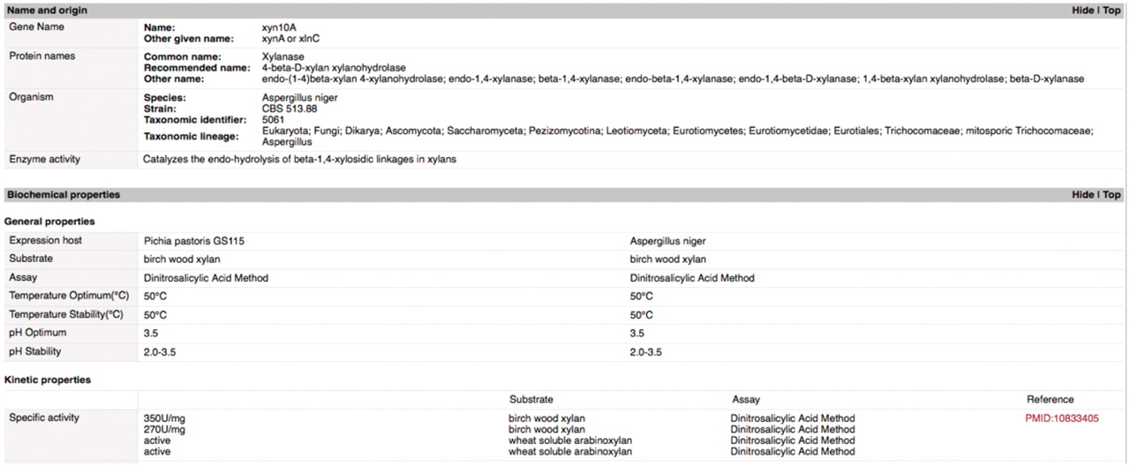
Figure 2. Gene page example. This screen shot illustrates the set-up and types of data available on mycoCLAP. This is ...
Notes:
Figure 2. Gene page example. This screen shot illustrates the set-up and types of data available on mycoCLAP. This is part of the gene page for the glycoside hydrolase XYN10A_ASPNG (a family 10 xylanase from Aspergillus niger). The ‘Names and Origin’ section includes any names or abbreviations used to identify the enzyme in the literature or on other databases. A search by any of those names will deliver this enzyme as a hit. The next section contains biochemical properties extracted from the literature. This entry has the enzyme’s specific activity, pH optima and temperature optima on birch wood xylan when expressed from two different hosts. Other information recorded on gene pages includes nucleotide and amino acid sequences, protein domains, assay conditions, enzyme family, literature citations and other features recorded in the literature that make the entry unique.
Unless provided in the caption above, the following copyright applies to the content of this slide: © The Author(s) 2011. Published by Oxford University Press.This is Open Access article distributed under the terms of the Creative Commons Attribution Non-Commercial License (http://creativecommons.org/licenses/by-nc/2.5), which permits unrestricted non-commercial use, distribution, and reproduction in any medium, provided the original work is properly cited.

