Slide 1
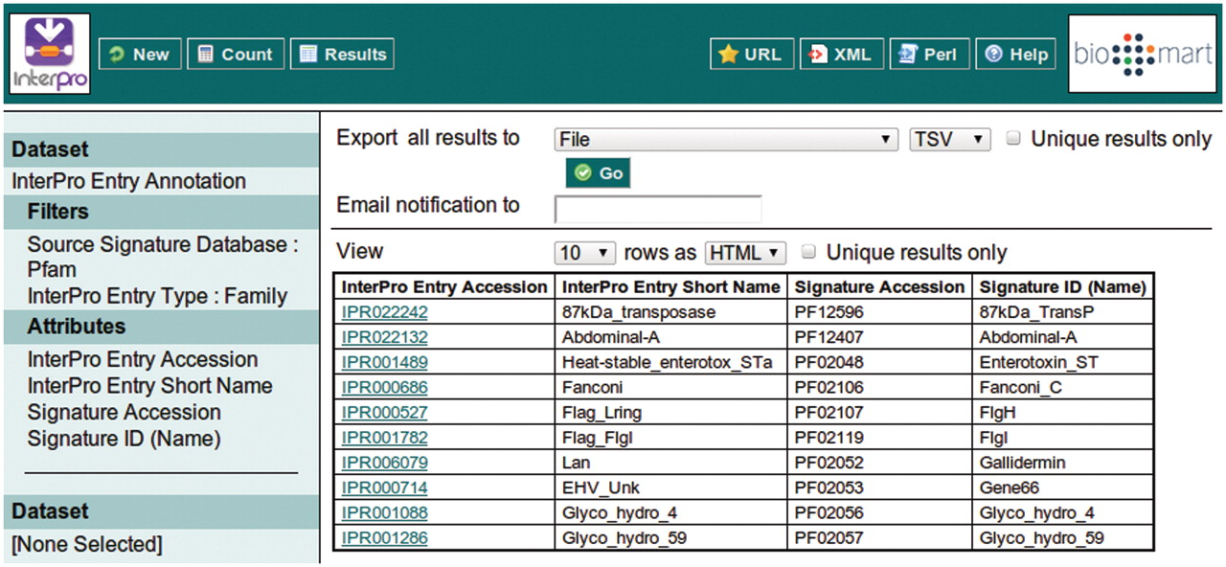
Figure 6. Clicking the ‘Results’ button at the top of the interface provides the first 10 results matching the query, ...
Notes:
Figure 6. Clicking the ‘Results’ button at the top of the interface provides the first 10 results matching the query, to allow the query to be modified or improved.
Unless provided in the caption above, the following copyright applies to the content of this slide: © The Author(s) 2011. Published by Oxford University Press.This is Open Access article distributed under the terms of the Creative Commons Attribution Non-Commercial License (http://creativecommons.org/licenses/by-nc/2.5), which permits unrestricted non-commercial use, distribution, and reproduction in any medium, provided the original work is properly cited.

