Slide 1
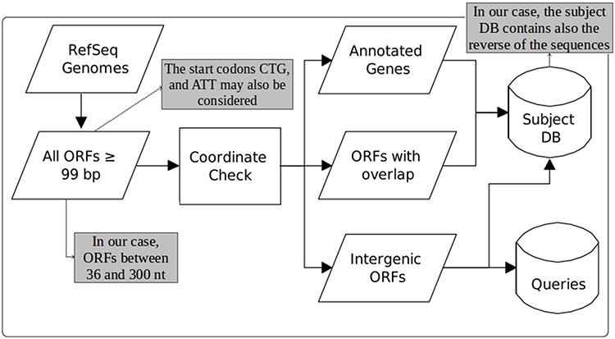
Figure 1. Construction of queries and the subject database (adapted from the work of Warren et al. (22)). The original ...
Notes:
Figure 1. Construction of queries and the subject database (adapted from the work of Warren et al. (22)). The original figure can be identified by white-background shapes. Illustrated in gray, the differences in our case are: only ORFs of length between 36 and 300 are considered; the start codons CTG and ATT may also be taken into account in addition to ATG, GTG and TTG; and the sequences that compose the subject DB are the ones coming from the three groups plus their reverse.
Unless provided in the caption above, the following copyright applies to the content of this slide: © The Author(s) 2020. Published by Oxford University Press.This is an Open Access article distributed under the terms of the Creative Commons Attribution License (http://creativecommons.org/licenses/by/4.0/), which permits unrestricted reuse, distribution, and reproduction in any medium, provided the original work is properly cited.

Slide 2
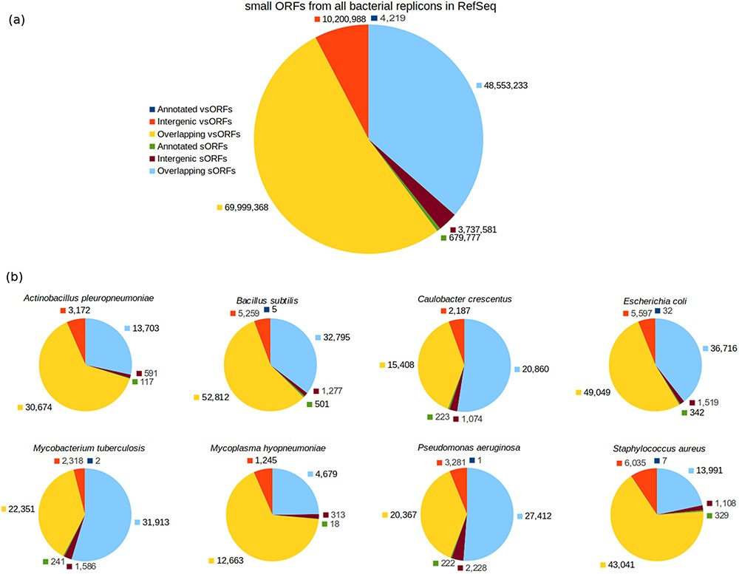
Figure 2. Category breakdown of small ORFs. (a) The whole set of small ORFs obtained for all bacteria in RefSeq. (b) ...
Notes:
Figure 2. Category breakdown of small ORFs. (a) The whole set of small ORFs obtained for all bacteria in RefSeq. (b) Small ORFs of the eight bacteria that we used in our experiments.
Unless provided in the caption above, the following copyright applies to the content of this slide: © The Author(s) 2020. Published by Oxford University Press.This is an Open Access article distributed under the terms of the Creative Commons Attribution License (http://creativecommons.org/licenses/by/4.0/), which permits unrestricted reuse, distribution, and reproduction in any medium, provided the original work is properly cited.

Slide 3
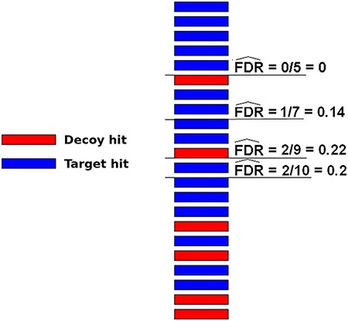
Figure 3. Illustration of how FDRs can be estimated using a composite target-decoy DB (from the work describing the ...
Notes:
Figure 3. Illustration of how FDRs can be estimated using a composite target-decoy DB (from the work describing the method MUMAL by Cerqueira et al. (52)). In this example, only one score (univariate analysis) is used. The hits are presented in descending order, i.e. the highest score is on top. For a given threshold value, the number of decoy hits with score greater or equal to this value is used to estimate the number of wrong matches among target hits obtained using the same threshold.
Unless provided in the caption above, the following copyright applies to the content of this slide: © The Author(s) 2020. Published by Oxford University Press.This is an Open Access article distributed under the terms of the Creative Commons Attribution License (http://creativecommons.org/licenses/by/4.0/), which permits unrestricted reuse, distribution, and reproduction in any medium, provided the original work is properly cited.

Slide 4
Figure 4. Plots of α score vs. bit score to E. coli datasets: Ec_vso (a) and Ec_so (b). Blue data points are decoy ...
Notes:
Figure 4. Plots of α score vs. bit score to E. coli datasets: Ec_vso (a) and Ec_so (b). Blue data points are decoy hits, while red data points represent target hits.
Unless provided in the caption above, the following copyright applies to the content of this slide: © The Author(s) 2020. Published by Oxford University Press.This is an Open Access article distributed under the terms of the Creative Commons Attribution License (http://creativecommons.org/licenses/by/4.0/), which permits unrestricted reuse, distribution, and reproduction in any medium, provided the original work is properly cited.

Slide 5
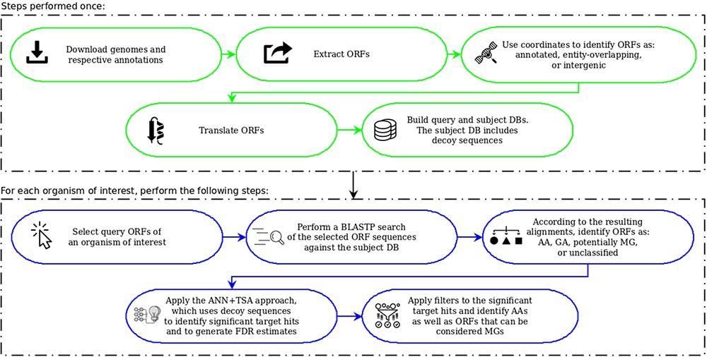
Figure 5. OCCAM pipeline. In green are the steps to be performed only once for a given version of genomes and ...
Notes:
Figure 5. OCCAM pipeline. In green are the steps to be performed only once for a given version of genomes and respective annotations. In blue are the steps to be executed for each organism of interest.
Unless provided in the caption above, the following copyright applies to the content of this slide: © The Author(s) 2020. Published by Oxford University Press.This is an Open Access article distributed under the terms of the Creative Commons Attribution License (http://creativecommons.org/licenses/by/4.0/), which permits unrestricted reuse, distribution, and reproduction in any medium, provided the original work is properly cited.

Slide 6
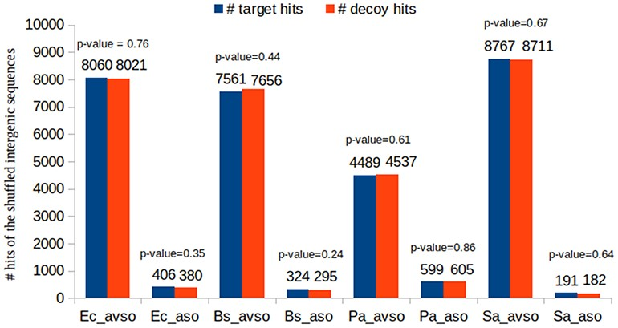
Figure 6. Showing that a wrong hit has the same probability of being decoy or target.
Notes:
Figure 6. Showing that a wrong hit has the same probability of being decoy or target.
Unless provided in the caption above, the following copyright applies to the content of this slide: © The Author(s) 2020. Published by Oxford University Press.This is an Open Access article distributed under the terms of the Creative Commons Attribution License (http://creativecommons.org/licenses/by/4.0/), which permits unrestricted reuse, distribution, and reproduction in any medium, provided the original work is properly cited.

Slide 7
Figure 7. Plots of α score vs. bit score to E. coli datasets: Ec_vso and Ec_so. Clouds of random alignments are ...
Notes:
Figure 7. Plots of α score vs. bit score to E. coli datasets: Ec_vso and Ec_so. Clouds of random alignments are identified by relabeling instances according to the obtained ML model. These plots are the same plots presented in Figure 4a and b, but here all label-1 hits considered random alignments were relabeled to 0. Therefore, the blue data points are those regarded as random, while red data points are considered significant alignments.
Unless provided in the caption above, the following copyright applies to the content of this slide: © The Author(s) 2020. Published by Oxford University Press.This is an Open Access article distributed under the terms of the Creative Commons Attribution License (http://creativecommons.org/licenses/by/4.0/), which permits unrestricted reuse, distribution, and reproduction in any medium, provided the original work is properly cited.

Slide 8
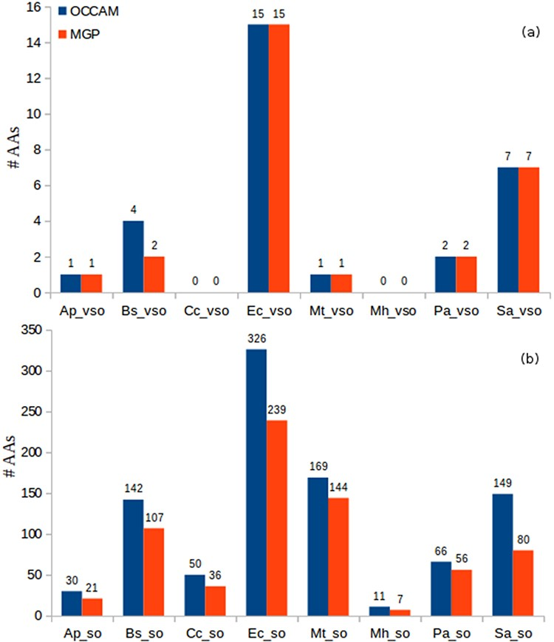
Figure 8. Identification of AAs in OCCAM and MGP for all datasets. (a) vsORF chart. (b) sORF chart. Total number of AAs ...
Notes:
Figure 8. Identification of AAs in OCCAM and MGP for all datasets. (a) vsORF chart. (b) sORF chart. Total number of AAs for OCCAM: 973. Total number of AAs for MGP: 718. The difference of 255 is exactly the number of hits with e-value > 10−5.
Unless provided in the caption above, the following copyright applies to the content of this slide: © The Author(s) 2020. Published by Oxford University Press.This is an Open Access article distributed under the terms of the Creative Commons Attribution License (http://creativecommons.org/licenses/by/4.0/), which permits unrestricted reuse, distribution, and reproduction in any medium, provided the original work is properly cited.

