Slide 1
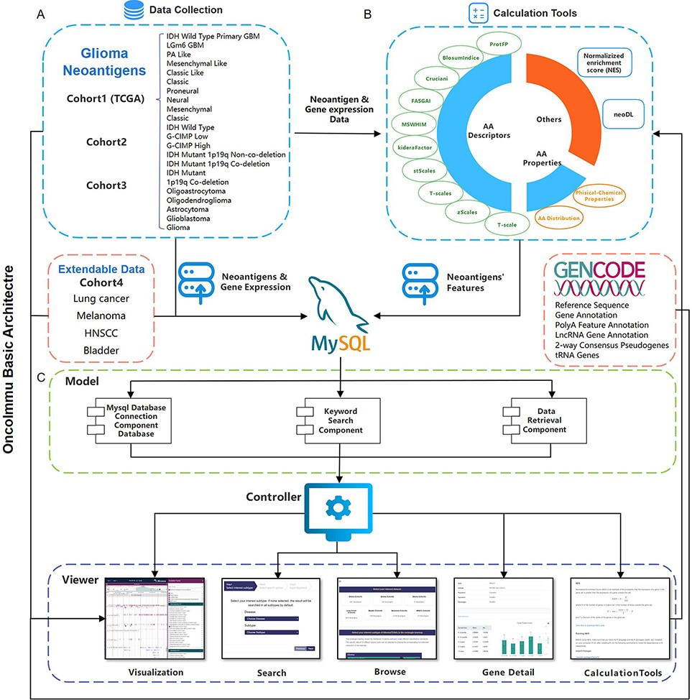
Figure 1. Schematic overview of data collection, data processing and key functionality of GNIFdb. (A) GNIFdb collects ...
Notes:
Figure 1. Schematic overview of data collection, data processing and key functionality of GNIFdb. (A) GNIFdb collects neoantigens from three independent glioma cohorts including 20 pathological or molecular subtypes in Cohort 1 from TCGA, 46 GBMs in Cohort 2 and 13 GBMs in Cohort 3. Cohort 4 includes four other solid tumors (lung cancer, melanoma, HNSCC and bladder cancer) as extendable data. (B) Intrinsic features of neoantigens in all the four cohorts were calculated using amino acid descriptors of protFP (28, 29), blosum Indice (30), crucianiProperties (31), FASGAI (32), MS-WHIM (28, 29), kideraFactor (33), stScales (34), T-scale (32), zScales (35), and VHSE (36), physical-chemical properties (37) of Tiny, Small, Aliphatic, Aromatic, Non-polar, Polar, Basic, Acidic, auto-correlation, auto-covariance, Boman index, crosscovariance, hydrophobic moment, hydrophobicity, theoretical net charge, instability, and molecular weight and AA properties. NES method and neoDL we previously developed are also included. (C) We implemented the GNIFdb following the Model-View-Controller architecture. The Model component handles data derived from multiple sources in MySQL databases and flat experimental data files, calculating the intrinsic features of neoantigens, performing statistical analysis and generating visualization plots. The View component provides heterogeneous and synchronized views to present the information and interact with the users. The front-end template engine of Bootstrap combined with HTML and JavaScript provide better visibility and usability of our functionality. The Controller component, a mediator between the Model and View components, deals with the application logic.
Unless provided in the caption above, the following copyright applies to the content of this slide: © The Author(s) 2022. Published by Oxford University Press.This is an Open Access article distributed under the terms of the Creative Commons Attribution License (https://creativecommons.org/licenses/by/4.0/), which permits unrestricted reuse, distribution, and reproduction in any medium, provided the original work is properly cited.

