Slide 1
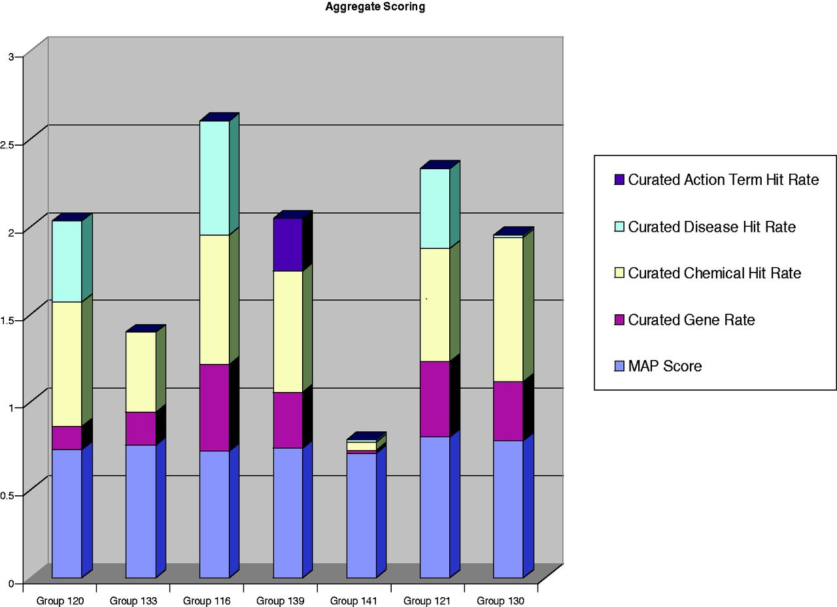
Figure 6 Aggregate metrics for each participating group. The results of MAP (9) scores and chemical, gene, disease and ...
Notes:
Figure 6 Aggregate metrics for each participating group. The results of MAP (9) scores and chemical, gene, disease and action term recall scores are aggregated onto a single bar graph for each participating group. Two of the groups clearly distinguished themselves with respect to aggregate benchmarking results. Group 121 held the highest MAP score (80%) while also delivering strong recall scores in the three major recall categories (chemicals, genes and diseases). Group 116 delivered the highest recall scores in two of the three major data categories (i.e. gene and disease recall). Three other groups (120, 139 and 130) had respectable recall scores in most, if not all, of the major data categories.
Unless provided in the caption above, the following copyright applies to the content of this slide: © The Author(s) 2012. Published by Oxford University Press.This is an Open Access article distributed under the terms of the Creative Commons Attribution License (http://creativecommons.org/licenses/by-nc/3.0/), which permits non-commercial reuse, distribution, and reproduction in any medium, provided the original work is properly cited. For commercial re-use, please contact journals.permissions@oup.com.

