Slide 1
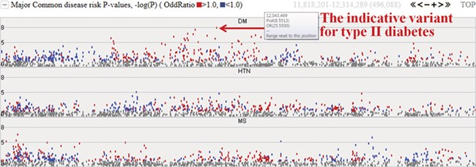
Figure 4 Disease risks of type II diabetes (DM), hypertension (HTN) and metabolic syndrome (MS). Each dot represents ...
Notes:
Figure 4 Disease risks of type II diabetes (DM), hypertension (HTN) and metabolic syndrome (MS). Each dot represents risk P values (–logP). The red and blue colour indicates odds ratio ≥1.0 and <1.0, respectively. The horizontal axis denotes the genomic positions of the chosen chromosome (chr1).
Unless provided in the caption above, the following copyright applies to the content of this slide: © The Author(s) 2020. Published by Oxford University Press.This is an Open Access article distributed under the terms of the Creative Commons Attribution License (http://creativecommons.org/licenses/by/4.0/), which permits unrestricted reuse, distribution, and reproduction in any medium, provided the original work is properly cited.

