Slide 1
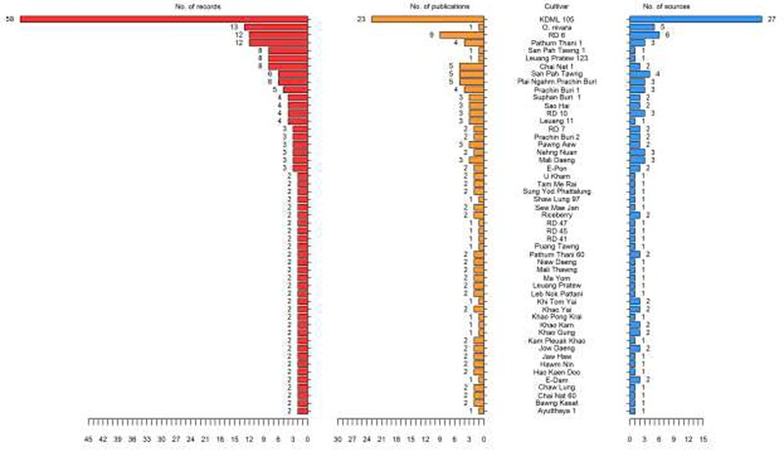
Figure 1. List of Thai rice cultivars in ThRSDB. The numbers of records (red), publications (yellow) and sources (blue) ...
Notes:
Figure 1. List of Thai rice cultivars in ThRSDB. The numbers of records (red), publications (yellow) and sources (blue) for each cultivar are illustrated. The cultivars with only one record are provided in Supplementary Table S1.
Unless provided in the caption above, the following copyright applies to the content of this slide: © The Author(s) 2020. Published by Oxford University Press.This is an Open Access article distributed under the terms of the Creative Commons Attribution License (http://creativecommons.org/licenses/by/4.0/), which permits unrestricted reuse, distribution, and reproduction in any medium, provided the original work is properly cited.

Slide 2
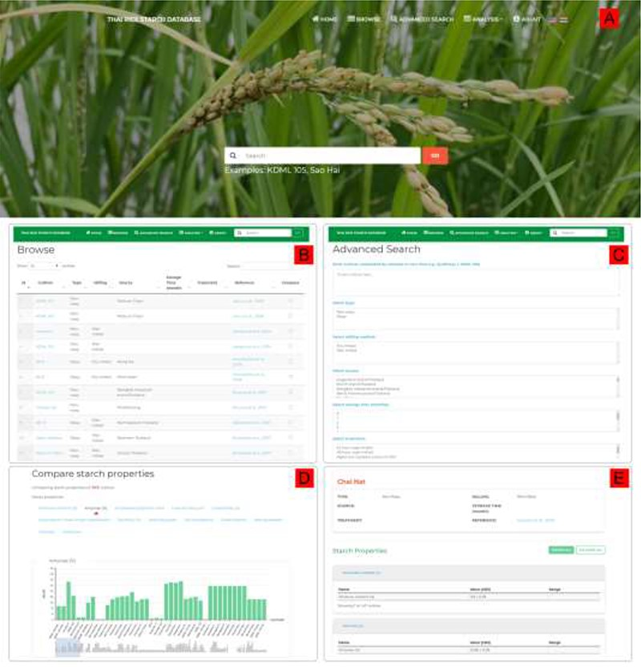
Figure 2. ThRSDB web interface. (A) Homepage with the top navigation menu and the Search form. The flag icons are for ...
Notes:
Figure 2. ThRSDB web interface. (A) Homepage with the top navigation menu and the Search form. The flag icons are for switching between English and Thai version. (B) Browse page. The Search box is provided on the top menu of every page except the homepage. (C) Advanced Search page. (D) A bar chart comparing the percentage amylose between cultivars. Other starch properties are listed, which can be selected to display the corresponding chart. (E) The page presenting detailed information on a selected cultivar.
Unless provided in the caption above, the following copyright applies to the content of this slide: © The Author(s) 2020. Published by Oxford University Press.This is an Open Access article distributed under the terms of the Creative Commons Attribution License (http://creativecommons.org/licenses/by/4.0/), which permits unrestricted reuse, distribution, and reproduction in any medium, provided the original work is properly cited.

Slide 3
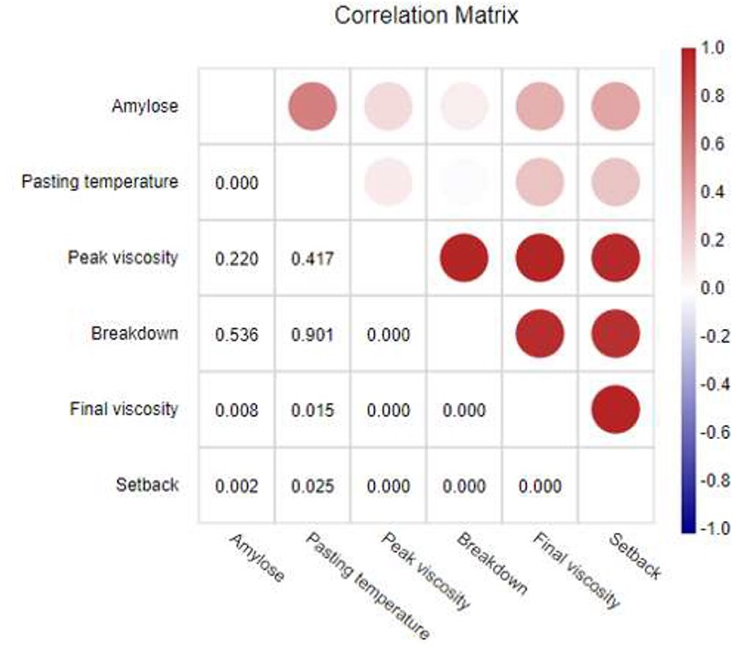
Figure 3. Correlation matrix between six starch parameters of Thai rice cultivars. The upper triangular matrix ...
Notes:
Figure 3. Correlation matrix between six starch parameters of Thai rice cultivars. The upper triangular matrix illustrates the correlation coefficients represented by a color on a continuous scale. The red color indicates a positive correlation, and blue color defines a negative correlation. The lower triangular matrix shows the P-values.
Unless provided in the caption above, the following copyright applies to the content of this slide: © The Author(s) 2020. Published by Oxford University Press.This is an Open Access article distributed under the terms of the Creative Commons Attribution License (http://creativecommons.org/licenses/by/4.0/), which permits unrestricted reuse, distribution, and reproduction in any medium, provided the original work is properly cited.

Slide 4
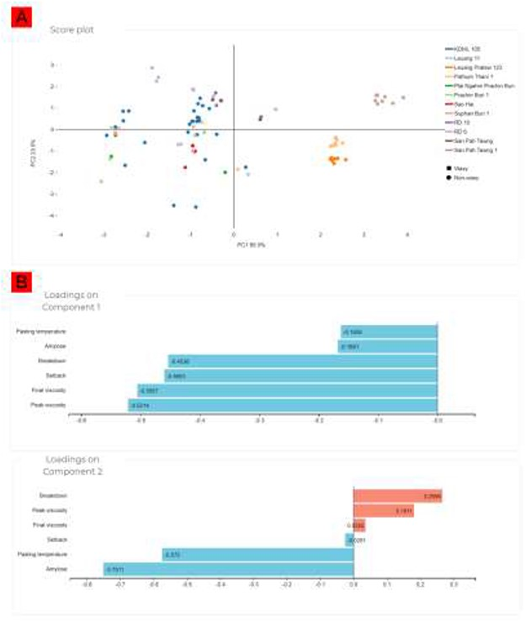
Figure 4. PLS-DA of the Thai rice cultivars. (A) Score plot showing the separation between the cultivars. (B) Loading ...
Notes:
Figure 4. PLS-DA of the Thai rice cultivars. (A) Score plot showing the separation between the cultivars. (B) Loading plots indicating the influences of each starch parameter on the separation of the cultivars.
Unless provided in the caption above, the following copyright applies to the content of this slide: © The Author(s) 2020. Published by Oxford University Press.This is an Open Access article distributed under the terms of the Creative Commons Attribution License (http://creativecommons.org/licenses/by/4.0/), which permits unrestricted reuse, distribution, and reproduction in any medium, provided the original work is properly cited.

