Slide 1
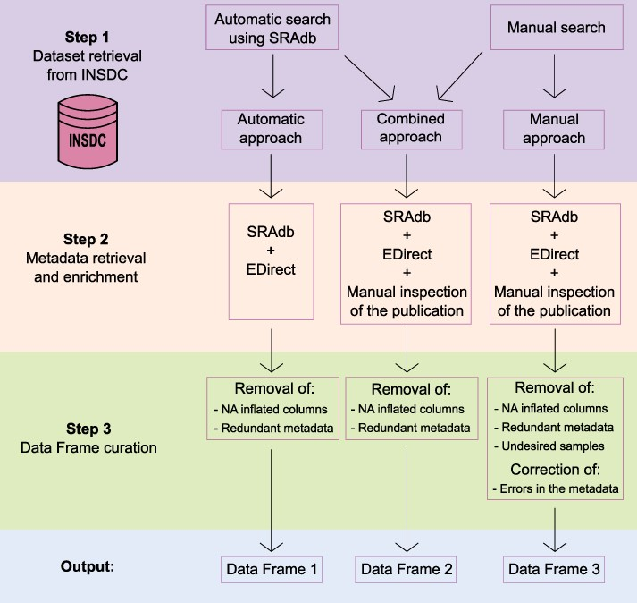
Figure 1. Schematic representation of the three-step framework adopted in the study to collect datasets and metadata ...
Notes:
Figure 1. Schematic representation of the three-step framework adopted in the study to collect datasets and metadata and generate three differently curated data frames.
Unless provided in the caption above, the following copyright applies to the content of this slide: © The Author(s) 2022. Published by Oxford University Press.This is an Open Access article distributed under the terms of the Creative Commons Attribution License (https://creativecommons.org/licenses/by/4.0/), which permits unrestricted reuse, distribution, and reproduction in any medium, provided the original work is properly cited.

Slide 2
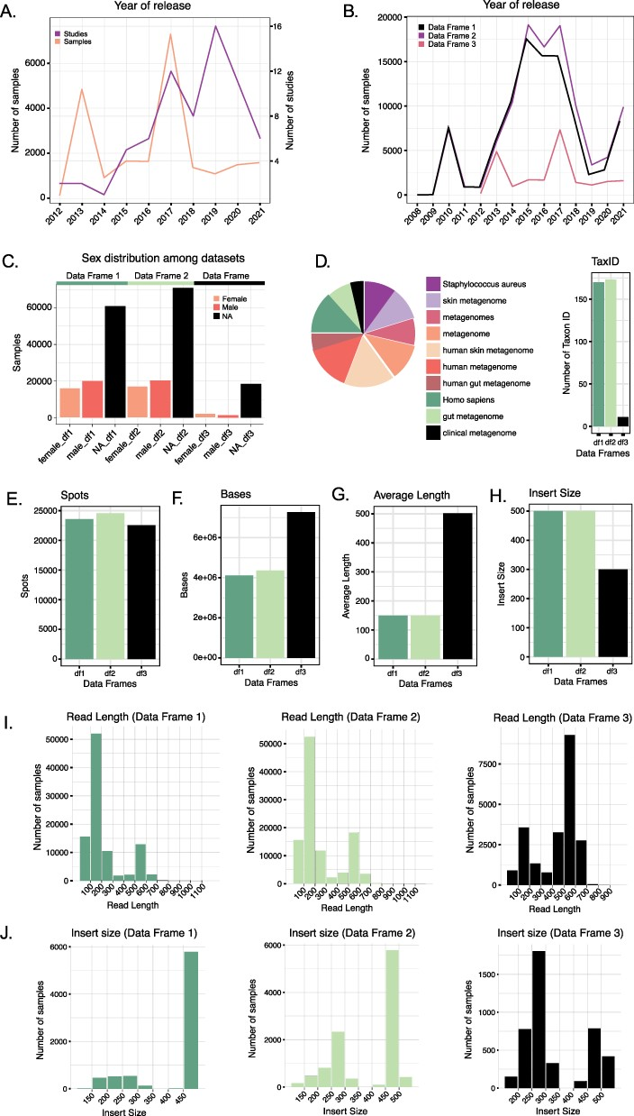
Figure 2. (A) Number of studies and samples from Data Frame 3 released every year starting from 2012. (B) Comparison of ...
Notes:
Figure 2. (A) Number of studies and samples from Data Frame 3 released every year starting from 2012. (B) Comparison of the number of samples released each year for the three Data Frames. Data Frames 1 and 2 contain samples starting from 2008, whereas Data Frame 3 only from 2012. (C) Distribution of the variable ‘sex’ in the three Data Frames. In all three cases, the majority of the samples do not have such information reported. (D) The number of Taxon ID/Scientific names used in the three Data Frames (barplot) and relative abundance (as a logarithm) of the Taxon ID/Scientific names used for the samples in Data Frame 3 (pie chart). (E–H) Comparison of the median number of spots (E), bases (F), reads average length (G) and insert size (H) in the three Data Frames. (I) Read length distribution in the three Data Frames. (J) Distribution of the insert size in the three Data Frames.
Unless provided in the caption above, the following copyright applies to the content of this slide: © The Author(s) 2022. Published by Oxford University Press.This is an Open Access article distributed under the terms of the Creative Commons Attribution License (https://creativecommons.org/licenses/by/4.0/), which permits unrestricted reuse, distribution, and reproduction in any medium, provided the original work is properly cited.

Slide 3
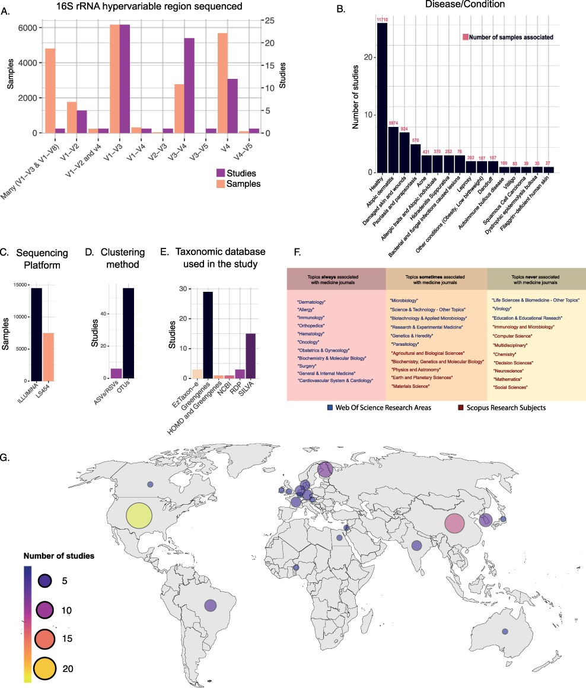
Figure 3. (A) Number of samples and studies that used specific 16S rRNA hypervariable regions in Data Frame 3. (B) The ...
Notes:
Figure 3. (A) Number of samples and studies that used specific 16S rRNA hypervariable regions in Data Frame 3. (B) The number of studies and samples for each disease/condition investigated in Data Frame 3. (C–E) Frequency of use of the different sequencing platforms (C), clustering methods (D) and taxonomic databases (E) in Data Frame 3. (F) Table showing the WoS research areas and Scopus research subjects that described the scientific journals in which the studies of Data Frame 3 have been published. The research areas/subjects are divided into three boxes depending on how often they were associated with the Scopus research subject ‘Medicine’. Going from left to right are shown the research areas/subjects that were always (left), sometimes (center) and never (right) associated with the Scopus research subject ‘Medicine’. (G) Geographical distribution of the studies included in Data Frame 3.
Unless provided in the caption above, the following copyright applies to the content of this slide: © The Author(s) 2022. Published by Oxford University Press.This is an Open Access article distributed under the terms of the Creative Commons Attribution License (https://creativecommons.org/licenses/by/4.0/), which permits unrestricted reuse, distribution, and reproduction in any medium, provided the original work is properly cited.

