Slide 1
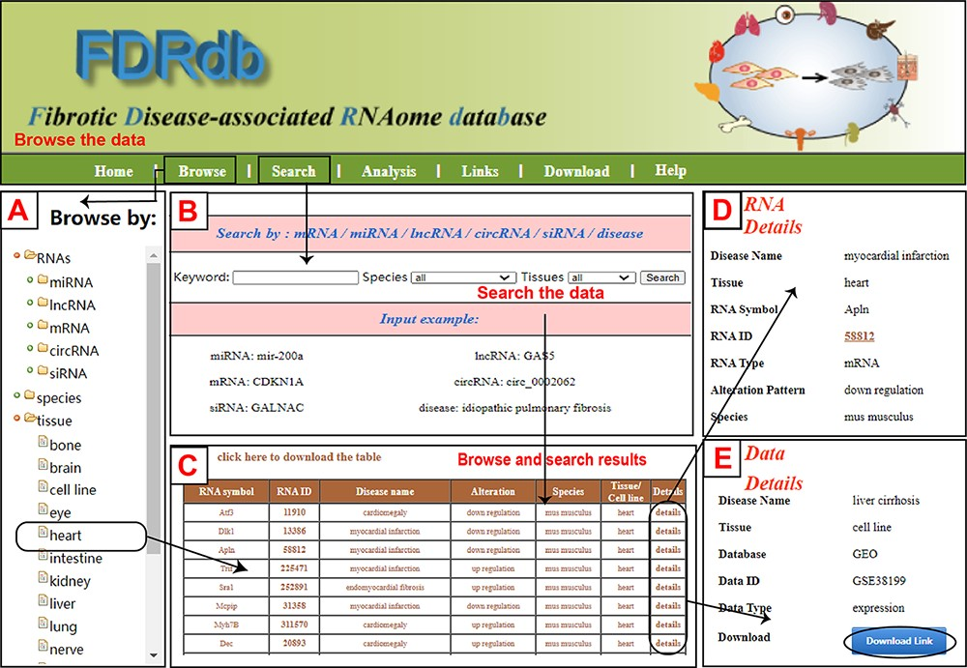
Figure 1. A schematic workflow of the FDRdb. (A) The ‘RNA browse’ page. (B) The ‘Search’ page. (C) The ‘Result’ page. ...
Notes:
Figure 1. A schematic workflow of the FDRdb. (A) The ‘RNA browse’ page. (B) The ‘Search’ page. (C) The ‘Result’ page. (D) The detailed information of RNA entries. (E) The detailed information of dataset entries.
Unless provided in the caption above, the following copyright applies to the content of this slide: © The Author(s) 2022. Published by Oxford University Press.This is an Open Access article distributed under the terms of the Creative Commons Attribution-NonCommercial License (https://creativecommons.org/licenses/by-nc/4.0/), which permits non-commercial re-use, distribution, and reproduction in any medium, provided the original work is properly cited. For commercial re-use, please contact journals.permissions@oup.com

Slide 2
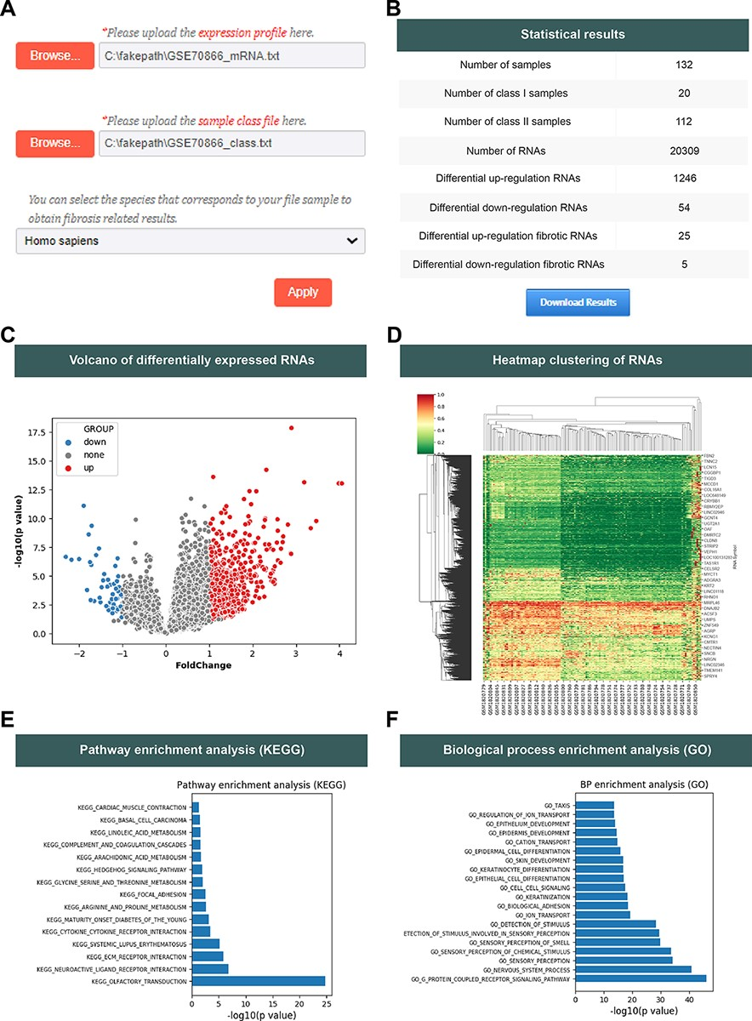
Figure 2. The analysis function of the FDRdb. (A) The upload interface on the ‘Analysis’ page. (B) The statistics of ...
Notes:
Figure 2. The analysis function of the FDRdb. (A) The upload interface on the ‘Analysis’ page. (B) The statistics of analysis results. (C) The volcano plot of differentially expressed RNAs. (D) The heatmap clustering of differentially expressed RNAs. A statistical bar chart of pathway enrichment analysis in KEGG (E) and analysis of biological process enrichment in GO (F).
Unless provided in the caption above, the following copyright applies to the content of this slide: © The Author(s) 2022. Published by Oxford University Press.This is an Open Access article distributed under the terms of the Creative Commons Attribution-NonCommercial License (https://creativecommons.org/licenses/by-nc/4.0/), which permits non-commercial re-use, distribution, and reproduction in any medium, provided the original work is properly cited. For commercial re-use, please contact journals.permissions@oup.com

Slide 3
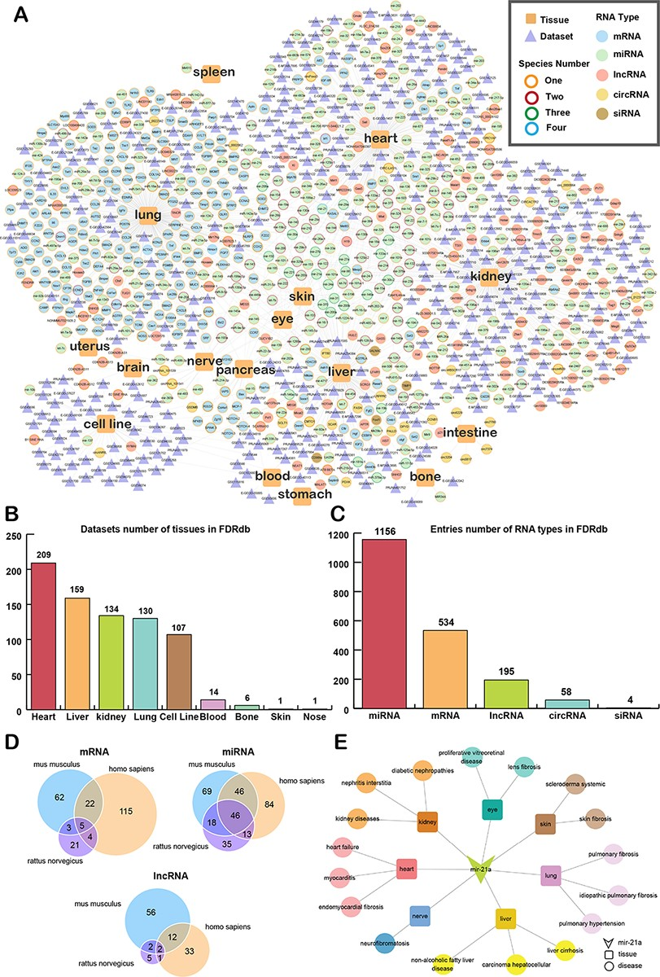
Figure 3. The landscape of data in the FDRdb. (A) The network of associations between fibrotic diseases and ...
Notes:
Figure 3. The landscape of data in the FDRdb. (A) The network of associations between fibrotic diseases and RNAs/datasets in different tissues. (B) The statistics of tissues with fibrotic datasets in the FDRdb. (C) The statistics of fibrotic RNAs in the FDRdb. (D) The Venn diagram showing the RNAs common to different species. (E) The RNA-tissue-disease sub-network of mir-21a.
Unless provided in the caption above, the following copyright applies to the content of this slide: © The Author(s) 2022. Published by Oxford University Press.This is an Open Access article distributed under the terms of the Creative Commons Attribution-NonCommercial License (https://creativecommons.org/licenses/by-nc/4.0/), which permits non-commercial re-use, distribution, and reproduction in any medium, provided the original work is properly cited. For commercial re-use, please contact journals.permissions@oup.com

