Slide 1
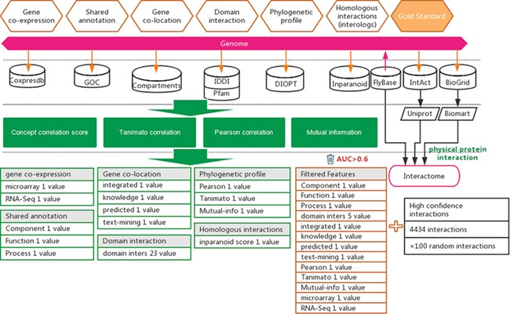
Figure 1 Workflow for the inference of functional interactions between Drosophila genes. High-quality experimental ...
Notes:
Figure 1 Workflow for the inference of functional interactions between Drosophila genes. High-quality experimental reported protein interactions were integrated from three databases and were used as positive examples. Six types of functional association evidence from 10 databases were collected to infer putative functional interactions. A total of 17 high-quality feature values were selected from 36 feature values that characterize this evidence with different mathematical representations. Random gene pairs after removing positive examples were used as negative examples. The number of negative examples was 100 times that of the positive examples.
Unless provided in the caption above, the following copyright applies to the content of this slide: © The Author(s) 2020. Published by Oxford University Press.This article is published and distributed under the terms of the Oxford University Press, Standard Journals Publication Model (https://academic.oup.com/journals/pages/open_access/funder_policies/chorus/standard_publication_model)

Slide 2
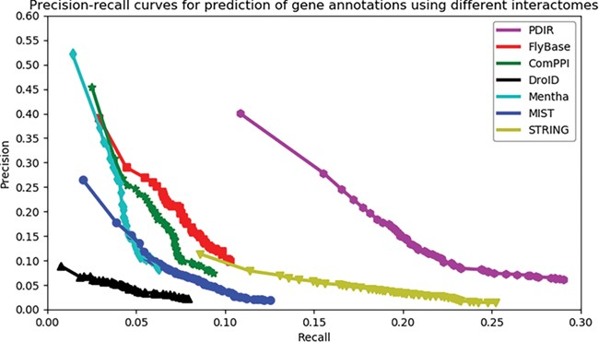
Figure 2 Assessment of the capabilities of seven interactomes to group functionally associated genes together. The ...
Notes:
Figure 2 Assessment of the capabilities of seven interactomes to group functionally associated genes together. The precision-recall curves of gene function prediction using different interactomes are illustrated. Precision estimates the proportion of correct annotations identified by an interactome. Recall estimates the proportion of new annotations that is identified by an interactome.
Unless provided in the caption above, the following copyright applies to the content of this slide: © The Author(s) 2020. Published by Oxford University Press.This article is published and distributed under the terms of the Oxford University Press, Standard Journals Publication Model (https://academic.oup.com/journals/pages/open_access/funder_policies/chorus/standard_publication_model)

Slide 3
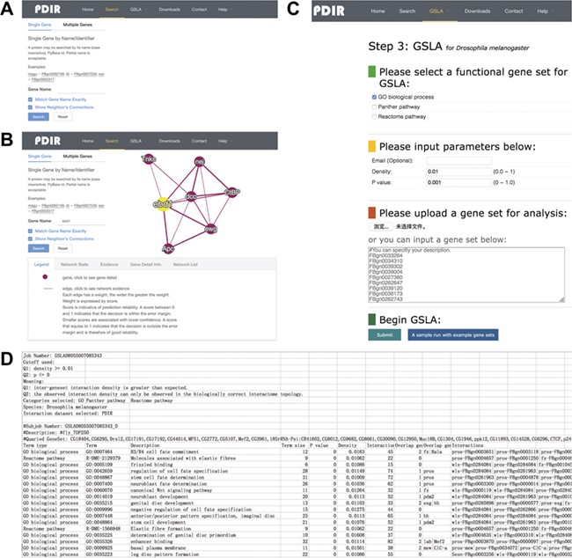
Figure 3 Interface of PDIR and GSLA. (A) Two search options in PDIR. (B) Search result page. A right click on the edge ...
Notes:
Figure 3 Interface of PDIR and GSLA. (A) Two search options in PDIR. (B) Search result page. A right click on the edge will show interaction details. (C) Interface of GSLA. (D) Results of a GSLA analysis job.
Unless provided in the caption above, the following copyright applies to the content of this slide: © The Author(s) 2020. Published by Oxford University Press.This article is published and distributed under the terms of the Oxford University Press, Standard Journals Publication Model (https://academic.oup.com/journals/pages/open_access/funder_policies/chorus/standard_publication_model)

Slide 4
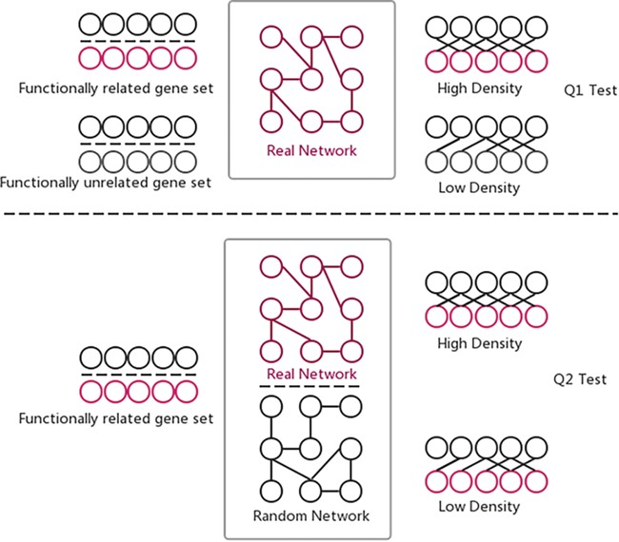
Figure 4 Two hypothesis tests that GSLA used to identify significant functional associations between two gene sets ...
Notes:
Figure 4 Two hypothesis tests that GSLA used to identify significant functional associations between two gene sets that are biologically meaningful. Q1 tests whether the density of functional associations between two biologically meaningful gene sets is higher than random gene pairs, while Q2 tests whether the strong functional associations observed between two gene sets can only be observed from the biologically correct network, rather than any random interactomes.
Unless provided in the caption above, the following copyright applies to the content of this slide: © The Author(s) 2020. Published by Oxford University Press.This article is published and distributed under the terms of the Oxford University Press, Standard Journals Publication Model (https://academic.oup.com/journals/pages/open_access/funder_policies/chorus/standard_publication_model)

Slide 5
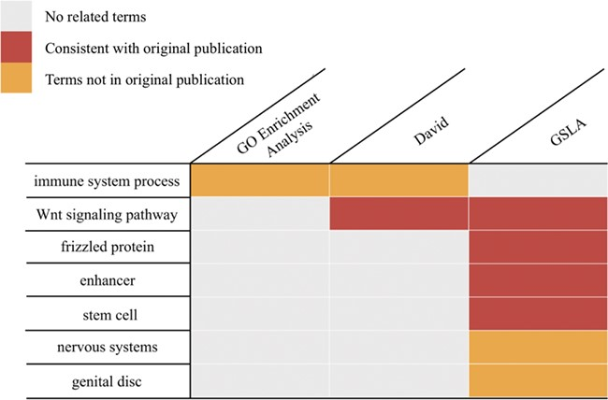
Figure 5 Functional interpretations produced by PDIR/GSLA. Compared with GO enrichment analysis and DAVID, the ...
Notes:
Figure 5 Functional interpretations produced by PDIR/GSLA. Compared with GO enrichment analysis and DAVID, the annotations produced by GSLA are more comprehensive and more accurate.
Unless provided in the caption above, the following copyright applies to the content of this slide: © The Author(s) 2020. Published by Oxford University Press.This article is published and distributed under the terms of the Oxford University Press, Standard Journals Publication Model (https://academic.oup.com/journals/pages/open_access/funder_policies/chorus/standard_publication_model)

